Slide 1
The Story of Barnham’s Brilliant Bespoke Timeline!

Slide 2
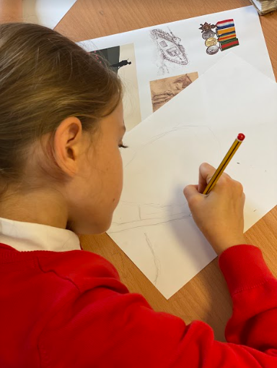
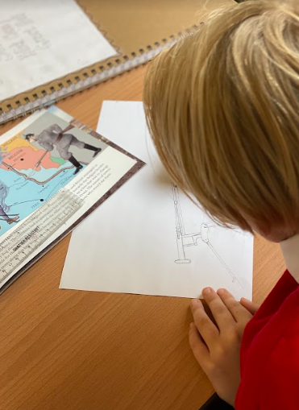
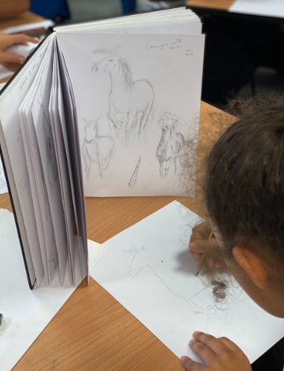
Year 5 using books to research images for their sketches.

Slide 3
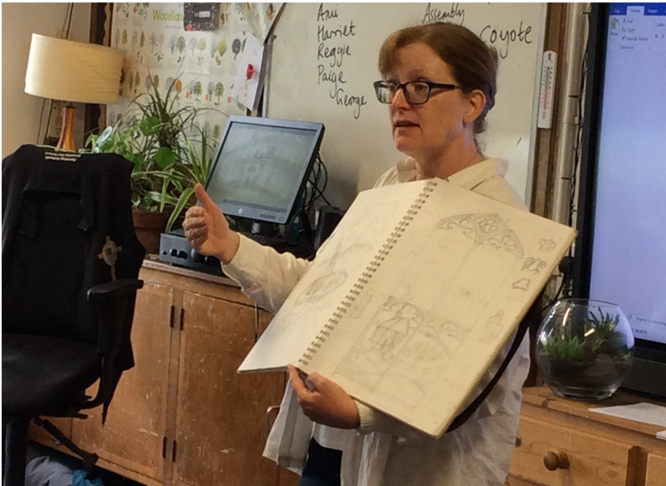
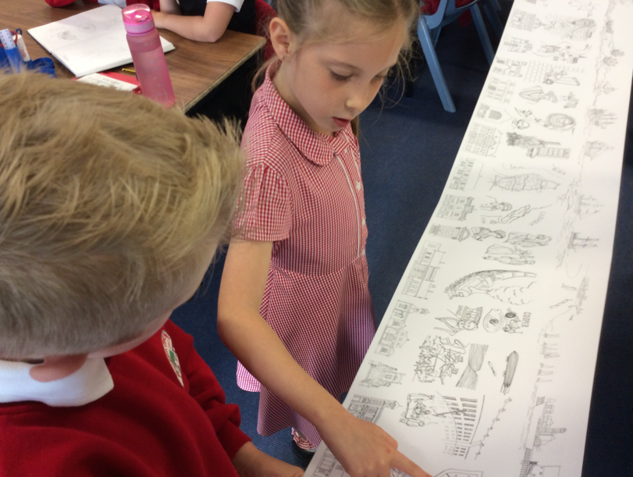
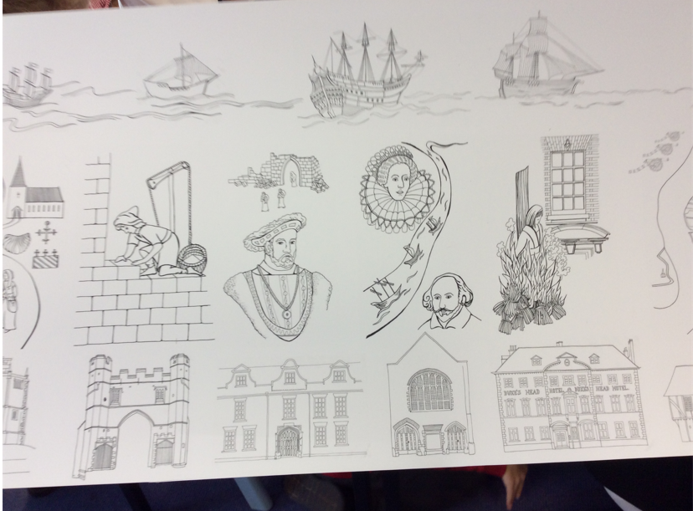
Gaining inspiration from Nicola’s drawings.

Slide 4
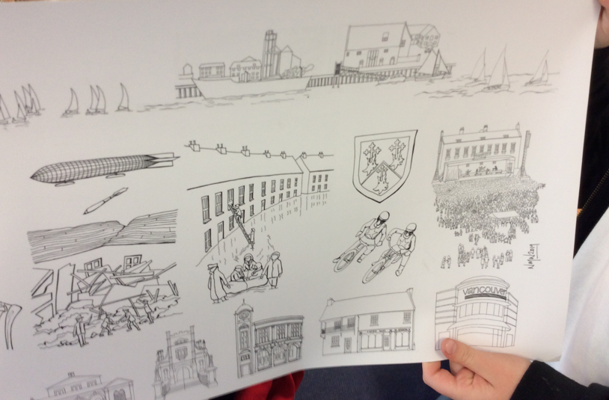
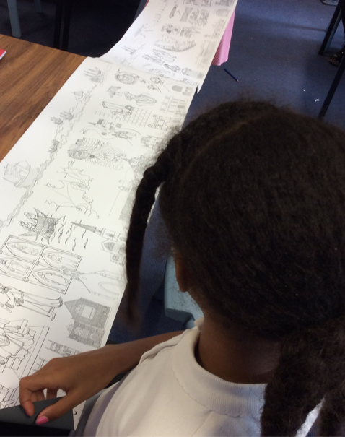
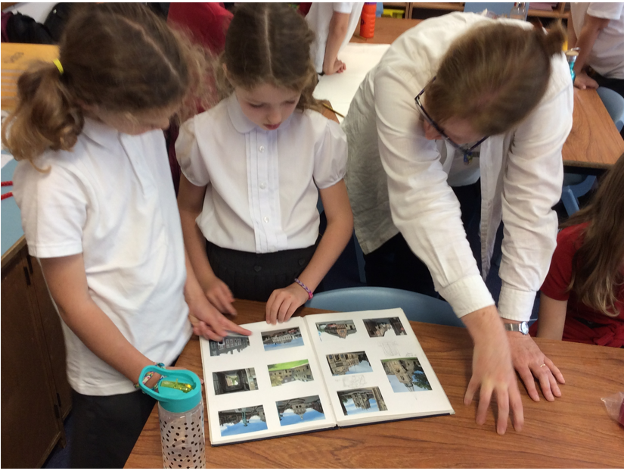
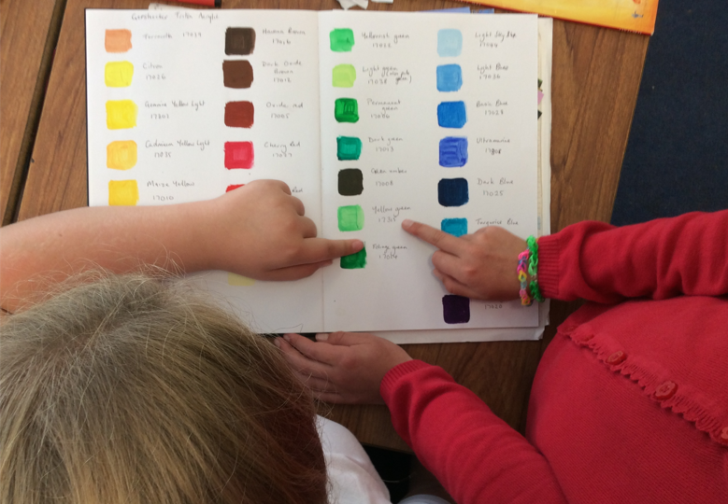
Exploring Nicola’s amazing sketch books

Slide 5
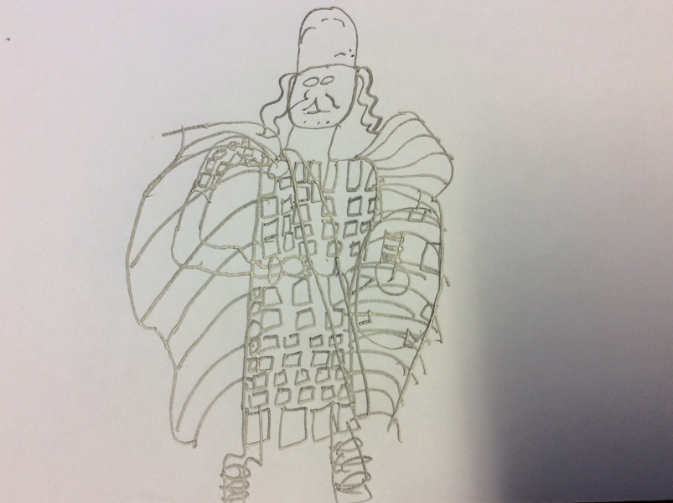
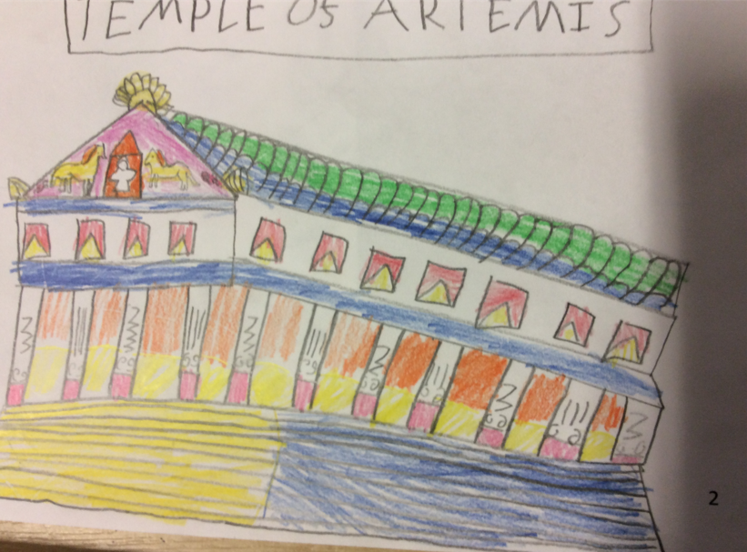
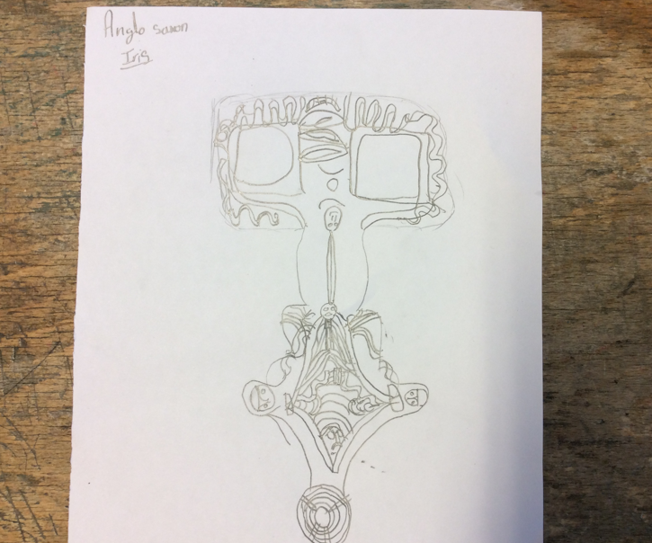
Examples of Year 3 sketches

Slide 6
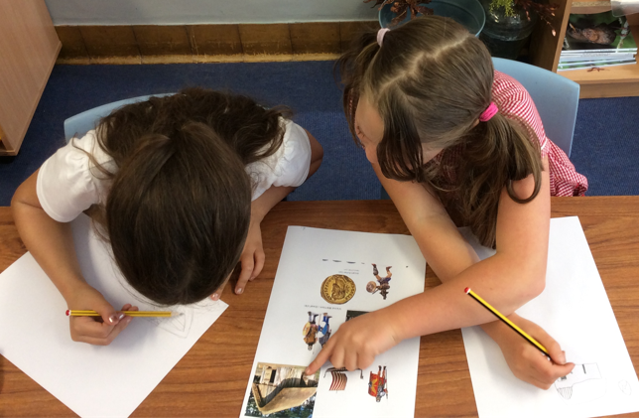
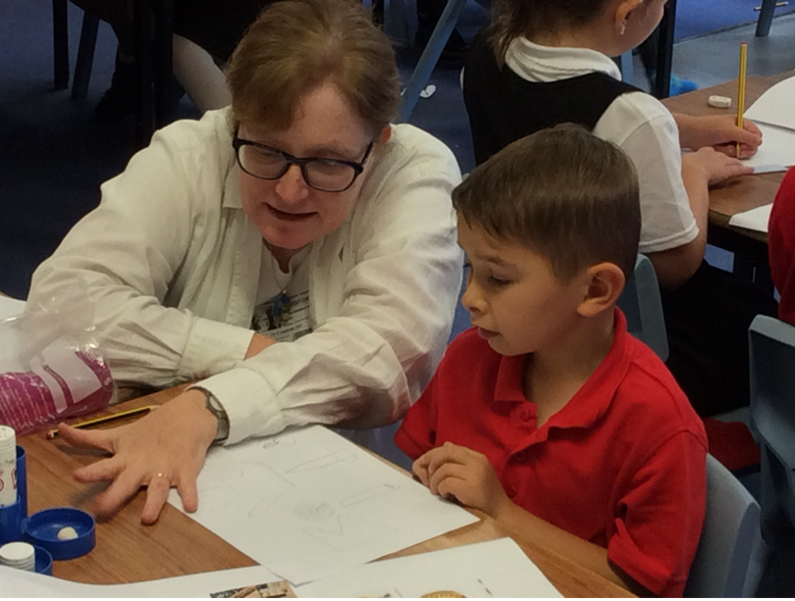
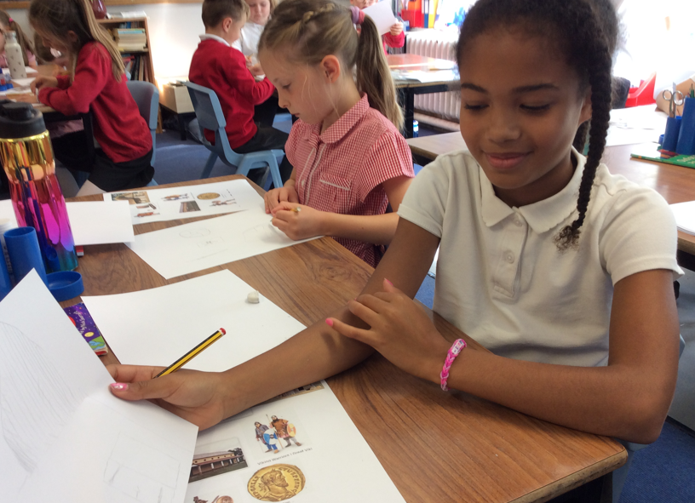
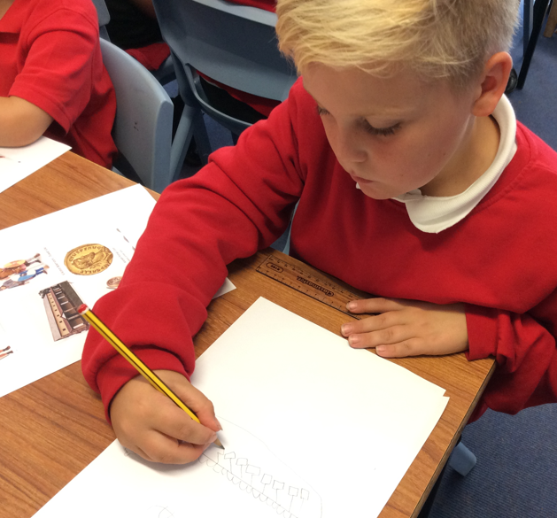
Year 4 artists and historians at work!

Slide 7
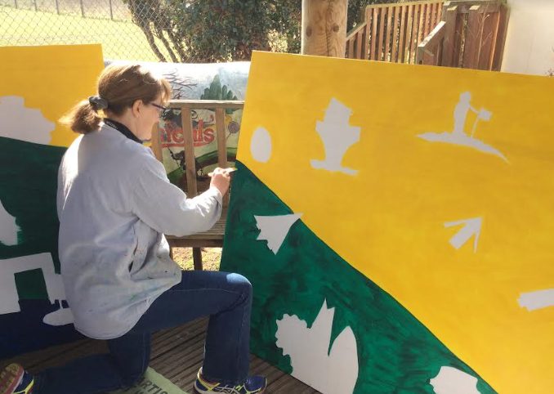
Nicola at work in the outdoor classroom.

Slide 8
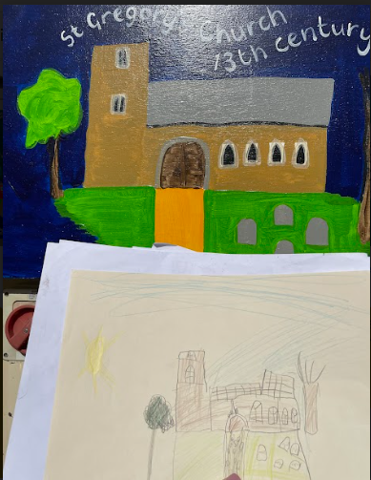
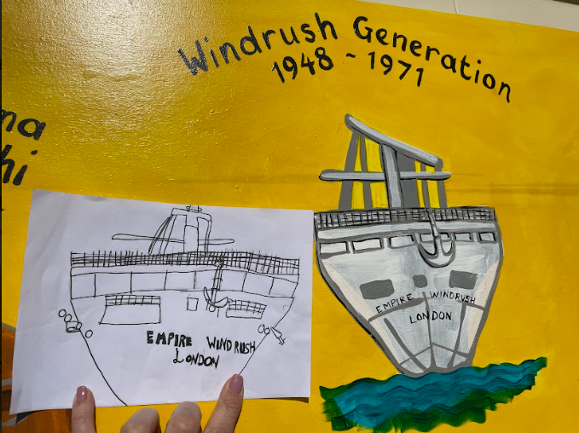
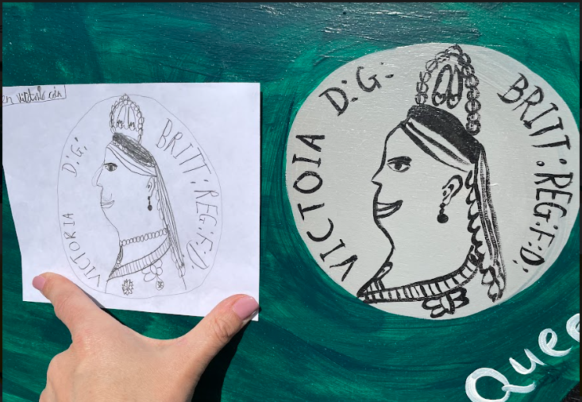
From sketches to professionally completed paintings.

Slide 9
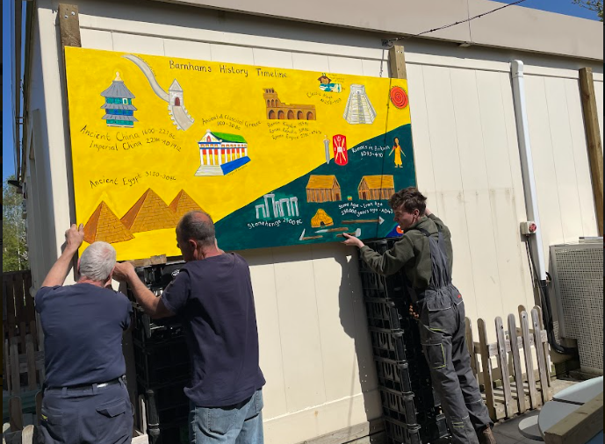
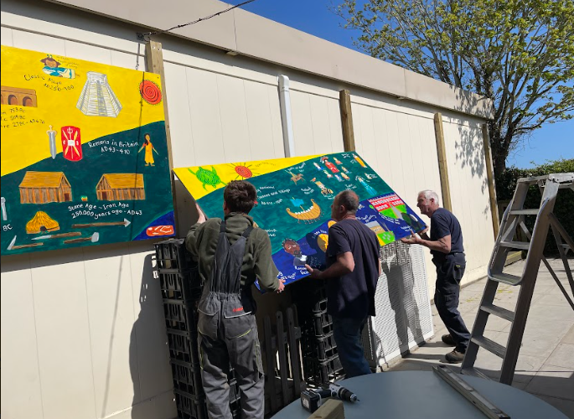
Mounting the boards

Slide 10
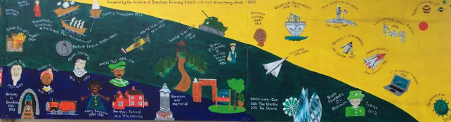
Local events and historical figures have been on a blue background, national on a green and international on a yellow background to help children to see the events in context and to make links between and across periods.

Slide 11
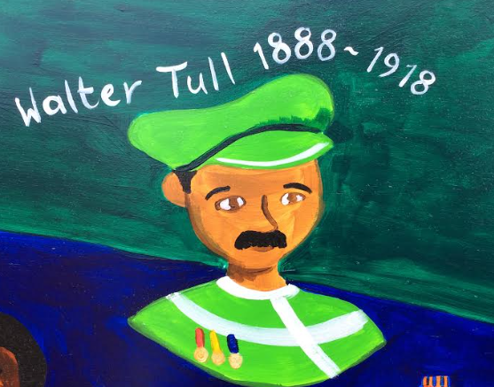
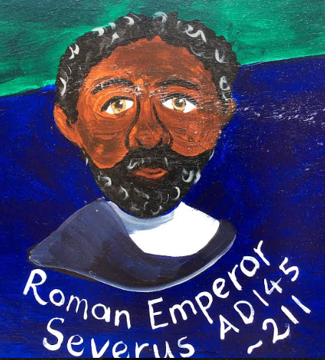
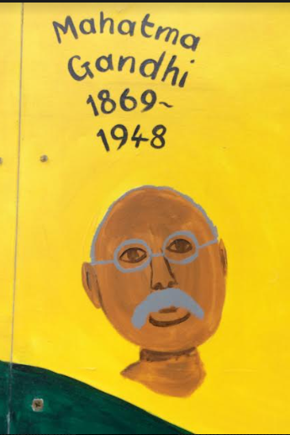
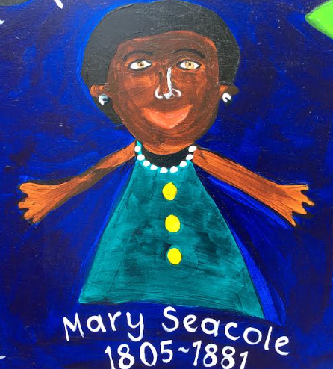
Promoting and celebrating diversity

Slide 12
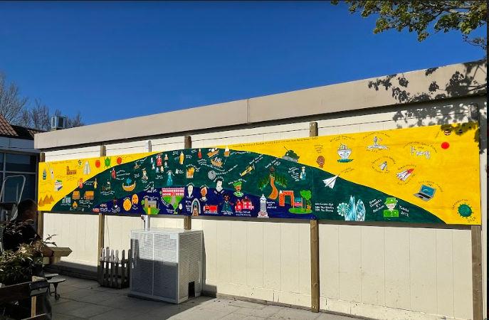
The end result . . . Barnham’s brilliant, bespoke timeline!

Slide 13
Barnham’s History Timeline
We were very excited to return to school after the Easter break to find our stunning timeline completed, varnished and stretching the length of the Year 5 wall between the school hall and the playing field.
Work began September when plans were finalised in meetings with advisor Kate Argyle, from Historic England, and professional artist, Nicola Marray-Woods. The aim was to involve the whole school community to create a valuable learning resource which would also serve to promote and celebrate the children’s love of both history and art by using their drawings to create a 10 metre long timeline featuring key historical figures, major events and significant achievements from prehistoric times to the present day.
The ambitious project was launched by Nicola in a school assembly. We were all fascinated to be hear about the design process and to learn about the art techniques and materials that she would be using. The children were inspired further when Nicola visited each class for a question and answer session on her life as an artist and were delighted to be given the opportunity to see her amazing sketch books.
The children could not wait to start sketching and loved sharing their own art work with Nicola, who was happy to offer advice and encouragement. Each class began by using books and iPads to research images from the areas of the national curriculum studied in class. Later in the term, they drew additional pictures to depict important local events, such as the foundation of St Gregory’s church, the discoveries made at the Barnham dig and the building of the Euston Estate as well as further national and international historical figures and events. By painting the artwork on different backgrounds (blue for local, green for national and yellow for international history) Nicola has made it is easier for the children to see when, where and how the events link to others, thus increasing their chronological awareness and understanding. The significance of the role played by leading women and women and men of colour has been championed both on a local and international scale, with pictures of Mary Seacole, Emperor Severus, Boudicca, Duleep Singh, Gandhi, Walter Tull and Queen Elizabeth II featuring prominently.
It was wonderful to watch Nicola at work in the outdoor classroom as she magically transformed four white washed plywood boards into our incredible timeline.
“It was really exciting to have an actual artist to make the timeline right outside our classroom, “said Alyssa (Year 5) whilst Charlie, also in Year 5, added, “ I love the drawings and the bright colours. My favourite is the picture of RAF Honington because I always go past it on my way to school.”
We are certain that the children will be able to enjoy and learn from the incredible timeline now and for many years to come.
By Ian Holman
History Coordinator
Barnham CEVC Primary School

