Slide 1
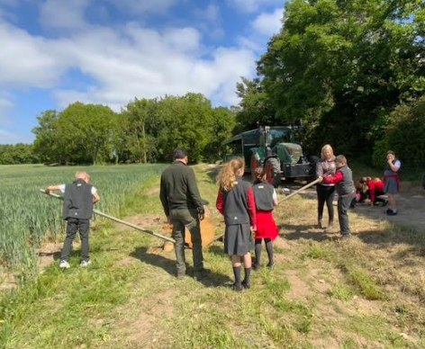
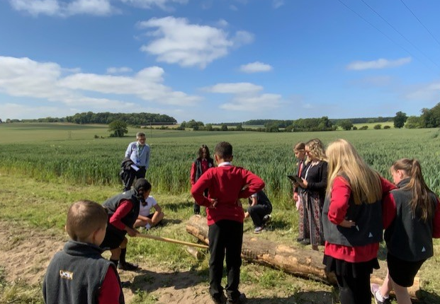
A curriculum full of vision!
Bringing the curriculum to life by large scale investigating
Year 5 – Forces and levers

Slide 2

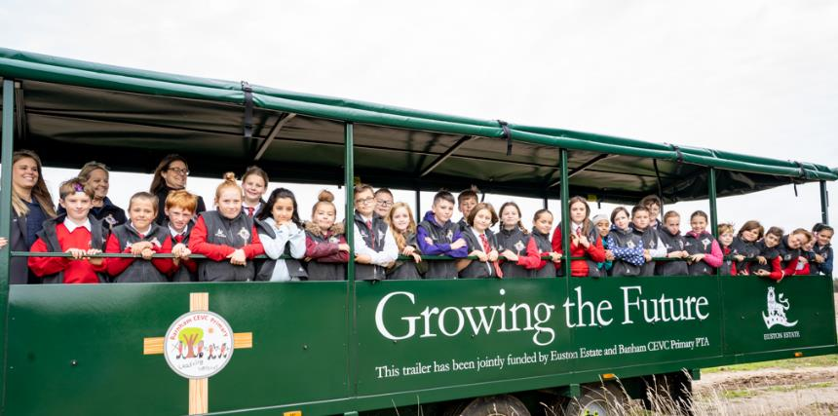
Curriculum Partnership
Reciprocal partnership includes:
Risk assessing, Health & Safety Liaison, Joint funding, DBS checks, supporting grants and bids, produce grown on the farm is used in our school kitchen and ensuring the voice of the youngest generation is heard across a variety of professions!

Slide 3

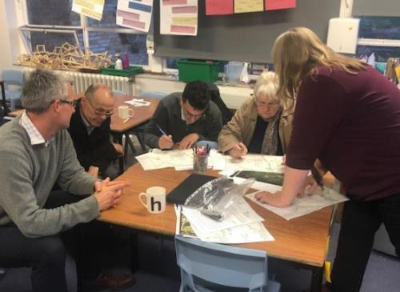
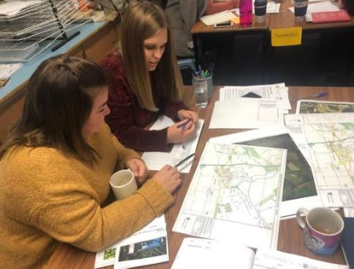
Curriculum Partnership
Working partnership with Historic England:
Shared planning of our History Curriculum with Historic England, Local Archivist and History Group Members.
Rich professional development for staff

Slide 4

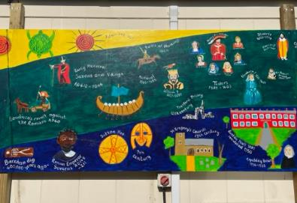
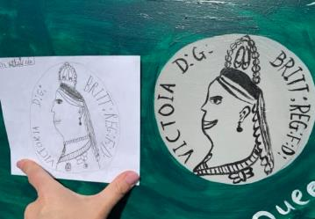
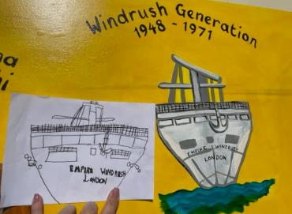
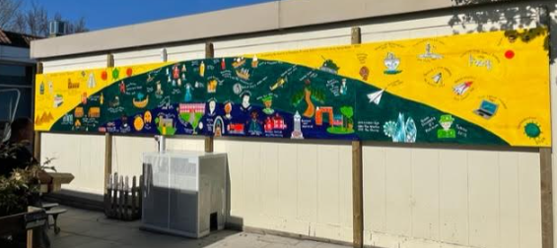
Working with industry experts
Designing and creating our bespoke 32ft History Curriculum!

Slide 5
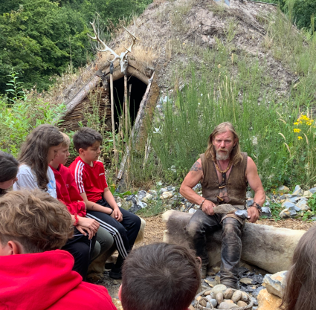
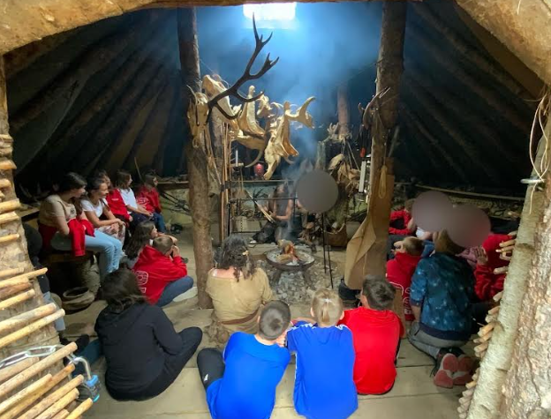
A curriculum full of vision!
Learning from knowledgeable experts

Slide 6
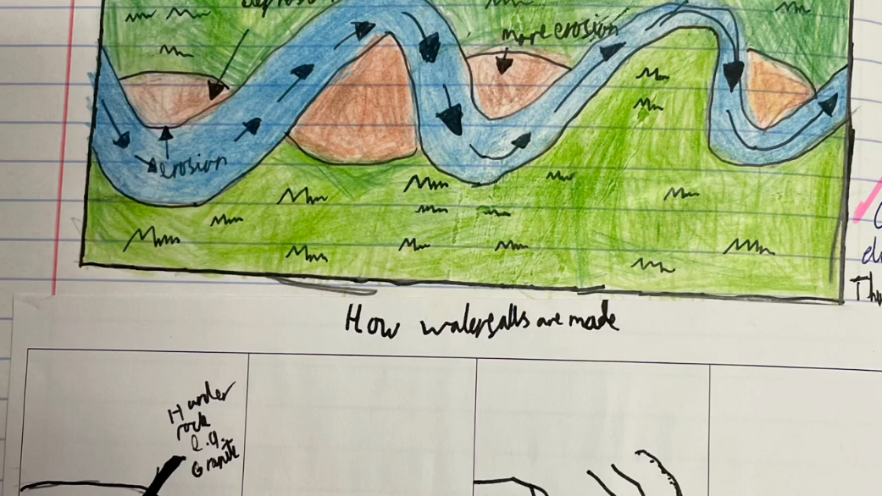
A curriculum full of vision!
Applying learning from the classroom into real life contexts

Slide 7
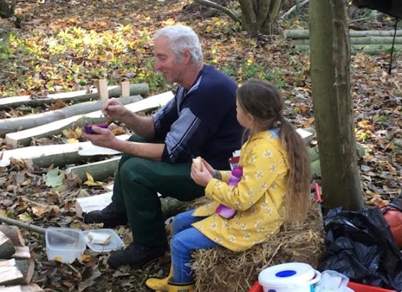
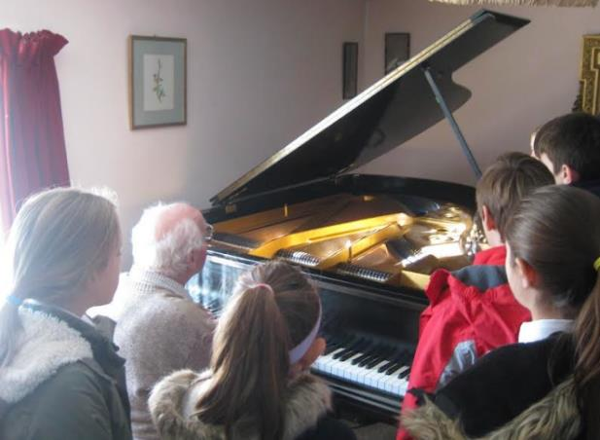
A curriculum full of vision!
Intergenerational Learning Opportunities
Notes:
George’s family were Jewish and lived in Berlin, his Father was a consultant dermatologist.
In 1933 George recalled looking outside of his window and seeing women demonstrating with flaming torches shouting ‘kill the jews’
They moved to Florence. In 1938 things began to change swiftly for Jewish families in Germany.
Gerorge’s Grandfather was born in Liverpool – his father went back to Berlin to apply for British passports and they moved to North London
Subsequently, joined the British Army and was posted to Wales, He moved to Suffolk and taught at Silver Jubliee School, which is now KEGs,

Slide 8

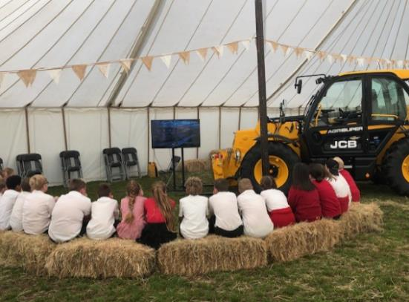
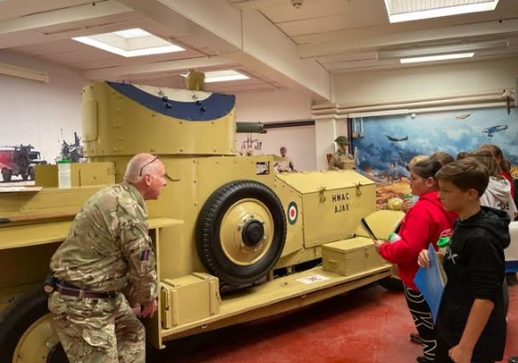
A curriculum full of vision!
Discovering potential future career paths…

Slide 9
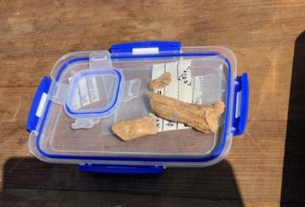
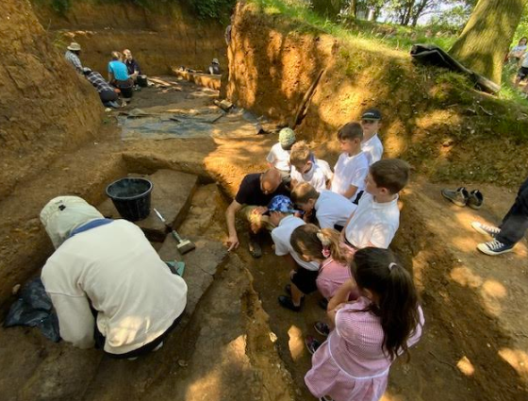
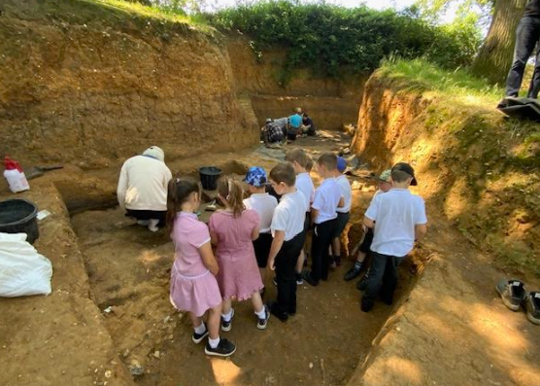
A curriculum full of vision!
Discovering future career paths…
Interleaving learning – History into Science
Notes:
Metatarsal and retractable claw of a lion from 400,00o years ago.
Lions then were 25% bigger than an African male lion today

Slide 10

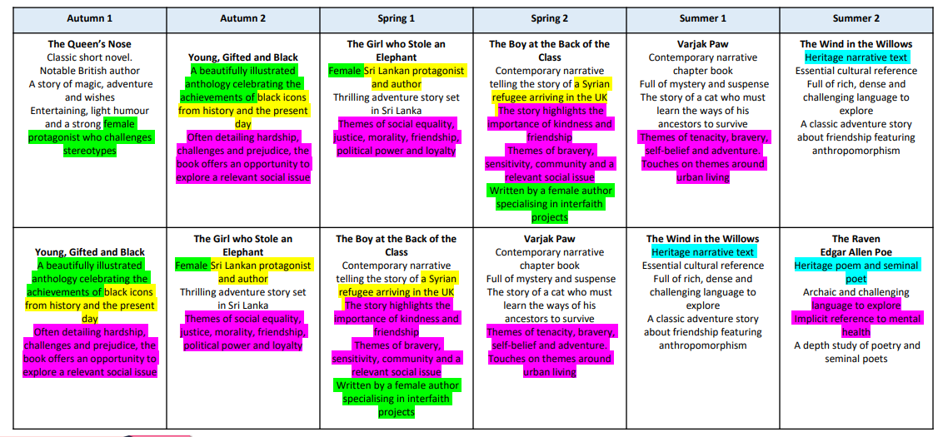
A curriculum full of vision!
Thematic Mapping to ensure that children are exposed to a wide range of social, ethical and moral issues,
from the safe platform of a shared book.
Year 4 Example

Slide 11
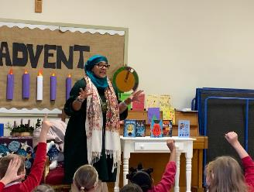


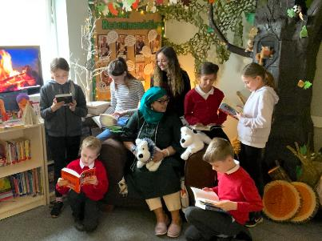
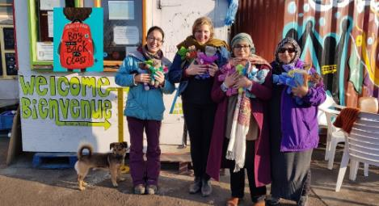
A curriculum full of vision!

Slide 12
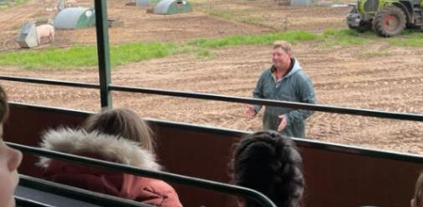
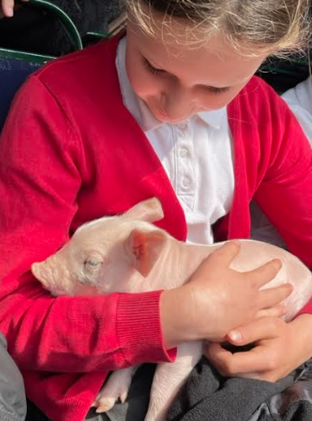

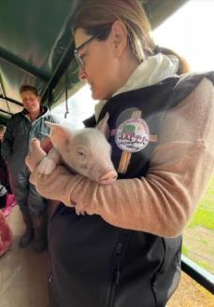
A curriculum full of vision!
Interleaving learning and experiences…

Slide 13
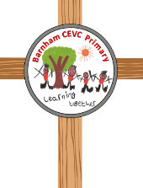
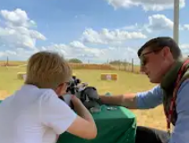
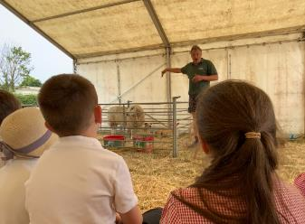
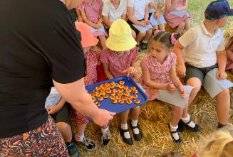
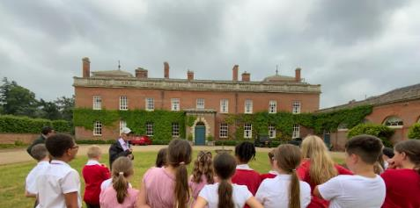
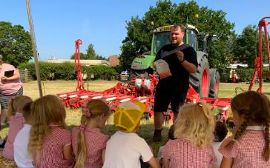
Countryside Week
Day 1 – Air Rifle Shooting and Deer Discovery
Day 2 – Euston Hall
Day 3 – Breckland Produce
Day 4 – Machinery
Day 5 – Community Collective Worship and Livestock

Slide 14

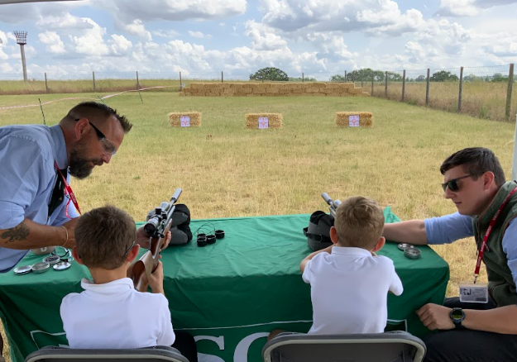
Opportunities to discover new skills and talents

Slide 15
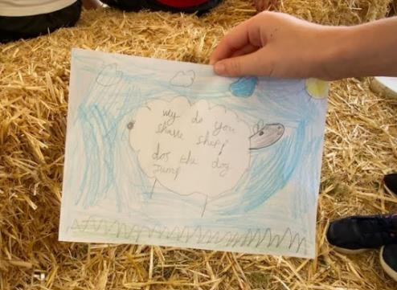
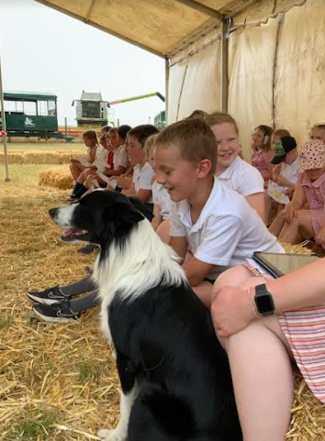
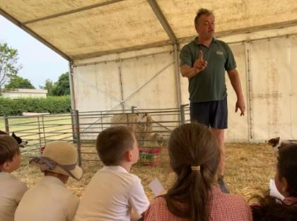
Making learning irresistible…

Slide 16
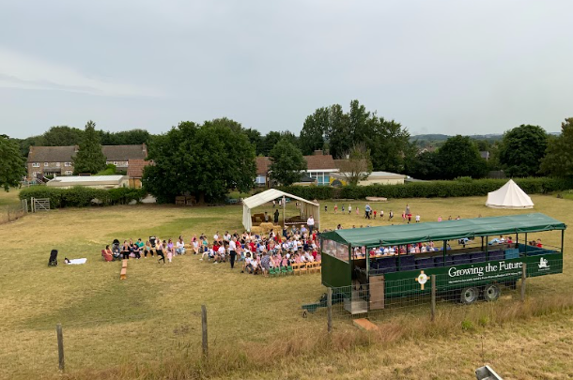
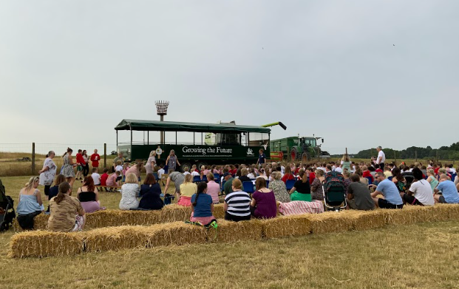
Countryside Week
Community Collective Worship

Slide 17
Curriculum Impact
Leaders have created an ambitious, well-considered curriculum designed to meet pupils’ needs. Leaders thread learning beyond the classroom throughout the year and across all classes. This enriches pupils’ learning and helps them to see connections between what they learn in class and the real world.
OfSTED December 2022
Apologies if this is out of the blue but we held an open day at our High Lodge visitor centre yesterday. Five separate Barnham pupils came to the stand through the day and all named the six species of deer resident in the UK, some of them were able to identify them from the skins we had on the table! They all told me that Roe and Red deer are native to the UK and the Muntjac are not native, one boy even told me muntjac were invasive non-natives. They also demonstrated a keen background knowledge of deer and the countryside in excess of many of the adults we engaged with and that I often engage with on a day to day basis. They were all really enthusiastic as they were sharing their knowledge with my team. They all said that they had learnt about deer in school. I’m really sorry but I didn’t think at the time to take their names to pass on to you but I just wanted to let you know how pleasantly surprised and genuinely impressed I was not only with the pupils and the way that they came across but that Barnham are educating their children about the countryside around them and how the kids seem to have been taking it all in.
Wildlife Ranger Manager, Forestry England, August 2023

