Slide 1

Animals, including humans
The circulatory system

Slide 2
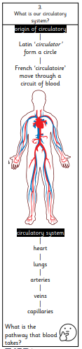
LO: To understand what the circulatory
system is.
I can name the four main parts of the circulatory system.
I can represent the circulatory system.
I know what pathway the blood takes in the circulatory system.
Stick your knowledge note in your book.

Slide 3
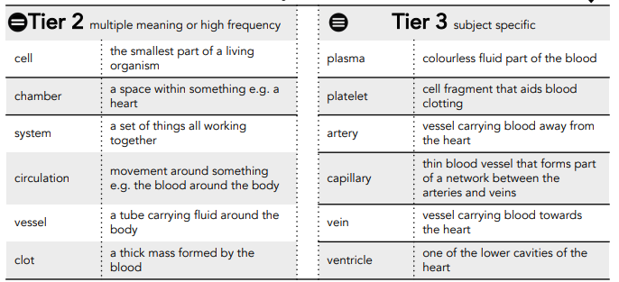

Slide 4
Teaching slide
Watch…
https://school-learningzone.co.uk/key_stage_two/ks2_science/the_human_body/the_circulatory_system/the_circulatory_system.html

Slide 5
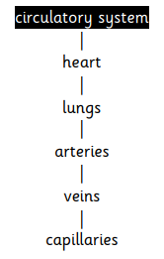
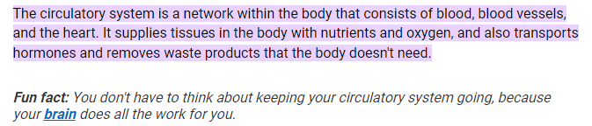
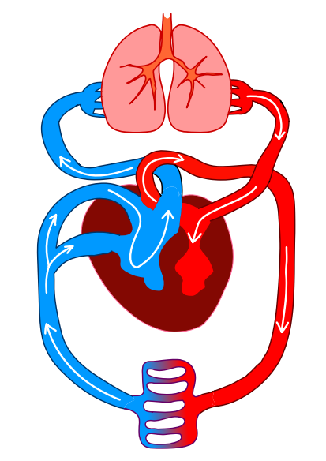
Teaching slide
The circulatory system is like a delivery system around your body.
Blood is used to transport oxygen around the body; it also gets rid of carbon dioxide. In addition to this, it transports and delivers nutrients and water to every cell in the body.

Slide 6
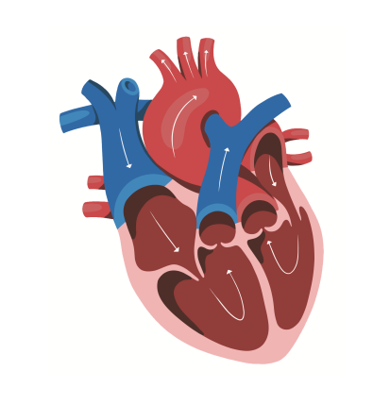
The heart
The heart: https://www.bbc.co.uk/bitesize/topics/zcyycdm/articles/z9w9r2p
The heart is roughly the size of a large fist and is located near the chest’s centre. Its job is to pump persistently and to ensure the circulatory system is working all the time.
The heart pumps oxygenated blood (from the lungs) around the body. Whilst the blood is circulating the body, the red blood cells pick up deoxygenated blood (carbon dioxide and takes it to the lungs to get rid of).
deoxygenated blood
oxygenated blood
red blood cells

Slide 7
The lungs
The heart is a magnificent organ, but it also relies on another magnificent organ, the lungs, to fulfil its work.
The heart and lungs work together to circulate re-oxygenated blood to all the cells around the body, collecting carbon dioxide (a waste product) along the way from the cells, disposing of them
deoxygenated blood
Oxygenated blood
Red blood cells

Slide 8
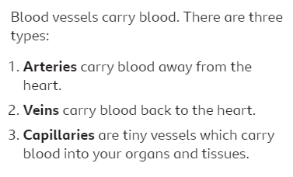
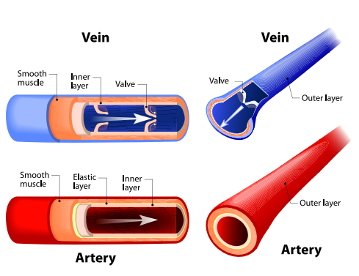
Blood vessels
Blood vessels: https://www.bbc.co.uk/bitesize/topics/zcyycdm/articles/z9w9r2p
The arteries are blood vessels which transport oxygen-rich blood away from the heart and towards tissues in the body. Each artery has three layers: the intima, the media and the adventitia.
Veins are blood vessels that carry blood to the heart. This blood comes from your tissues where it has been deoxygenated. Veins also carry blood towards the lungs to give them oxygen.

Slide 9
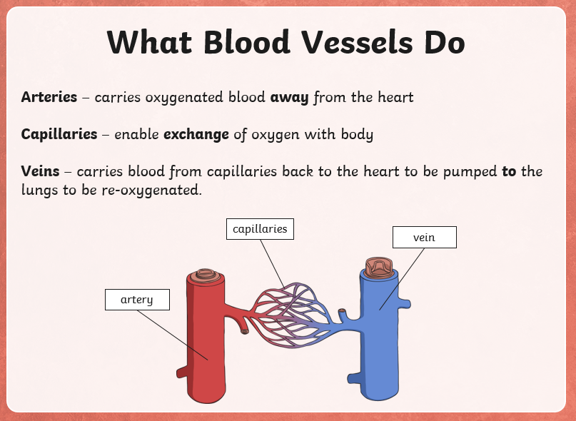
Teaching slide

Slide 10
Independent work
delivery system | deoxygenated blood
blood cells | oxygenated blood
circulate | deposited
arteries | veins
red blood cells | waste
Stick this template in your book. Can you label each part and tell me their function.
Labels:
Heart
Lungs
Artery
Vein
Blood
Capillaries
Rest of the body
The circulatory system is… It is made up of… I am now going to go into more detail about each part.
Lungs
Heart
Arteries
Veins
Capillaries
Notes:
Children get oxygen from the lungs and this goes to the heart through viens - it gets an extra pump from the heart and is distributed around the body via arteries. The oxygen is released to different parts of the body through the capillaries. Around the body, the blood picks up carbon dioxide, takes it back to the heart via veins, gets and extra pump from the heart to the lungs to be exhaled via arteries.
Children start at lungs with oxygenated blood (red up) and then when they get to the body (capillaries) they will turn into deoxygenated blood (blue cup).

Slide 11
Independent
What is our circulatory system? What is the pathway that blood takes?
Use your knowledge notes to support you in answering the questions.

