Slide 1
Visits and Visitors
2023-24

Slide 2
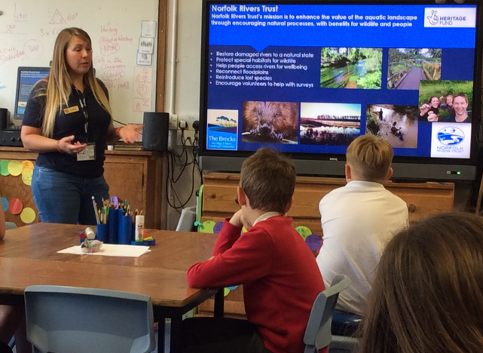
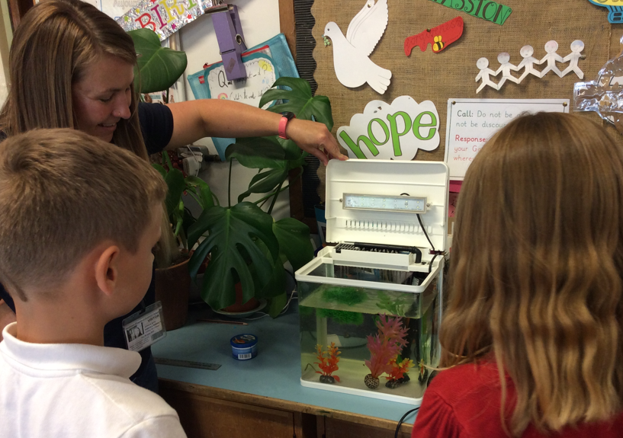
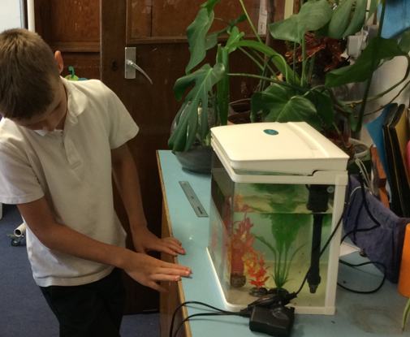
‘Eels on Wheels’ project with Ursula from the Norfolk Rivers Trust

Slide 3
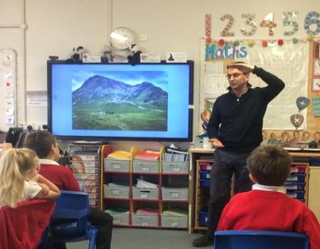
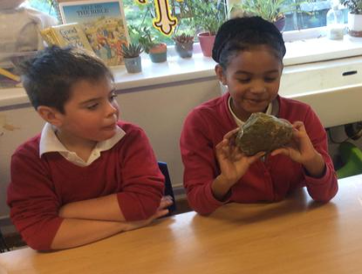
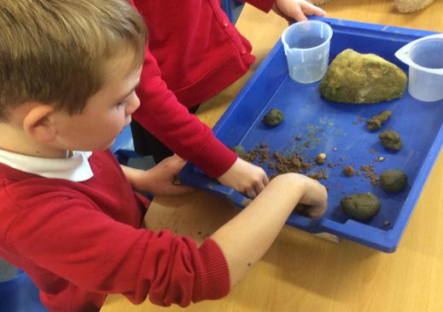
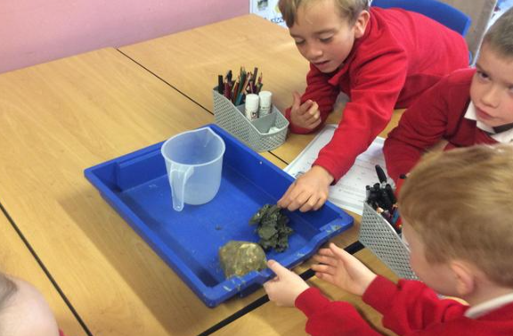
Year 3 learning about rocks and soils with Matthew
Hawthorne,
Euston Estate
Manager

Slide 4
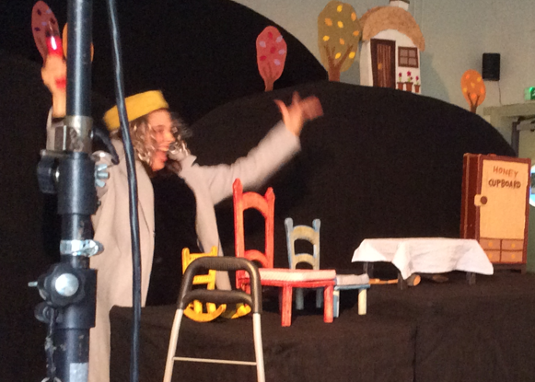
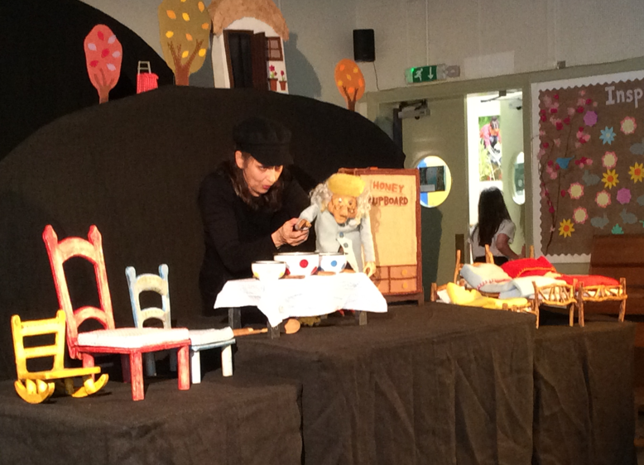
Whole-School
Puppet Theatre and Workshop

Slide 5
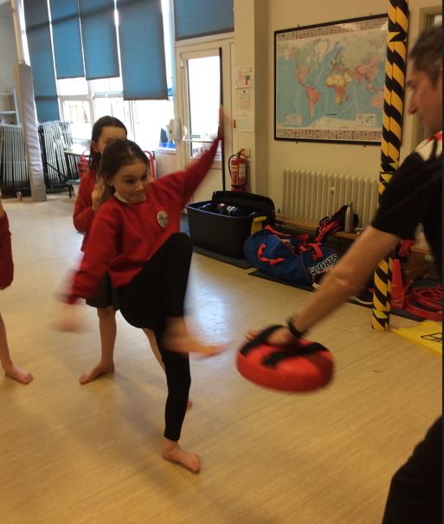
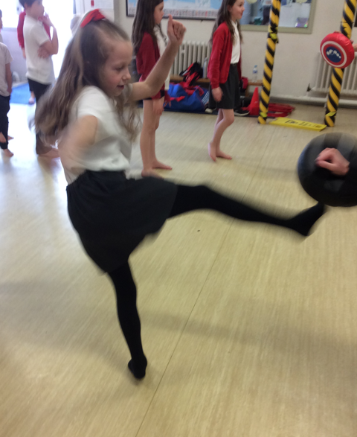
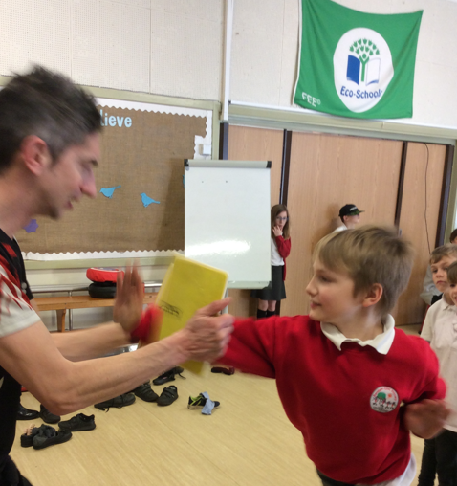
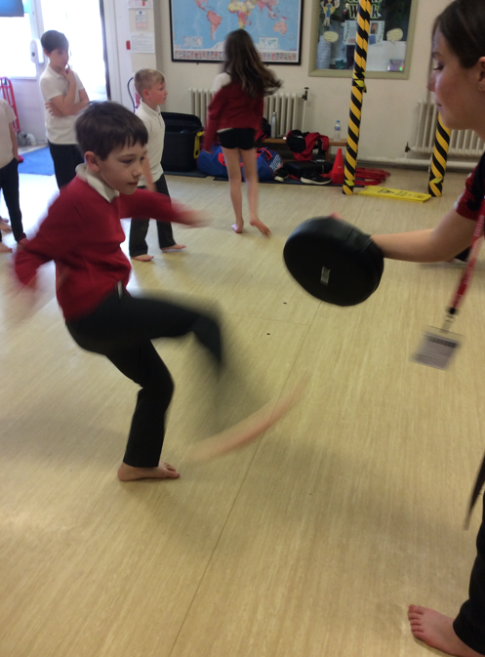
Whole School
Karate Workshop

Slide 6
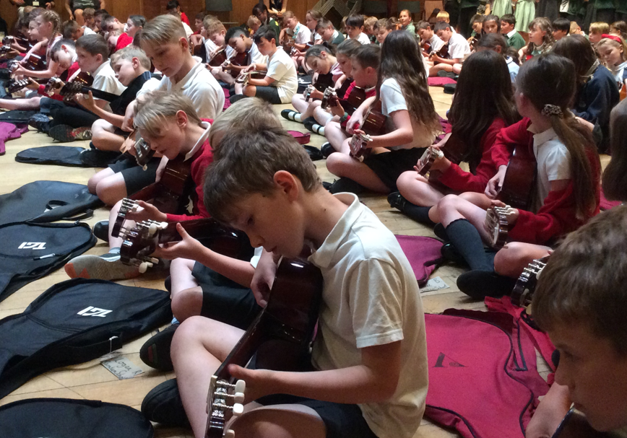
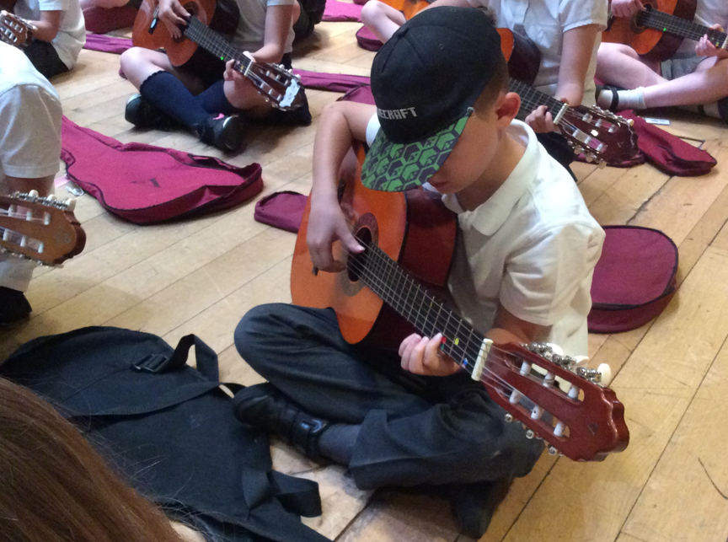
Performing at The Apex

Slide 7
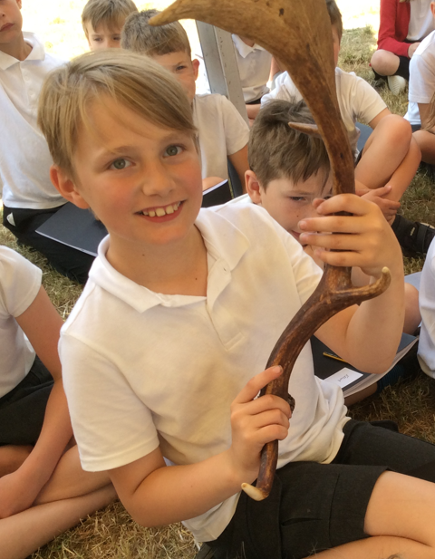
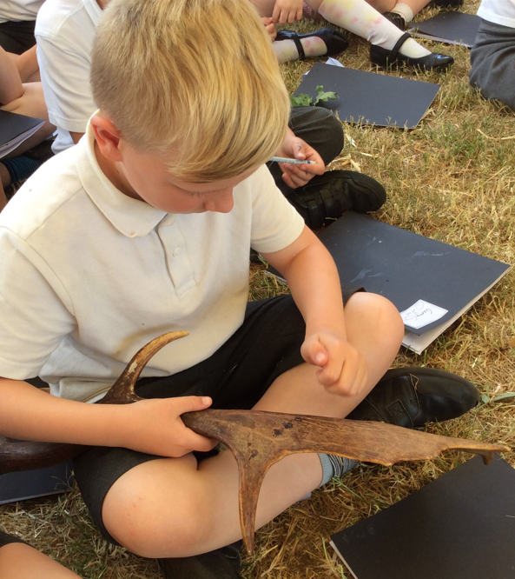
Countryside Week:
Deer and Conservation

Slide 8
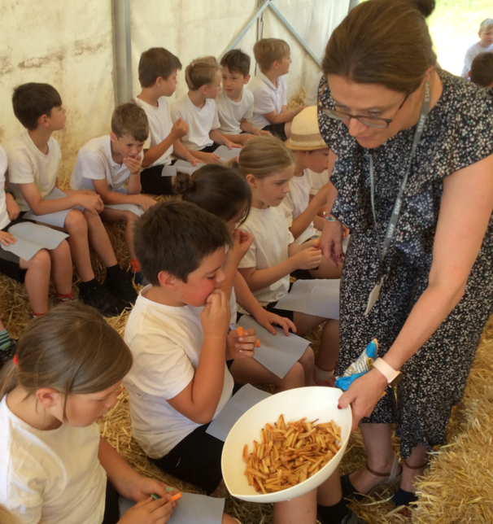
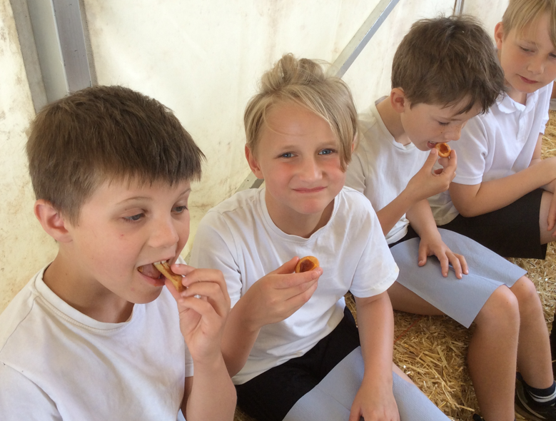
Countryside Week (held on the school playing field): Mrs Arnold serves carrots, parsnips and potatoes grown in the field behind our school!

Slide 9
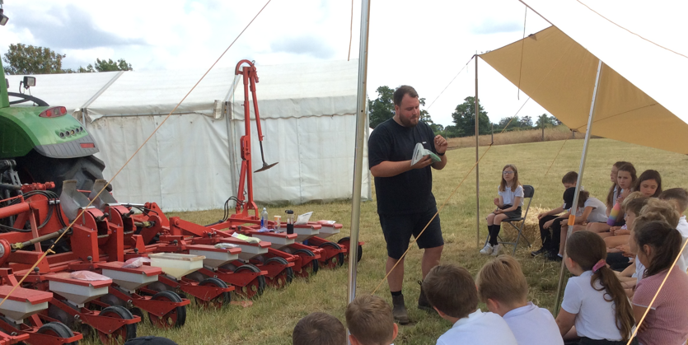
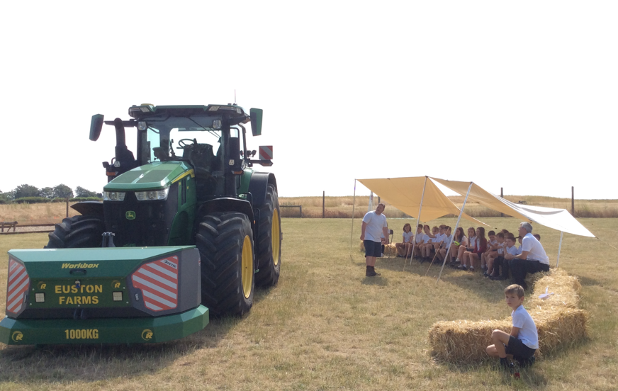
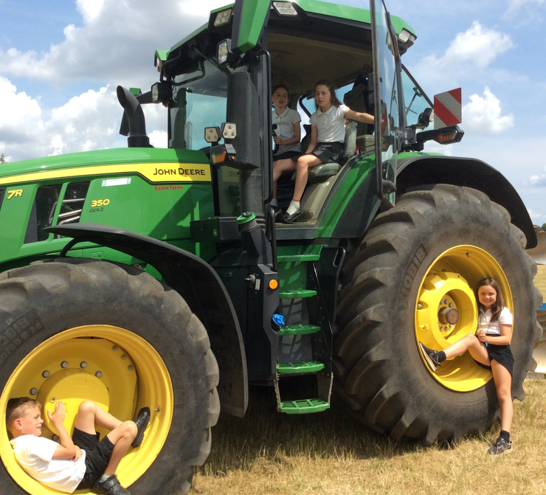
Countryside Week: Learning about farm-machinery and how seeds are sown and crops harvested

Slide 10
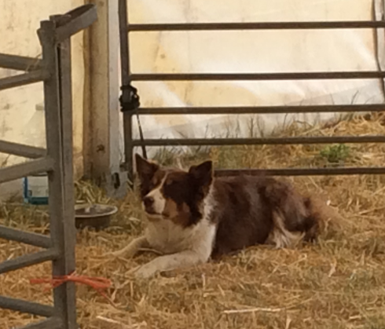
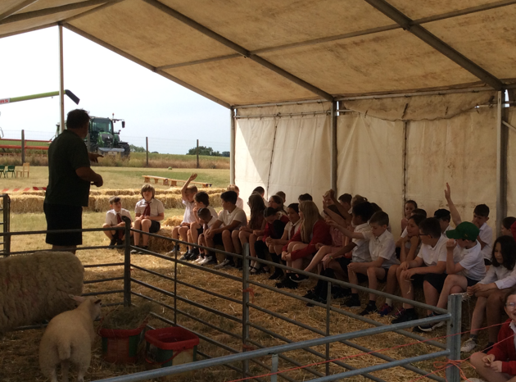
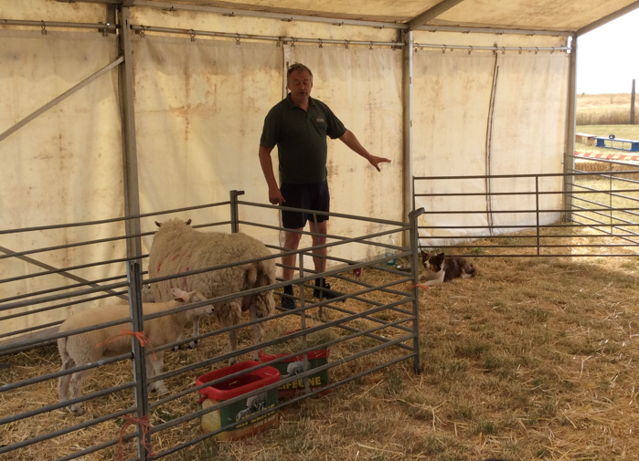
‘Countryside Week’:
Learning about sheep farming

Slide 11
Visits and visitors this year have also included:
Bikeability
Year 6 science circulatory system
Visit to learn about DNA for Years 5 and 6 at Cambridge University
Visit to a mosque in Cambridge and synagogue in Norwich
Lots of visits to the local church
Visits from a variety of local churches including Salvation Army

