Slide 1
Phonics Workshop
September 2024

Slide 2
Aims
To revisit why phonics is taught and how it is linked to reading, writing and spelling.
To recap how phonics and reading is taught at Barnham.
To know how you can support your child at home.
Notes:
Aims of the session and what we hope to achieve by providing this session to parents.

Slide 3




How many times have you already read today?
Notes:
Slide purpose:
To help parents see the value of reading by getting them to reflect on their own reading experiences
Suggested script:
Just think about how many times you have already read things today. More than ever, we are surrounded by text and reading is a vital skill.
We want all of our children to become confident readers who can navigate the world of reading around them.

Slide 4
Phonics is…
making connections between the sounds of our spoken words and the letters that are used to write them down.

Slide 5
Consanguineous
When we come across unfamiliar words, we draw upon:
our knowledge of phonics;
our knowledge of patterns in words;
our knowledge of root words;
our prior knowledge and understanding.
Phonics is the starting point of learning to read and is a skill that will be used throughout life.
Notes:
Consanguineous- descended from the same ancestor - from the same blood origin
relating to or denoting people descended from the same ancestor.
"consanguineous marriages may give rise to recessive syndromes"

Slide 6
Our aim in phonics:
We aim to ensure that all pupils:
have a secure understanding of Phases 2 and 3 by the end of Reception and are able to segment and blend words within Phases 2 and 3;
are introduced to the ‘tricky words’ early in the Autumn term in Reception and aim to read and write the high frequency words for Phase 2 to 3 before they enter Year 1;
have completed Phase 4 and 5 in Year 1.
Notes:
Purpose of teaching phonics and what it supports the children to develop

Slide 7
The language of phonics
Notes:
Recap language- so when children mention this to parents they can feel confident in their understanding.

Slide 8
The language of phonics
Phoneme – the sound (for example, “fffff”)
Notes:
Recap language- so when children mention this to parents they can feel confident in their understanding.

Slide 9
The language of phonics
Phoneme – the sound (for example, “fffff”)
Grapheme – the way it is written (for example, f / ph)
Notes:
Recap language- so when children mention this to parents they can feel confident in their understanding.

Slide 10
The language of phonics
Phoneme – the sound (for example, “fffff”)
Grapheme – the way it is written (for example, f / ph)
Digraph – two letters representing one sound (for example, ai or er)
Notes:
Recap language- so when children mention this to parents they can feel confident in their understanding.

Slide 11
The language of phonics
Phoneme – the sound (for example, “fffff”)
Grapheme – the way it is written (for example, f / ph)
Digraph – two letters representing one sound (for example, ai or er)
Split digraphs – two letters split making one sound (for example, make, late)
Notes:
Recap language- so when children mention this to parents they can feel confident in their understanding.

Slide 12
The language of phonics
Notes:
Recap language- so when children mention this to parents they can feel confident in their understanding.

Slide 13
The language of phonics
Trigraphs – three letters representing one sound (for example, igh or air)
Notes:
Recap language- so when children mention this to parents they can feel confident in their understanding.

Slide 14
The language of phonics
Trigraphs – three letters representing one sound (for example, igh or air)
Quadgraph - four letters representing one sound (eigh / ay)
Notes:
Recap language- so when children mention this to parents they can feel confident in their understanding.

Slide 15
The language of phonics
Trigraphs – three letters representing one sound (for example, igh or air)
Quadgraph - four letters representing one sound (eigh / ay)
Segmenting – Splitting the word up into phonemes (eg, frog = f-r-o-g)
Notes:
Recap language- so when children mention this to parents they can feel confident in their understanding.

Slide 16
The language of phonics
Trigraphs – three letters representing one sound (for example, igh or air)
Quadgraph - four letters representing one sound (eigh / ay)
Segmenting – Splitting the word up into phonemes (eg, frog = f-r-o-g)
Blending – Merging the phonemes to make a word (eg, b-oo-k = book)
Notes:
Recap language- so when children mention this to parents they can feel confident in their understanding.

Slide 17
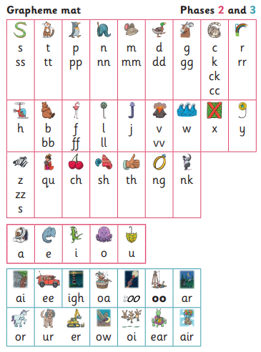
The phonemes (sounds) we learn in Reception…
Notes:
Recap language- so when children mention this to parents they can feel confident in their understanding.

Slide 18
Activity
How many phonemes are in each of these words?
under starfish
duck
garden caterpillar
Notes:
Quick activity.

Slide 19
Activity
under
4 phonemes
Notes:
This will support parents to understand their child’s experiences of learning phonics. Phonics require deeper thinking.

Slide 20
Activity
starfish
6 phonemes

Slide 21
Activity
duck
3 phonemes

Slide 22
Activity
garden
5 phonemes

Slide 23
Activity
caterpillar
6 phonemes

Slide 24
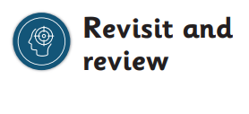
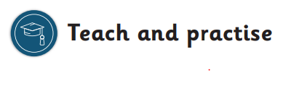
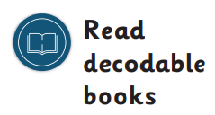
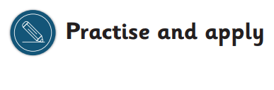
How we teach phonics…
break down of a phonics lesson
Notes:
Just briefly recap the structure of a phonics session.
Teach a lesson

Slide 25
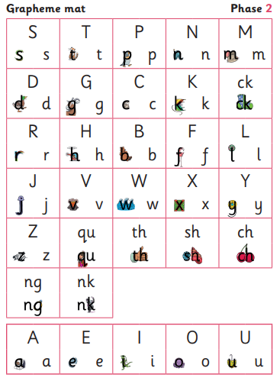
Phase 2
Reception
Autumn Term

Slide 26
Phase 3
Reception
Spring Term

Slide 27
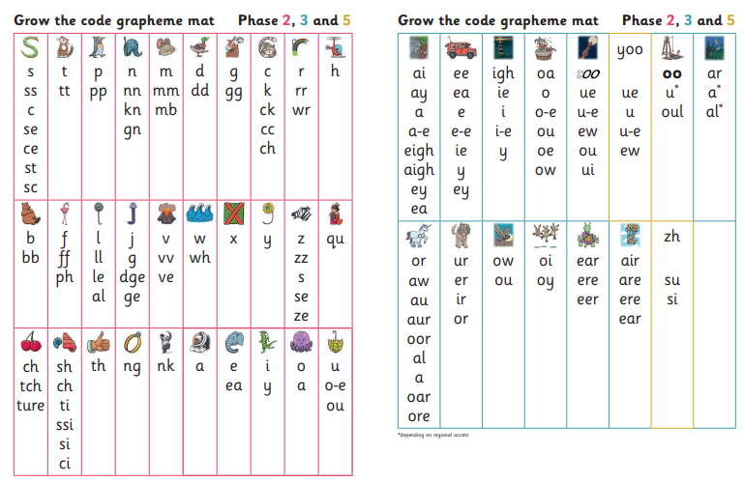
Phase 5
Year 1

Slide 28
How will we check progress?
Children’s ability to blend and segment
Children’s fluency in reading tricky words
Half termly assessments (+ assessments throughout term)
Children’s fluency in reading
Phonics screening check for Year 1s - June
Notes:
Touch on the PSC in June.
Interventions- keep up not catch up

Slide 29
How you can support your child
Practise, practice, practise
Praise your child for practising their sounds at home
Find sounds your child has learnt in different contexts (for example, in computer games, on signs, in stories)
Be excited about the new sounds your child has learnt
Think of words beginning with a specific sound (initial sounds)
Notes:
Lots of people are keen for this. Realistic strategies, for example put on your c-oa-t.

Slide 30
How you can support your child
Segment words and ask your child to tell you that word – phonics on the run
Play I-spy using sounds instead of letter names
Try alternate sounds when reading words
Pretend to need help reading a word- get your child to teach you
Read with your child every day!
Notes:
Lots of people are keen for this. Realistic strategies, for example put on your c-oa-t.

Slide 31

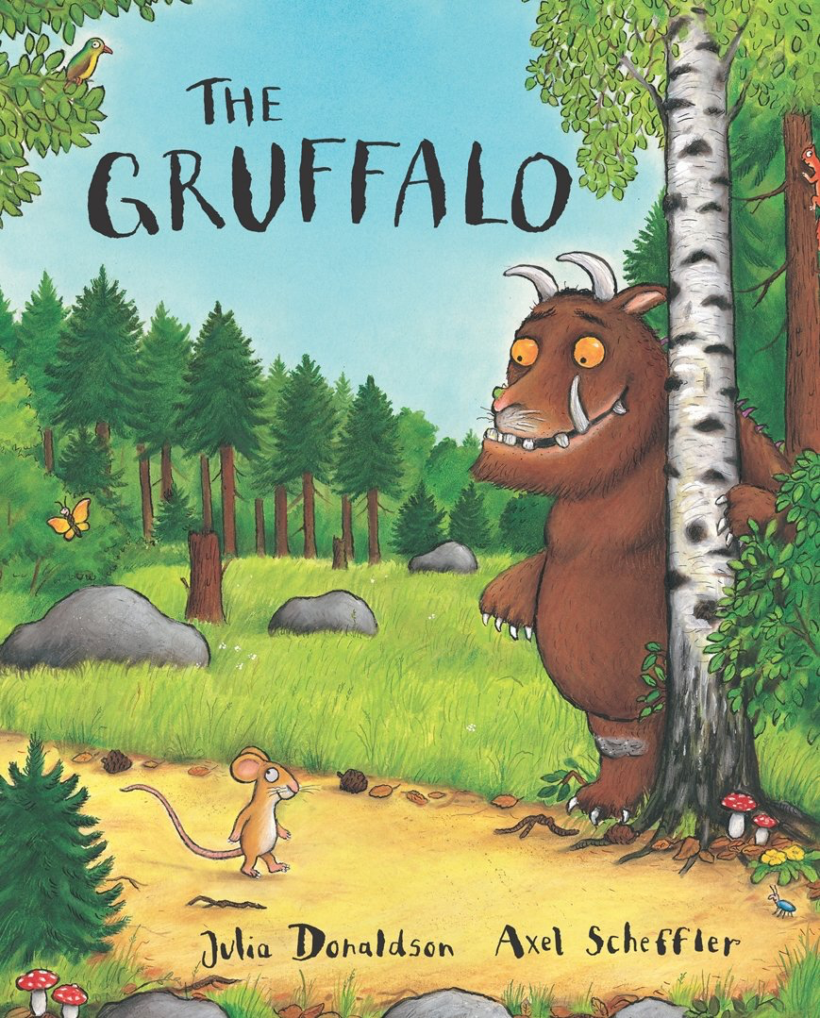



Books going home
Notes:
Slide purpose:
To introduce the process and format for reading at home
Suggested script:
As well as the ‘learning to read’ book that your child will bring home they will also bring home a book for sharing with you.
This shared book is SO important. This is how we are going to give them the WILL to read.
Please read with your child as often as you can – at least once a day if possible.

Slide 32
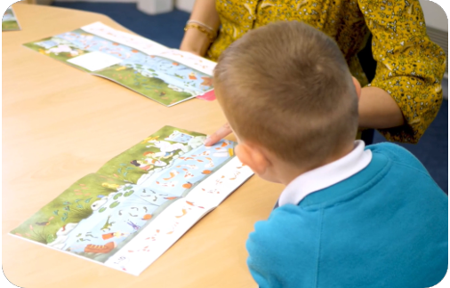
Reading a wordless books
Wordless books are invaluable as they teach reading behaviours and early reading skills to children who are not blending – yet!
Talk about the pictures.
Point to the images in the circles and find them on the page.
Encourage your child to make links from the book to their experiences.
Notes:
Slide purpose:
To give guidance on reading wordless books at home
Notes:
Read the slide.

Slide 33

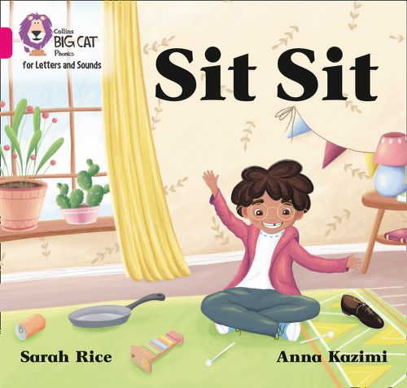
Listening to your child read their phonics book
Your child should be able to attempt to read their book without your help.
They might sound out words and blend them before they read them fluently.
If they can’t read a word, read it to them.
Talk about the book and celebrate their success.
Notes:
Slide purpose:
To give guidance on reading the decodable book at home
Notes
Read the slide.

Slide 34

Read with your child
Read a story to your child every day!
Make the story sound as exciting as you can by changing your voice.
Talk with your child as much as you can:
  Introduce new and exciting language.
  Encourage your child to use new vocabulary.
  Make up sentences together.
  Find different words to use.
  Describe things you see.
Notes:
Slide purpose:
To give guidance on reading the shared book at home
Notes:
Read the slide.

Slide 35
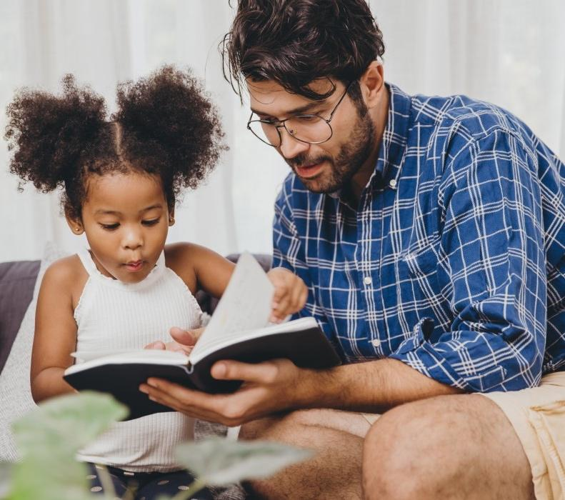
The most important thing you can do is read with your child
Reading a book and chatting had a positive impact a year later on children’s ability to…
understand words and sentences
use a wide range of vocabulary
develop listening comprehension skills.
The amount of books children were exposed to by age 6 was a positive predictor of their reading ability two years later.
Parental involvement in the development of children’s reading skills: A five-year longitudinal study (2002) Senechal, M. and Lefvre, J
Notes:
Slide purpose:
To summarise key takeaways
Suggested script:
Celebrate your child’s success at school.
Make time for reading at home!

Slide 36
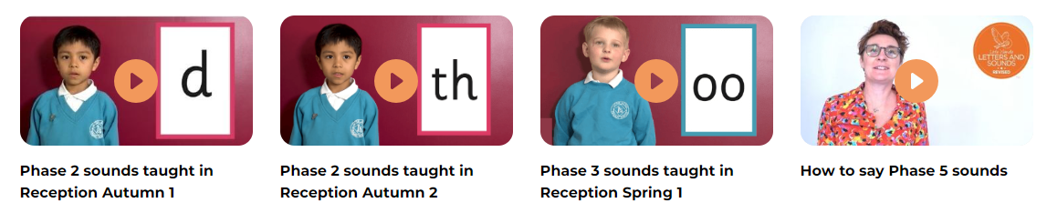
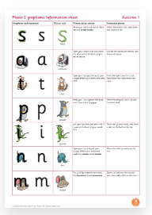
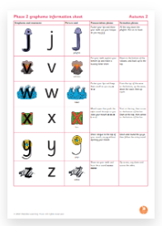
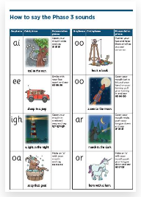
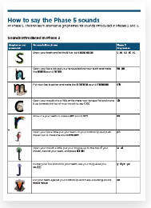
For parents…
https://www.littlewandlelettersandsounds.org.uk/resources/for-parents/
Notes:
Parent can look on the Little Wandle website - link on Moles Phonics page

Slide 37

For parents…
https://www.littlewandlelettersandsounds.org.uk/resources/for-parents/
Notes:
Parent can look on the Little Wandle website - link on Moles Phonics page

Slide 38
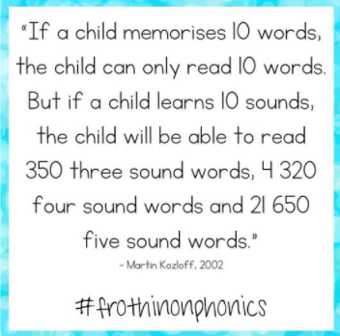

Slide 39
Questions

