Slide 1
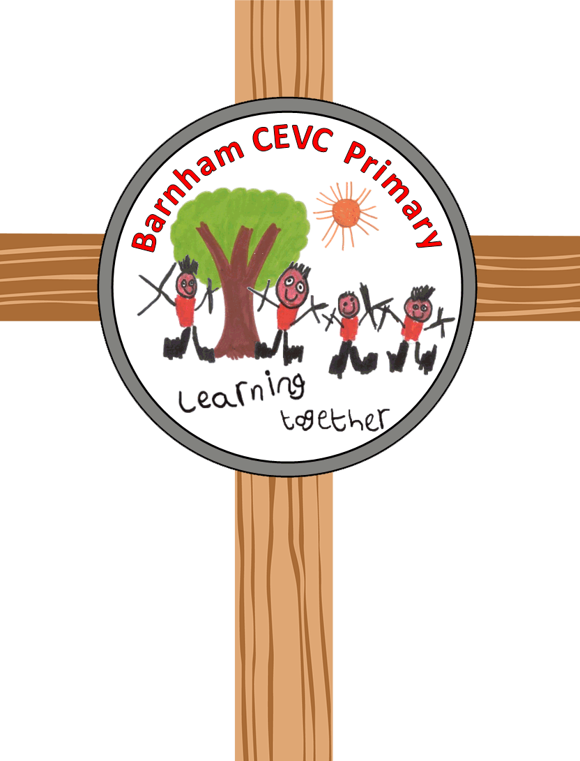
History
Intent
Intent

Slide 2
History
Why is History important?
At Barnham CEVC Primary, all of our teaching and learning builds on our core vision; Inspire, Cherish and Believe. We recognize that History is vital to a rich and broad primary education. We know that a high-quality history education will help pupils gain a coherent knowledge and understanding of Britain’s past and that of the wider world. We aim to inspire pupils’ curiosity to know more about the past and encourage pupils to ask perceptive questions, think critically, weigh evidence, sift arguments, and develop perspective and judgement. We are aware of the importance of history in helping pupils to understand the complexity of people’s lives, the process of change, the diversity of societies and relationships between different groups, as well as their own identity and the challenges of their time.
Intent

Slide 3
History
Aims of the History Curriculum
The national curriculum for History aims to ensure that all pupils:
know and understand the history of these islands as a coherent, chronological narrative, from the earliest times to the present day: how people’s lives have shaped this nation and how Britain has influenced and been influenced by the wider world
know and understand significant aspects of the history of the wider world: the nature of ancient civilisations; the expansion and dissolution of empires; characteristic features of past non-European societies; achievements and follies of mankind
gain and deploy a historically grounded understanding of abstract terms such as ‘empire’, ‘civilisation’, ‘parliament’ and ‘peasantry’
understand historical concepts such as continuity and change, cause and consequence, similarity, difference and significance, and use them to make connections, draw contrasts, analyse trends, frame historically-valid questions and create their own structured accounts, including written narratives and analyses
understand the methods of historical enquiry, including how evidence is used rigorously to make historical claims, and discern how and why contrasting arguments and interpretations of the past have been constructed
gain historical perspective by placing their growing knowledge into different contexts, understanding the connections between local, regional, national and international history; between cultural, economic, military, political, religious and social history; and between short- and long-term timescales.
Intent

Slide 4
History: The CUSP Curriculum at Barnham
CUSP History draws upon several powerful sources of knowledge
Substantive knowledge - this is the subject knowledge and explicit vocabulary used about the past. Common misconceptions are explicitly revealed as non-examples and positioned against known and accurate content. Misconceptions are challenged carefully and in the context of the substantive and disciplinary knowledge. In CUSP History, it is recommended that misconceptions are not introduced too early, as pupils need to construct a mental model in which to position new knowledge.
Disciplinary knowledge – this is the use of that knowledge and how children construct understanding through historical claims, arguments and accounts. We call it ‘Working Historically.’ The features of thinking historically may involve significance, evidence, continuity and change, cause and consequence, historical perspective, and contextual interpretation.
Historical analysis is developed through selecting, organising and integrating knowledge through reasoning and inference making in response to our structured questions and challenges. We call this ‘Thinking historically’
Substantive concepts, such as invasion and civilisation are taught through explicit vocabulary instruction as well as through the direct content and context of the study.
Intent

Slide 5
History at Key Stage 1 and Key Stage 2
At Barnham CEVCP children will gradually build on their skills throughout the Key Stages based on National Curriculum expectations.
KEY STAGE 1
The sequence in KS1 focuses on young children developing a sense of time, place and change. It begins with children studying Changes within living memory to develop an understanding of difference over time within concrete experiences of their lives. This chronological knowledge is foundational to the understanding of change over time.
Pupils study the Lives of significant individuals, focusing on David Attenborough and Mary Anning. Chronology and place in time steers the understanding of the context in which these significant individuals lived. Terms such as legacy are introduced and used within the context of each study. This study is revisited and enhanced by studying the Lives of further significant individuals, including Neil Armstrong, Mae Jemison, Bernard Harris Jr and Tim Peake.
In KS1, pupils study local history through significant events, people and places. The locality is further understood by knowing about the places, the buildings, the events, the people that tell a story of the past.
Events beyond their living memory. Here, pupils draw upon early concepts of chronology and connect it to more abstract, but known, events in the past focusing on the Great Fire of London.
There are further opportunities for pupils to revisit and retrieve prior learning with a focus on ‘Events beyond living memory’. Connections, where relevant, are made to wider studies, such as the Great Fire of Bury St Edmunds, Newmarket or Haverhill.
.
Intent

Slide 6
Lower Key Stage 2:
LOWER KEY STAGE 2
In KS2, pupils study the cultural and technological advances made by our ancestors as well as understanding how historians think Britain changed throughout the Stone, Bronze and Iron Ages. Archaeological history guides us to know how early humans were creative, innovative and expert at surviving in changeable environments. Having an in-depth understanding of Iron Age Britain offers solid foundations for the study of how Rome influenced Britain. This foundational knowledge is built upon and used to support long-term retrieval to contrast culture and technology. Pupils are able to draw upon prior understanding to support and position new knowledge, therefore constructing much more stable long-term memories. Substantive concepts, such as invasion, law, civilisation and society are developed through explicit vocabulary instruction, another central component of CUSP.
Studies of how Britain was settled by Anglo-Saxons and Scots gives a focus on cultural change and the influence of Christianity. Pupils study how powerful kings and their beliefs shaped the Heptarchy of Anglo-Saxon Britain.
CUSP also focuses on the Struggle for throne of England through a study of the Vikings, their origins, conquests and agreements with English Anglo-Saxon kings to settle and dwell in the region known as Danelaw.
Intent

Slide 7
Upper Key Stage 2
Later in KS2, knowledge of Anglo-Saxons is revisited and used to connect with a study of the Maya civilisation. The study compares advancement of the Maya culture and innovation to that of the Anglo-Saxons around c.AD 900. Here, location, settlement, people, culture and invention are compared and contrasted.
Pupils also study Significant monarchs after 1066. Five kings and queens are a focus of a depth study and comparison, drawing on their beliefs, actions and understanding their legacy. This chronological study revisits known periods of time and introduces new content and monarchs.
Ancient history, such as the Achievements of the earliest civilisations - Ancient Egyptians and the study of Ancient Greek life and achievements are also studied learning about the influence on the western world. The understanding of culture, people and places are central to these studies. CUSP History connects these studies with prior knowledge of what was happening in Britain at the same time. The effect of this is to deepen and connect a broader understanding of culture, people, places and events through comparison.
Recent history, such as the Battle of Britain for example, is studied in the context of how conflict changed society in the Second World War. Modern history is also studied through units such as the Windrush Generation. Knowing about slavery, Caribbean culture and the injustice of the past enlightens pupils to understand why events happened and how these pioneers faced racism, discrimination and prejudice. PSHE and SMSC are vital components of the history curriculum - challenging racism and prejudice in all its forms. This is an integral feature of CUSP that spotlights the lessons we can learn from the past.
Intent

Slide 8
Spaced Retrieval Practice Approach
Our history curriculum is delivered through a series of modules which are deliberately spaced throughout the academic year with opportunities to introduce and revisit key concepts. This approach enables staff to deepen pupil understanding and embed learning.
Our curriculum maps clearly show how our CUSP curriculum delivers (introduces and revisits) the National Curriculum expectations for history within and across year groups. All modules are identified on year group specific yearly overviews using green boxes.
Intent

Slide 9
Early Years
In Early Years, History is taught through Knowledge and Understanding of the World. The children learn about the world around them in their play and adult led activities. Our curriculum is designed to enable children to make sense of their physical world and community. Children are encouraged to be historians by:
Finding out about and showing curiosity and interest in features of objects, events and living things
Describing and talking about what they see, including noticing similarities and differences
Showing curiosity and asking questions about why things happen and how things work
Showing understanding of cause-effect relations
Noticing and commenting on patterns
Showing an awareness of change
Explaining their own knowledge and understanding, and asking appropriate questions of others
Investigating objects and materials by using all of their senses as appropriate
Intent

Slide 10

Content and sequence - EYFS to Key Stage 1
ELG’s | How this is achieved in EYFS | Year 1 | Year 2
Past and Present ELG: Children at the expected level of development will: Talk about the lives of the people around them and their roles in society. Know some similarities and differences between things in the past and now, drawing on their experiences and what has been read in class. Understand the past through settings, characters and events encountered in books read in class and storytelling.
Intent

Slide 11
Content and Sequence: Year 1
CUSP History Progression Tables
Year group, Unit Title and Name | Substantive concept | Previous Learning | Big Ideas/Key Questions/Learning Foci | Tier 2 Vocabulary | Tier 3 Vocabulary
Y1 Unit 1 Changes within living memory (This will be updated Summer 2022) | COMMUNITY Nationality, Rights, Society | Past and Present Talk about the lives of the people around them and their roles in society Know some similarities and differences between things in the past and now, drawing on their experiences and what has been read in class Understand the past through settings, characters and events encountered in books read in class and storytelling People, Culture and Communities Describe their immediate environment using knowledge from observation, discussion, stories, non-fiction texts and maps Know some similarities and differences between different religious and cultural communities in this country, drawing on their experiences and what has been read in class Explain some similarities and differences between life in this country and life in other countries, drawing on knowledge from stories, non-fiction texts and – when appropriate – maps | Stages What are the stages in my life? Changes What did I play with when I was a baby? Why was that? What did I play with when I was 1 or 2 years old? Why was that? What did I play with when I was 3 or 4 years old? Why was that? What did I play with when I started school? Why was that? Explain it What changes have happened in my lifetime? | toddler timeline different compare memory | construction physical imagination lifetime stages
Intent

Slide 12
Content and Sequence: Year 1 cont.
CUSP History Progression Tables
Year group, Unit Title and Name | Substantive concept | Previous Learning | Big Ideas/Key Questions/Learning Foci | Tier 2 Vocabulary | Tier 3 Vocabulary
Y1 Unit 3 More lives of significant people | KNOWLEDGE COMMUNITY Explore, Rights, Freedom, Society, Frontier, Pioneer | EYFS Past and Present People, Culture and Communities History Lives of significant people Science Animals, including humans Plants | Pioneer Who was Neil Armstrong? What did he achieve? Explorers Who is Mae Jemison? What did she achieve? Who is Bernard Harris Jr? What did he achieve? Who is Tim Peake? What did he achieve? Remember Compare the achievements of two significant individuals. What was similar and what was different? Study a third significant individual from the above. | legacy inspire pioneer explore similar | orbit racism significant astronaut expedition
Intent

Slide 13
Content and Sequence: Year 2
Year group, Unit Title and Name | Substantive concept | Previous Learning | Big Ideas/Key Questions/Learning Foci | Tier 2 Vocabulary | Tier 3 Vocabulary
Y2 Unit 1 Events beyond living memory | COMMUNITY DEMOCRACY City, Monarchy, King, Merchant, Parliament, Society, Religion | EYFS Past and Present People, Culture and Communities History Lives of significant people More lives of significant people Science Everyday materials | When and where? Where is London? When was the Great Fire of London? What? How did the fire start? Why did the fire spread so quickly? Study Sunday 2nd September 1666 - Where did the fire spread to? Study Monday 3rd and Tuesday 4th September 1666 - Where did the fire spread to? Study Wednesday 5th and Thursday 6th September 1666 Evidence and change How do we know about the Great Fire of London? Study sources of evidence, including artefacts, newspapers and diary entries from Samuel Pepys and John Evelyn. What effect did the fire have on London? As a consequence of the fire, what changes were made to London? | bustling raged extinguished merchant engulfed | flammable devoured possessions ineffective doused
Intent

Slide 14
Content and Sequence: Year 2 cont.
Year group, Unit Title and Name | Substantive concept | Previous Learning | Big Ideas/Key Questions/Learning Foci | Tier 2 Vocabulary | Tier 3 Vocabulary
Y2 Unit 2 Significant historical events, people and places in their own locality | COMMUNITY Monarchy, King, Queen, Religion, Society, Trade, Church, Settlement, | EYFS Past and Present People, Culture and Communities History Lives of significant people More lives of significant people Events beyond living memory | Schools add local history - Thetford today Remember - what is Thetford like today? Thetford in the past – how old are the houses and buildings? The Great Fire: what things happened in Thetford’s past? World War II: what things happened in Thetford’s past? What I know about Thetford : what do you remember about the past? | jockey chronology memorial devastated converted founded | monarch common code coat of arms racecourse airfield
Intent

Slide 15
Content and Sequence: Year 2 cont.
Year group, Unit Title and Name | Substantive concept | Previous Learning | Big Ideas/Key Questions/Learning Foci | Tier 2 Vocabulary | Tier 3 Vocabulary
Y2 Unit 3 Revisit events beyond living memory | COMMUNITY DEMOCRACY City, Monarchy, King, Merchant, Parliament, Society, Religion | EYFS Past and Present People, Culture and Communities History Lives of significant people More lives of significant people Events beyond living memory | What do you remember about the Great Fire of London? What happened during the Great Fire of London? What was the effect of the Great Fire of London and how do we know? | bustling raged extinguished merchant engulfed | flammable devoured possessions ineffective doused
Intent

Slide 16
Content and Sequence: Year 3
Year group, Unit Title and Name | Substantive concept | Previous Learning | Big Ideas/Key Questions/Learning Foci | Tier 2 Vocabulary | Tier 3 Vocabulary
Y3 Unit 1 Changes in Britain from the Stone Age to the Iron Age | KNOWLEDGE COMMUNITY Settlement, Belief, Conflict, Trade, Trade routes | EYFS Past and Present People, Culture and Communities History Lives of significant people More lives of significant people Events beyond living memory Revisit events beyond living memory Science Rocks | Stone Age Introduce the three periods of time in the Stone Age. What were Palaeolithic times like? How do we know? What were Mesolithic times like? How do we know? What were Neolithic times like? How do we know? Bronze Age When was the Bronze Age? What was the Bronze Age like? How do we know? How was the Bronze Age different to the Stone Age? Iron Age When was the Iron Age? What was the Iron Age like? How do we know? What changes do artefacts, burials and monuments tell us about the difference between the Stone Age, Bronze Age and Iron Age? | ancient community dense extinct roaming prehistory | domesticated arid gatherer nomad reared submerged
Intent

Slide 17
Content and Sequence: Year 3 cont.
Year group, Unit Title and Name | Substantive concept | Previous Learning | Big Ideas/Key Questions/Learning Foci | Tier 2 Vocabulary | Tier 3 Vocabulary
Y3 Unit 2 The Roman Empire and its impact on Britain | INVASION CIVILISATION Army, Conflict Empire, Settlement, Rules / Law, Rights, Tax, Trade, Nation, Emperor, Frontier, Religion | Lives of significant people More lives of significant people Events beyond living memory Revisit events beyond living memory Changes in Britain from the Stone Age to the Iron Age Science Rocks | People and belief Who were the Romans? What was it like to live in Rome? The invasion of ancient Britain Remember the Celtic people: what was it like to live during the Iron Age? When did the Romans invade Britain? Resistance and change Who resisted the Roman invasion? Technology: how did Britain change under Roman rule? Review session - can be used to elaborate or catch-up study Belief: how did Britain change under Roman rule? SUMMARISE IT: what was the impact of the Roman Empire on Britain? | previously conquered rebellion luxurious culture settlement | amphitheatre emperor aqueducts invasion barbarian forum
Intent

Slide 18
Content and Sequence: Year 4
Year group, Unit Title and Name | Substantive concept | Previous Learning | Big Ideas/Key Questions/Learning Foci | Tier 2 Vocabulary | Tier 3 Vocabulary
Y4 Unit 1 Britain’s settlement by Anglo-Saxons and Scots | INVASION POWER Kingdom, Monarchy Trade, Migration, Religion, Settlement, Conflict, King | Changes in Britain from the Stone Age to the Iron Age The Roman Empire and its impact on Britain | Cause Why did the Anglo-Saxons come to Britain? Where did the Anglo-Saxons come from? Anglo-Saxon life in Britain What was life like for Anglo-Saxons in Britain? What kingdoms were formed by the Anglo-Saxons? Evidence How do we know about the Anglo-Saxons? Religion How did religion influence the Anglo-Saxons? How do we know this? | abandoned defenceless dominant missionary pagan reliant | heptarchy laden sporadic vanquish viewpoint migration
Intent

Slide 19
Content and Sequence: Year 4 cont.
Year group, Unit Title and Name | Substantive concept | Previous Learning | Big Ideas/Key Questions/Learning Foci | Tier 2 Vocabulary | Tier 3 Vocabulary
Y4 Unit 2 The Viking and Anglo-Saxon struggle for the Kingdom of England to the time of Edward the Confessor | INVASION POWER Kingdom, Trade, Migration Belief, Settlement, Heir, Monarchy, Conflict, King, Religion | Changes in Britain from the Stone Age to the Iron Age The Roman Empire and its impact on Britain Britain’s settlement by Anglo-Saxons and Scots | Origins What was life like for Vikings? When did the Vikings attack Britain? Settlement Where did the Vikings invade and settle? Why were the Vikings so feared and successful? Struggle for power When were the Vikings most powerful? What peace was agreed between the Anglo-Saxons and Vikings? Consequence What happened to the Vikings in England? Why did the Normans and Vikings both think they had the right to the throne of England? | contested exile descendant heir plunder truce | decimated incursion ransack severed martyr marauding
Intent

Slide 20
Content and Sequence: Year 4 cont.
Year group, Unit Title and Name | Substantive concept | Previous Learning | Big Ideas/Key Questions/Learning Foci | Tier 2 Vocabulary | Tier 3 Vocabulary
Y4 Unit 3 The achievements of the earliest civilizations | Ancient Egypt | CIVILISATION | POWER Empire, Kingdom, Settlement, Society, King, Nobility, Power, Queen, Beliefs, Trade, War, Hierarchy, Slave | Changes in Britain from the Stone Age to the Iron Age The Roman Empire and its impact on Britain Britain’s settlement by Anglo-Saxons and Scots The Viking and Anglo-Saxon struggle for the Kingdom of England to the time of Edward the Confessor | People and place Who were a few of the earliest civilisations and what did they achieve? Who were the ancient Egyptians and where did they live? Ancient Egyptian kingdoms The Old Kingdom: who was significant and what did they achieve? The Middle Kingdom: who was significant and what did they achieve? The New Kingdom: who was significant and what did they achieve? Achievements and beliefs Achievements: how and what did the ancient Egyptians write? Achievements: How did the ancient Egyptians use the River Nile? Gods: what did the ancient Egyptians believe in? Evidence: what do we know about Tutankhamun? | colossal stability society civilisation irrigation mysteriously | funerary hieroglyphs artefact pillaged obelisk pharaoh
Intent

Slide 21
Content and Sequence: Year 5
Year group, Unit Title and Name | Substantive concept | Previous Learning | Big Ideas/Key Questions/Learning Foci | Tier 2 Vocabulary | Tier 3 Vocabulary
Y5 Unit 1 A non-European society that provides contrasts with British history | Maya c.AD 900 | CIVILISATION KNOWLEDGE POWER City-State, Conflict, Enemy, Famine, King, Nobility, Queen, Belief, Ruler, Rules and law, Settlement, Trade, War | Changes in Britain from the Stone Age to the Iron Age The Roman Empire and its impact on Britain Britain’s settlement by Anglo-Saxons and Scots The Viking and Anglo-Saxon struggle for the Kingdom of England to the time of Edward the Confessor The achievements of the earliest civilizations | People and place Where did the Maya live? What were the significant events in the Maya’s history? City-states What were Maya city-states like? City-state study – Tikal, Palenque or Chichen Itza Inventions What did the Maya invent? Consequences What happened to the Maya city-states? Comparisons Remember Britain and the Anglo-Saxons Compare location, settlement, people, culture and invention between Anglo-Saxons and Maya c. AD 900 | population famine descendant declining citizen native | deforestation codex sacrifice astronomy warrior polytheistic
Intent

Slide 22
Content and Sequence: Year 5 cont.
Year group, Unit Title and Name | Substantive concept | Previous Learning | Big Ideas/Key Questions/Learning Foci | Tier 2 Vocabulary | Tier 3 Vocabulary
Y5 Unit 2 Ancient Greece – a study of Greek life and achievements and their influence on the western world | POWER DEMOCRACY KNOWLEDGE Army, City-State, Conflict, Democracy, Empire, Enemy, Military, Belief, Navy, Rights, Ruler, Settlement, Slave, Society, Trade, Voyage and War | Changes in Britain from the Stone Age to the Iron Age The Roman Empire and its impact on Britain Britain’s settlement by Anglo-Saxons and Scots The Viking and Anglo-Saxon struggle for the Kingdom of England to the time of Edward the Confessor The achievements of the earliest civilizations A non-European society that provides contrasts with British history | People and belief Who were the Ancient Greeks and when did they rule? What beliefs did the Ancient Greeks hold? Powerful city-states City-states: what was the difference between Athens and Sparta? What was democracy like in Athens? Ancient Greek way of life (culture) Why was the theatre important to the Ancient Greeks? What myths and fables did the Ancient Greeks create? Pivotal battles What happened at the Battles of Marathon and Salamis? Why were they important? Legacy Why were the Olympic games invented by the Ancient Greeks? Who was Alexander the Great and why was he so renowned? | democracy honour phenomenal deteriorated armoured oppressive | city-state tyrant sanctuary tactical valiantly unified
Intent

Slide 23
Content and Sequence: Year 6
Year group, Unit Title and Name | Substantive concept | Previous Learning | Big Ideas/Key Questions/Learning Foci | Tier 2 Vocabulary | Tier 3 Vocabulary
Y6 Unit 1 A study of an aspect or theme in British history that extends pupils’ chronological knowledge beyond 1066 | Windrush generation | COMMUNITY DEMOCRACY Alliance, Ancestor, Army, Colony, Conflict, Freedom, Migration, Immigration, Monarchy, Peace, Rights, Rules, Society, Trade, Voyage, Religion, Nationality | Changes in Britain from the Stone Age to the Iron Age The Roman Empire and its impact on Britain Britain’s settlement by Anglo-Saxons and Scots The Viking and Anglo-Saxon struggle for the Kingdom of England to the time of Edward the Confessor The achievements of the earliest civilizations A non-European society that provides contrasts with British history Ancient Greece – a study of Greek life and achievements and their influence on the western world | People and place Where are the Caribbean islands? What’s their history? Migration and settlement How did the people of the Caribbean help Britain in the war against Nazi Germany and Hitler? Why did people migrate from the Caribbean to England in 1948? What was life in London like for the Windrush pioneers? Who was Sam King and what did he do? Who was Norma Best and what did she do? Application How did the Windrush migration change Britain for the better? | intolerance immigrate prejudice colony emigrate discrimination | racism segregation diversity disembarked demobilised iniquitous
Intent

Slide 24
Content and Sequence: Year 6
Year group, Unit Title and Name | Substantive concept | Previous Learning | Big Ideas/Key Questions/Learning Foci | Tier 2 Vocabulary | Tier 3 Vocabulary
Y6 Unit 2a A study of an aspect or theme in British history that extends pupils’ chronological knowledge beyond 1066 | Monarchs through time | POWER DEMOCRACY Conflict, Conquest, Empire, Monarchy, Queen, King Ancestor, Aristocracy, Church, Religion, Peace, Nation, Parliament Society, Rules / law, War | Changes in Britain from the Stone Age to the Iron Age The Roman Empire and its impact on Britain Britain’s settlement by Anglo-Saxons and Scots The Viking and Anglo-Saxon struggle for the Kingdom of England to the time of Edward the Confessor The achievements of the earliest civilizations A non-European society that provides contrasts with British history Ancient Greece – a study of Greek life and achievements and their influence on the western world Windrush generation | William the Conqueror How is William I remembered? What legacy did he leave? Henry VIII How is Henry VIII remembered? What legacy did he leave? Elizabeth I How is Elizabeth I remembered? What legacy did she leave? Charles II How is Charles II remembered? What legacy did he leave? Queen Victoria How is Queen Victoria remembered? What legacy did she leave? Summary In your opinion, who was the greatest past monarch? Why is that? | lucrative prosperity republic plundered arrogant duplicitous | aristocracy monastery dissolution privateers industrialisation annulment
Intent

Slide 25
Content and Sequence: Year 6
Year group, Unit Title and Name | Substantive concept | Previous Learning | Big Ideas/Key Questions/Learning Foci | Tier 2 Vocabulary | Tier 3 Vocabulary
Y6 Unit 2b A study of an aspect or theme in British history that extends pupils’ chronological knowledge beyond 1066 | Battle of Britain | INVASION COMMUNITY Monarchy, King, Conflict, Democracy, Dictator, Freedom, Laws, Military, Parliament, Prime Minister, Rights, War | Changes in Britain from the Stone Age to the Iron Age The Roman Empire and its impact on Britain Britain’s settlement by Anglo-Saxons and Scots The Viking and Anglo-Saxon struggle for the Kingdom of England to the time of Edward the Confessor The achievements of the earliest civilizations A non-European society that provides contrasts with British history Ancient Greece – a study of Greek life and achievements and their influence on the western world Windrush generation Monarchs through time | Cause Why did Britain declare war on Germany in 1939? Food shortage Why was rationing introduced? Threat Why were people evacuated from cities? Battle of Britain What happened in the Battle of Britain? Bombing cities The Blitz: how did Hitler continue to attack Britain? Consequence How did conflict change society in the Second World War? | ferocious infantry civilians intercept radar occupation | anti-Semitic Luftwaffe blitzkrieg evacuated rationing blackout
Intent

Slide 26
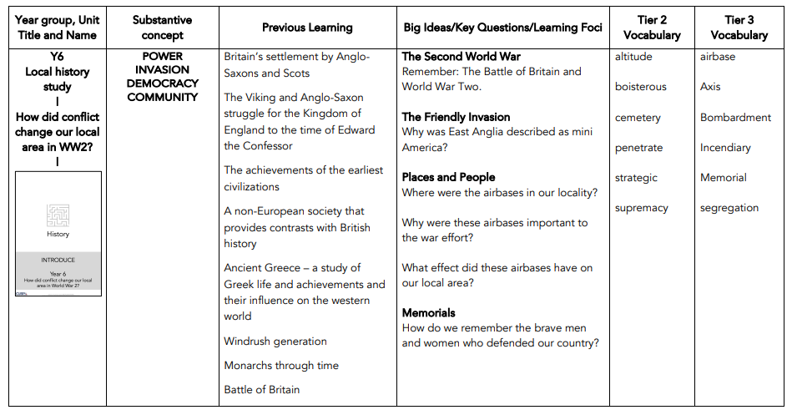
Content and Sequence: Year 6
Year group, Unit Title and Name | Substantive concept | Previous Learning | Big Ideas/Key Questions/Learning Foci | Tier 2 Vocabulary | Tier 3 Vocabulary
Y6 Unit 3 | Local history study | COMMUNITY | Coming soon | Coming soon | Coming soon | Coming soon
Intent

