Slide 1

History
Impact​
Impact

Slide 2
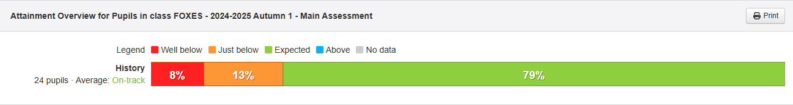
How do we measure the impact of history teaching?
Subject Leaders use insight as an assessment tool for seeing their subject assessment overviews across the school, as seen in this example:
Impact

Slide 3
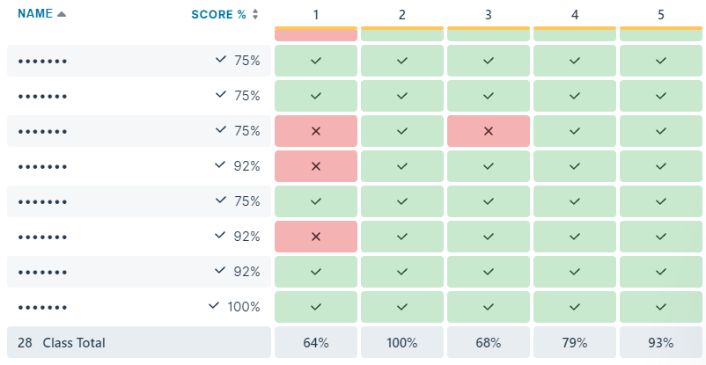
Cumulative quizzing
Pupil end of module results are compared to show how much pupils have gained and retained across the module.
Impact
End of module quizzing

Slide 4
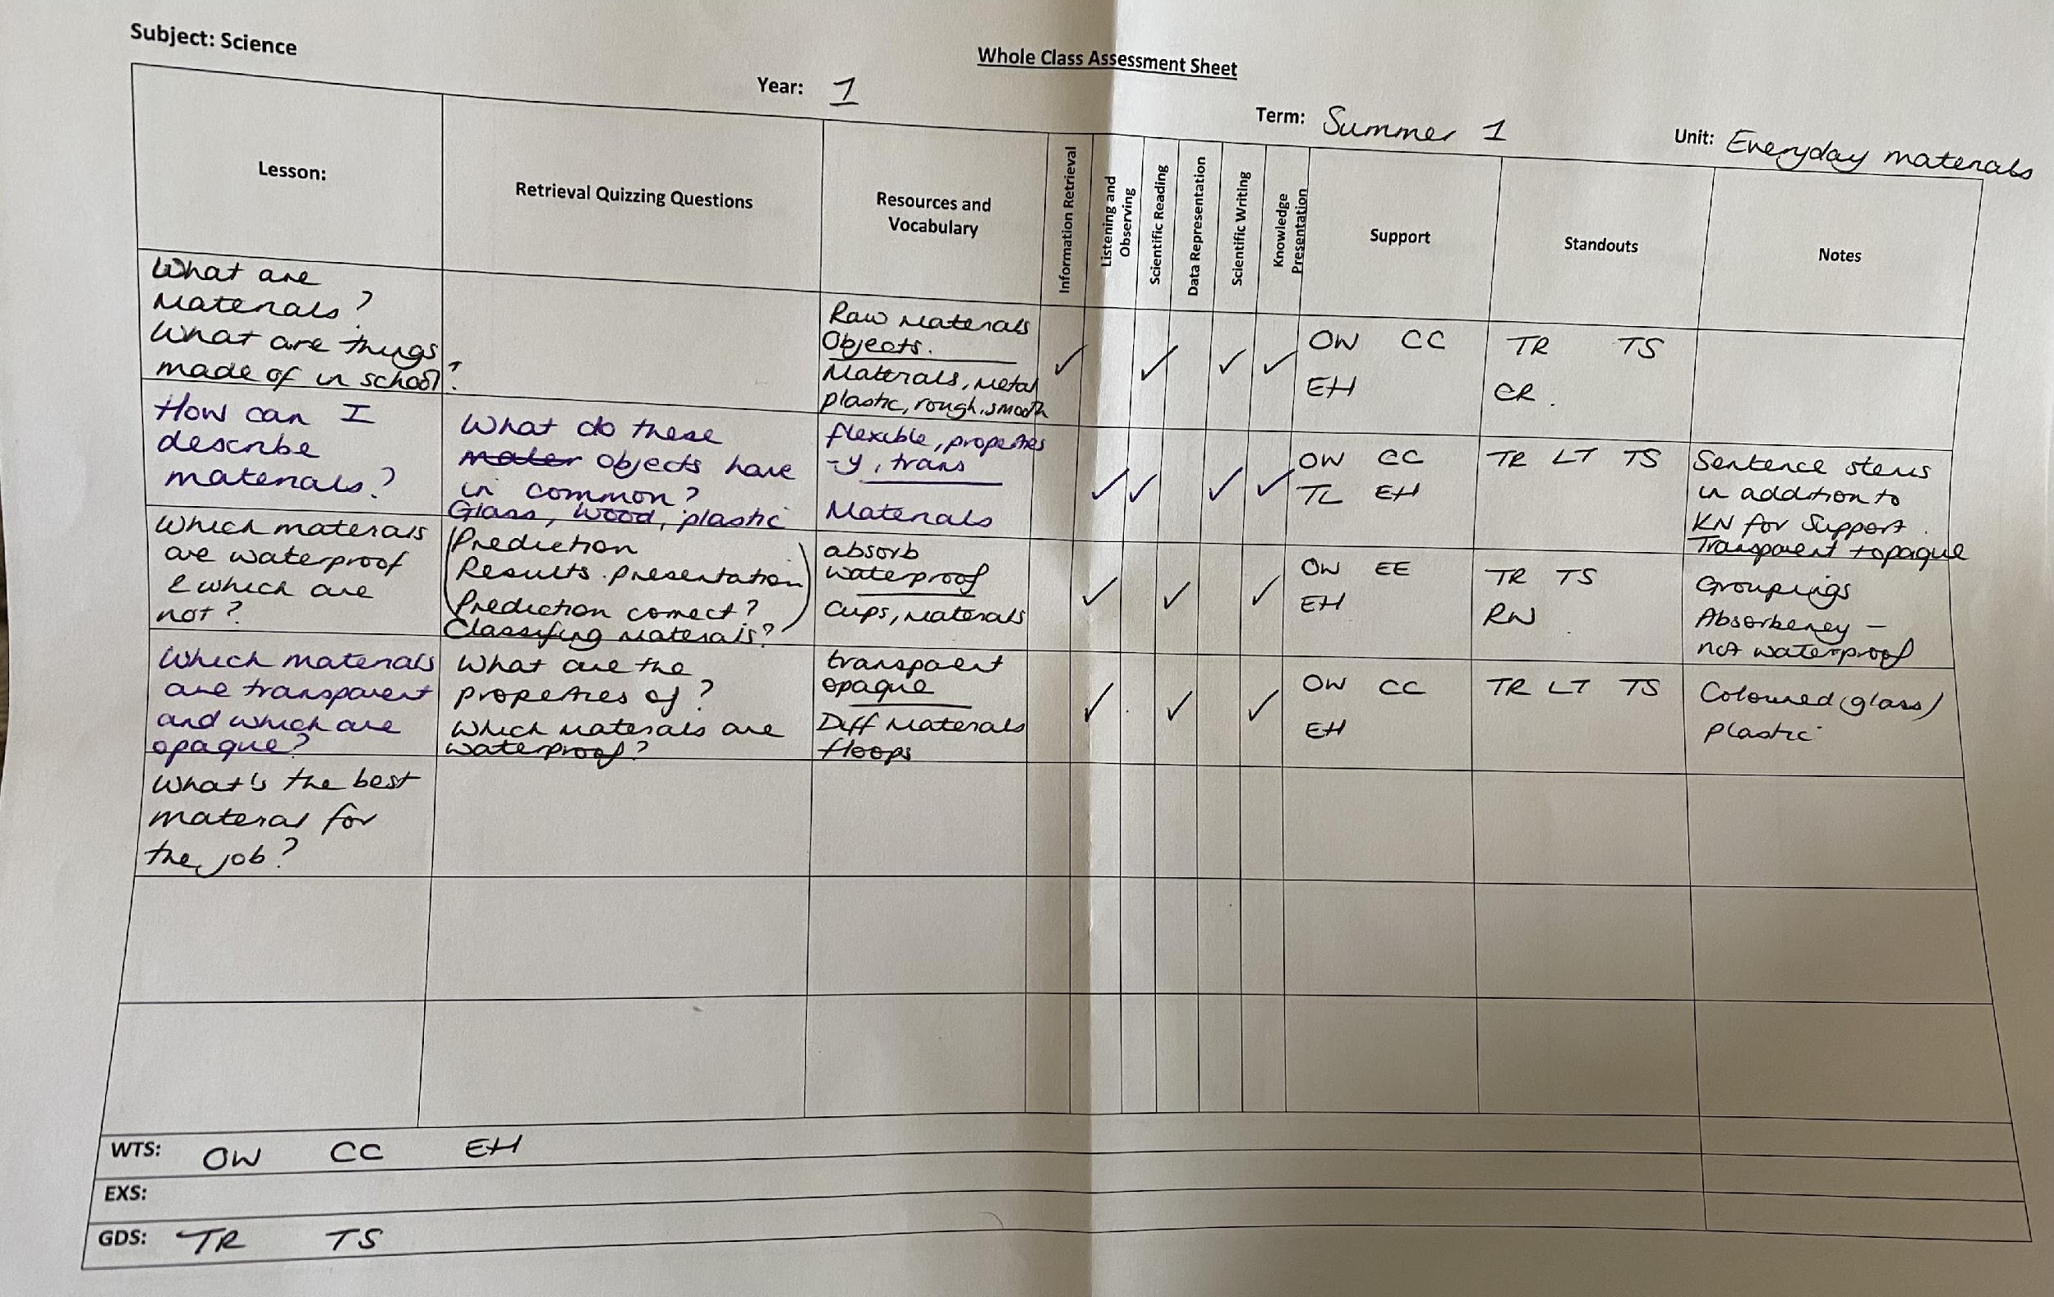
Teacher assessment
Work is regularly assessed through the use of 'Whole Class Feedback Sheets', and pupils are given regular feedback on their successes and development areas within and across modules.
Impact
Ongoing document used by teachers throughout the module. Subsequent lessons are adapted for further retrieval or address misconceptions.

Slide 5
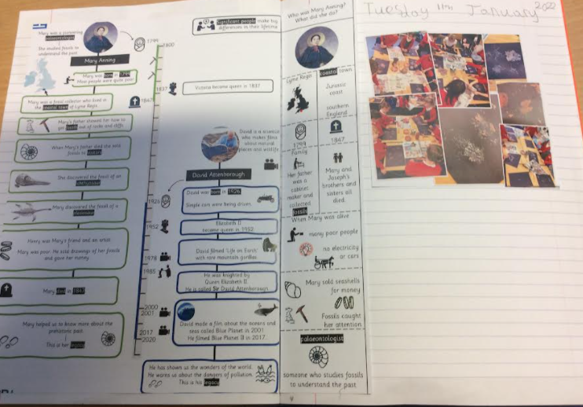
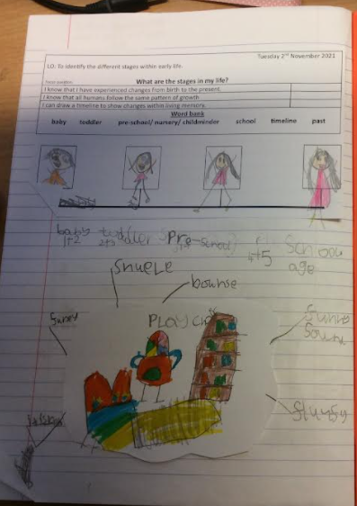
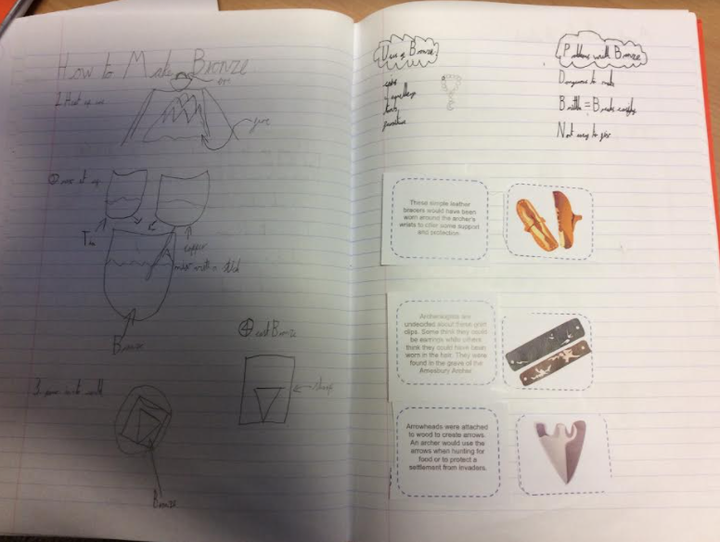
Sequence of learning: Year 1 and 2 examples (Greater Depth)
Impact

Slide 6
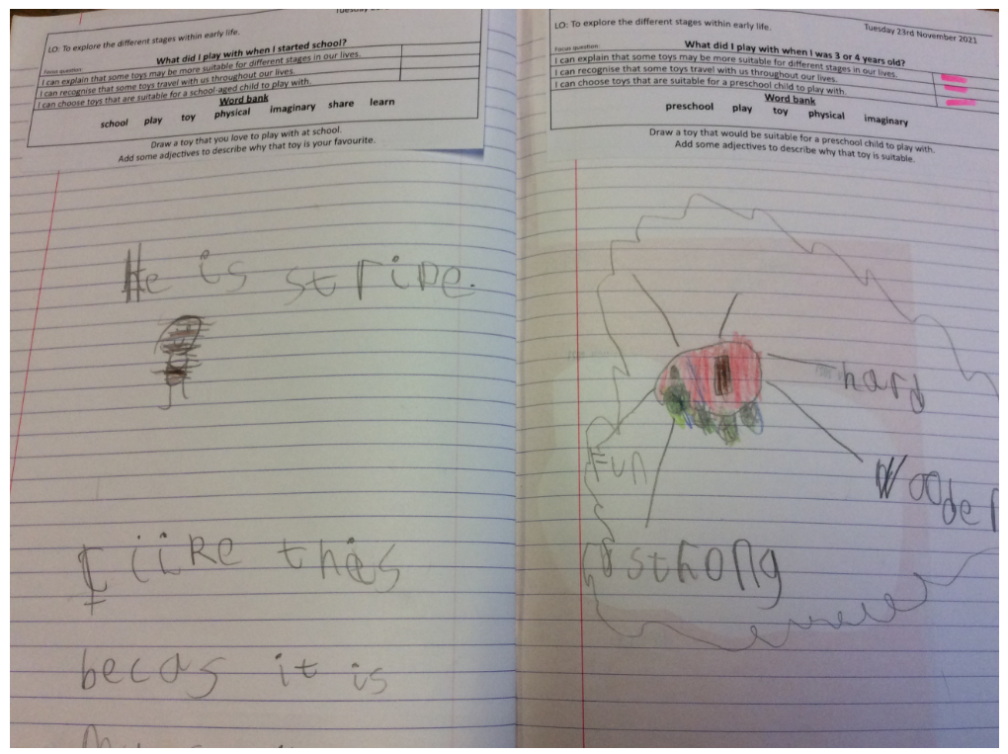
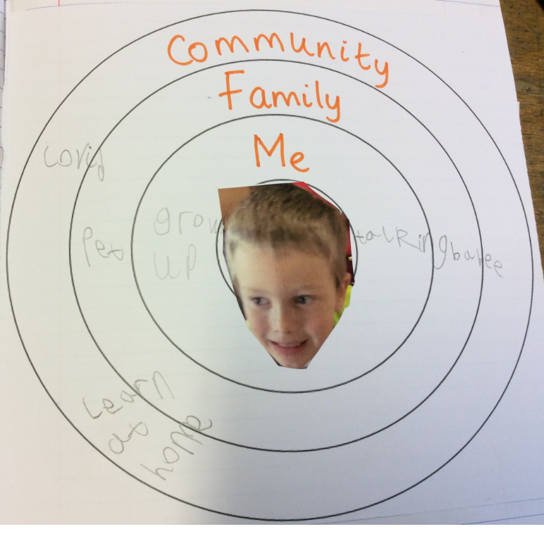
Sequence of learning: Year 1 and 2 examples (Greater Depth)
Impact

Slide 7
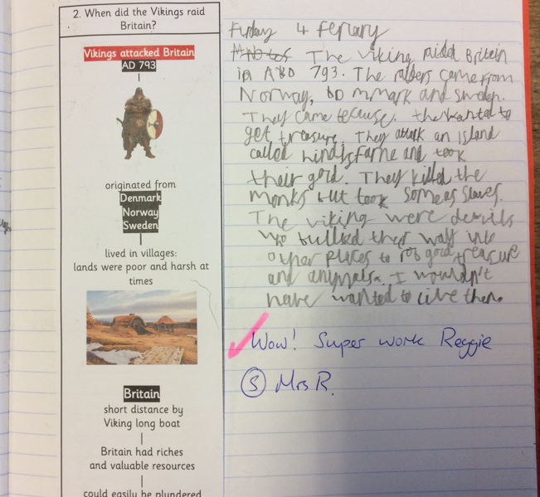
Sequence of learning: Year 4 examples (SEND)
Impact

Slide 8
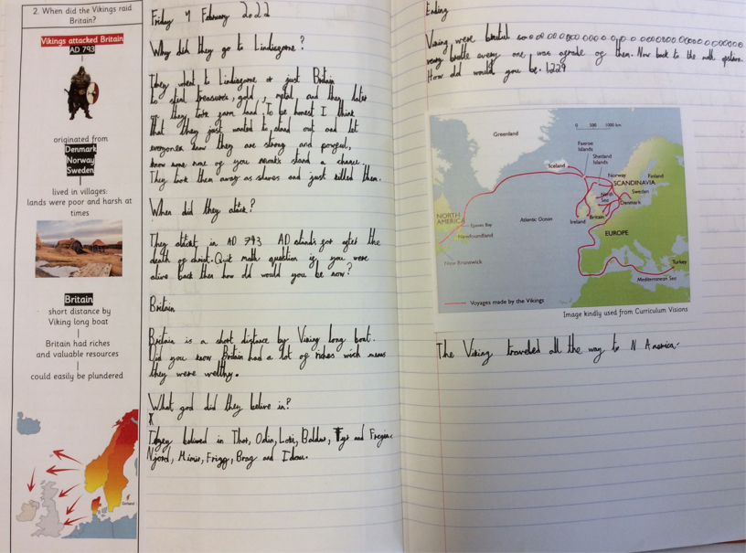
Sequence of learning: Year 4 examples (Expected)
Impact

Slide 9
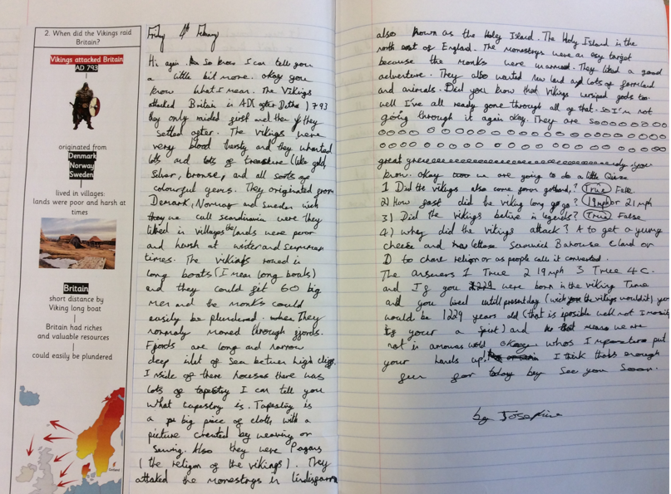
Sequence of learning: Year 4 examples (Greater Depth)
Impact

Slide 10
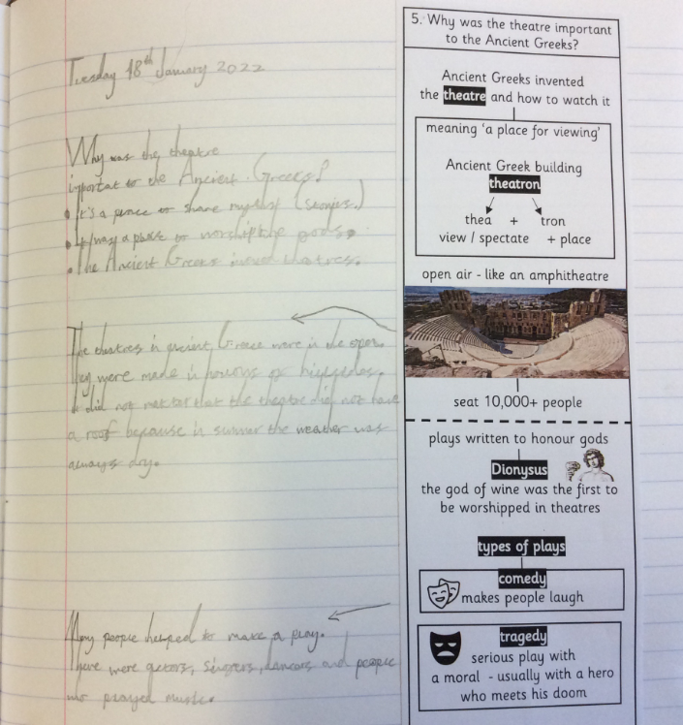
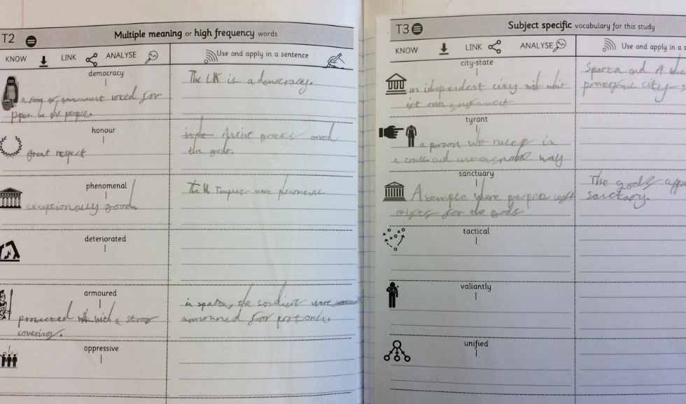
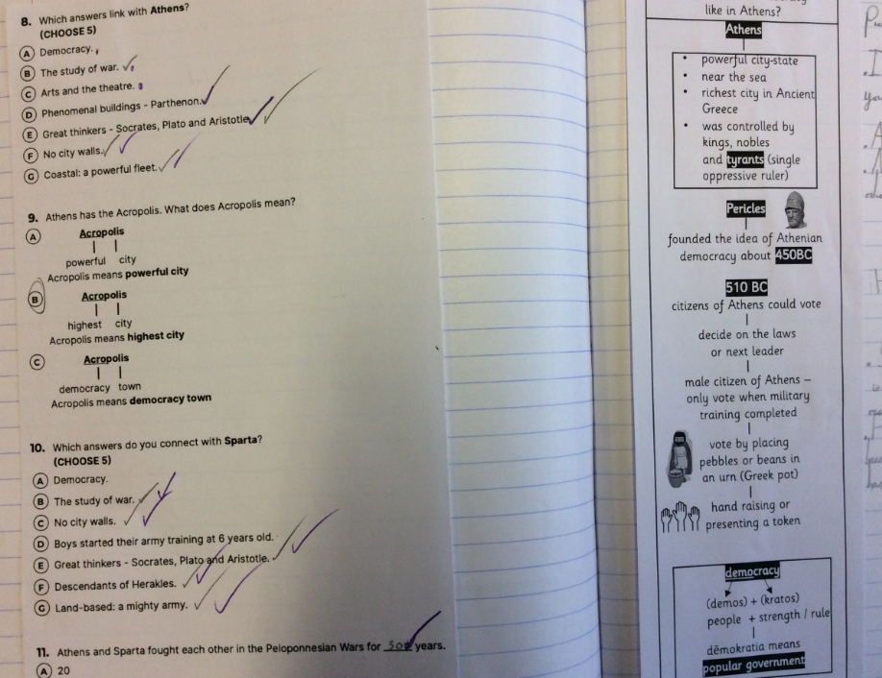
Sequence of learning: Year 5 examples (SEND)
Impact

Slide 11
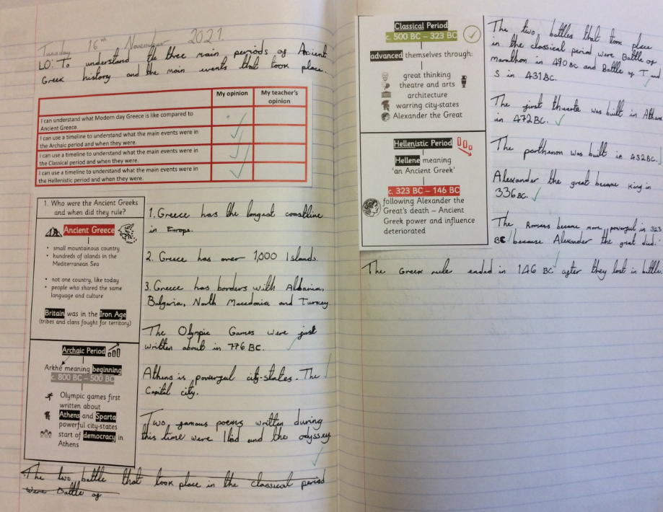
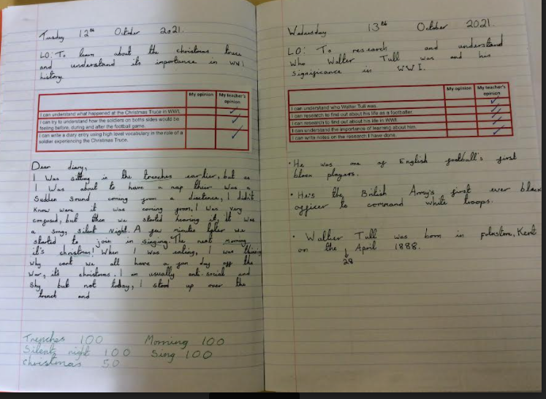
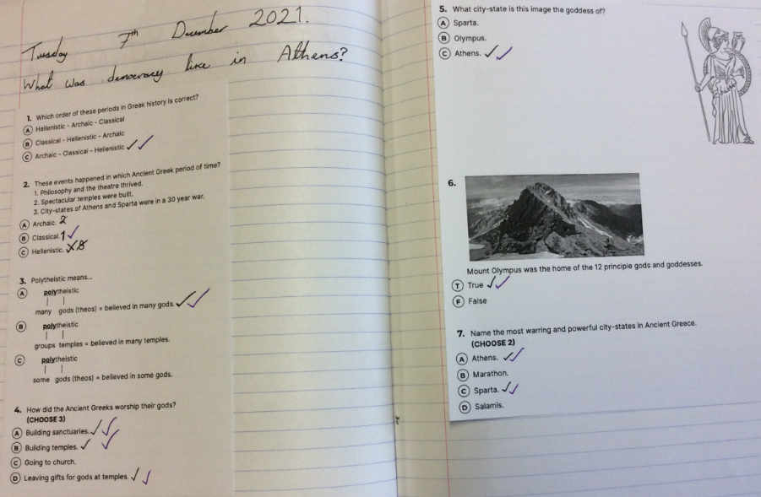
Sequence of learning: Year 5 examples (Average)
Impact

Slide 12
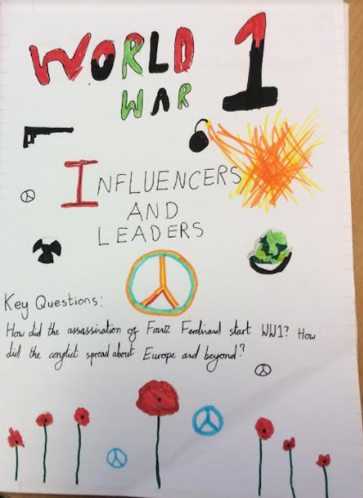
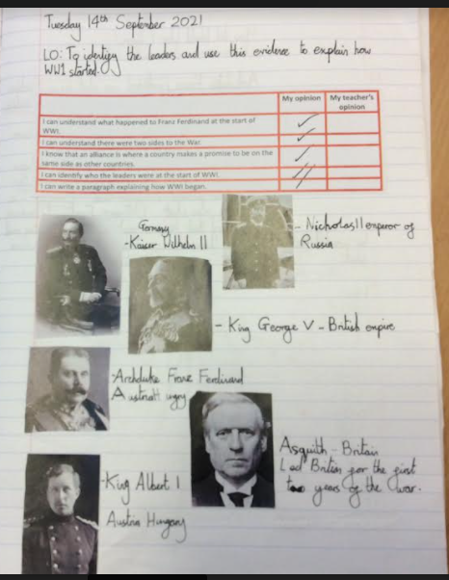
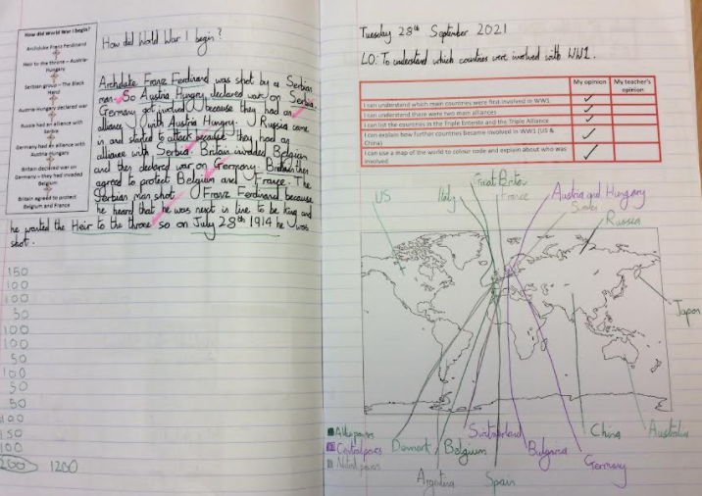
Sequence of learning: Year 5 examples (Greater Depth)
Impact

Slide 13
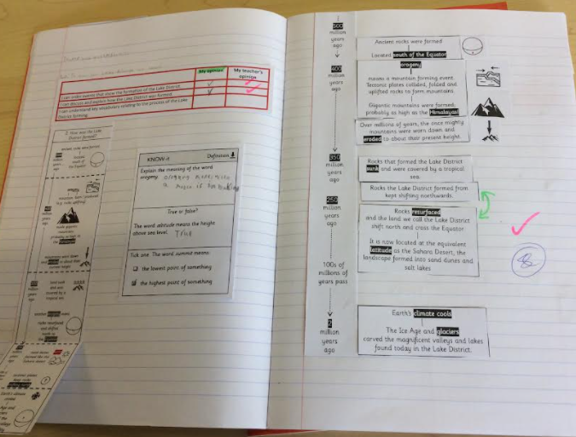
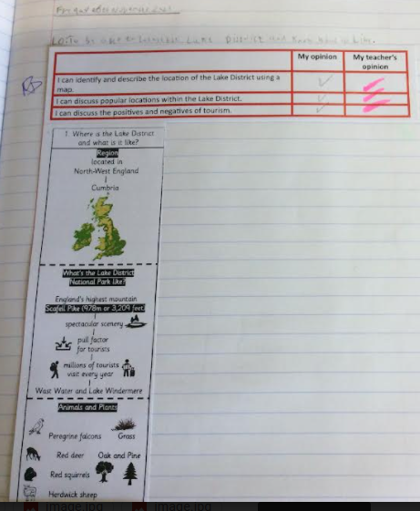
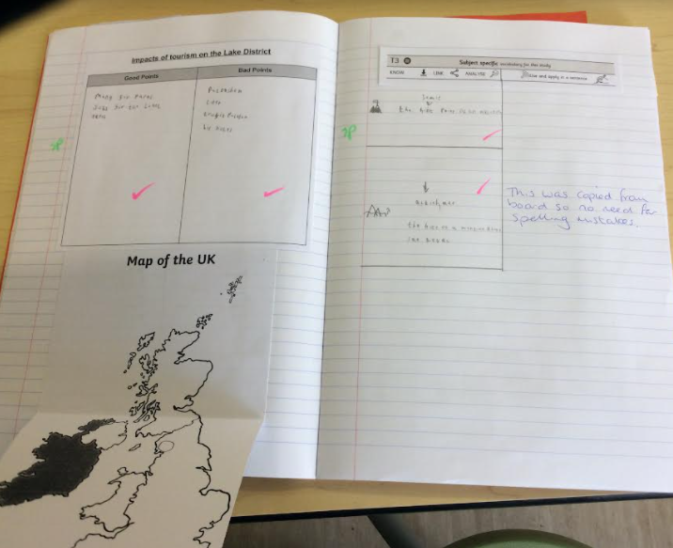
Sequence of learning: Year 6 examples (SEND)
Impact

Slide 14
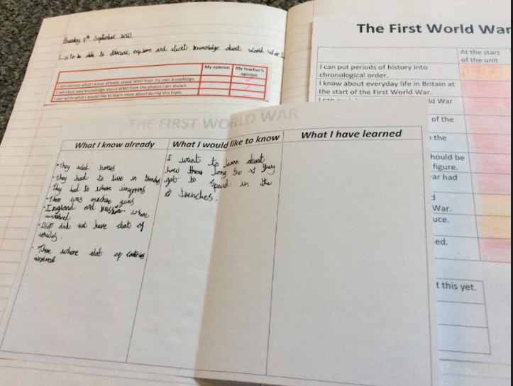
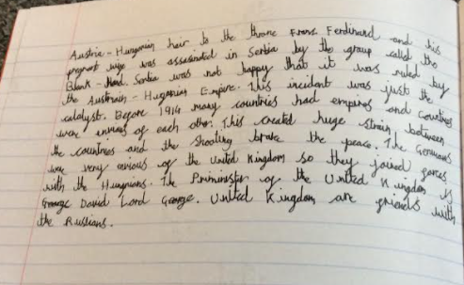
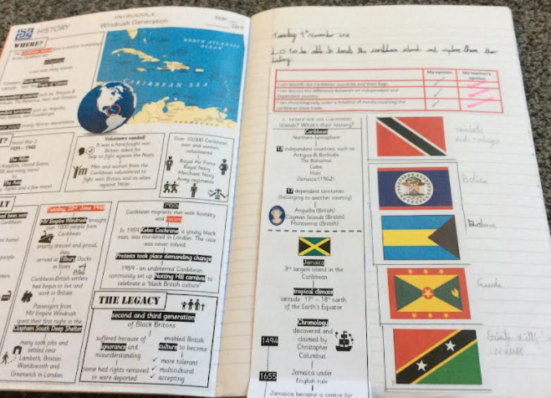
Sequence of learning: Year 6 examples (Expected)
Impact

Slide 15
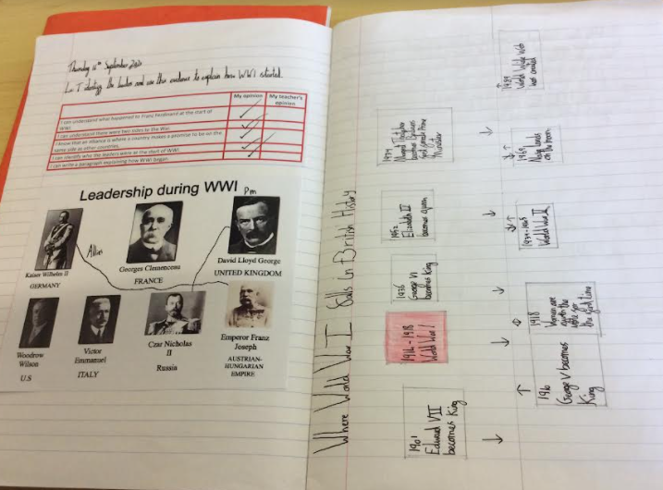
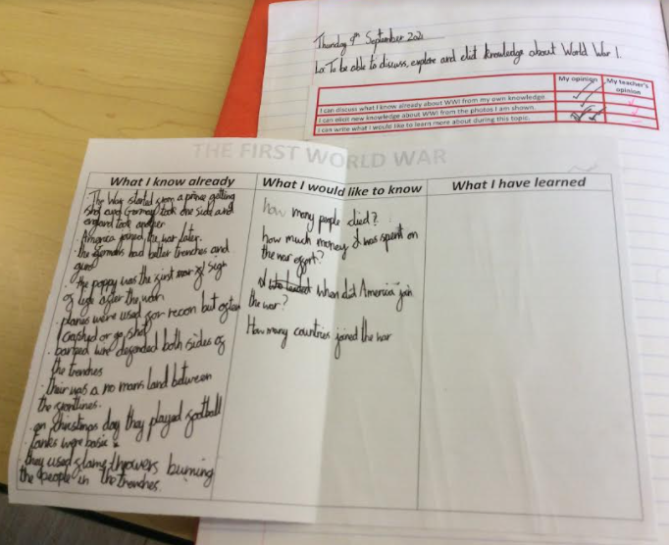
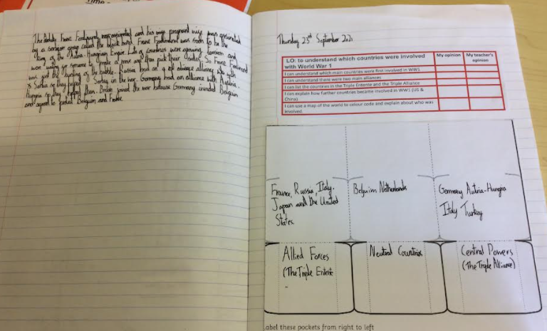
Sequence of learning: Year 6 examples (Greater depth)
Impact

