Slide 1

History
Implementation
Implementation

Slide 2
Development of skills, knowledge and understanding
CUSP History draws upon prior learning, wherever the content is taught. For example, in the EYFS, pupils may learn about the past and present through daily activities, exploring through change, and understanding more about the lives of others through books and visitors as well as their own experiences. These experiences are drawn upon and used to position new learning in KS1.
The structure is built around the principles of advancing cumulative knowledge, chronology, change through cause and consequence, as well as making connections within and throughout periods of time studied.
CUSP History is planned so that the retention of knowledge is much more than just ‘in the moment knowledge’. The cumulative nature of the curriculum is made memorable by the implementation of Bjork’s desirable difficulties, including retrieval and spaced retrieval practice, word building and deliberate practice tasks. This powerful interrelationship between structure and research-led practice is designed to increase substantive knowledge and accelerate learning within and between study modules. That means the foundational knowledge of the curriculum is positioned to ease the load on the working memory: new content is connected to prior learning. The effect of this cumulative model supports opportunities for children to associate and connect with significant periods of time, people, places and events.
CUSP History strategically incorporates a range of modules that revisit, elaborate and sophisticate key concepts, events, people and places.
A guiding principle of CUSP History is that pupils become ‘more expert’ with each study and grow an ever broadening and coherent mental timeline. This guards against superficial, disconnected and fragmented understanding of the past. Specific and associated historical vocabulary is planned sequentially and cumulatively from Y1 to Y6. High frequency, multiple meaning words (Tier 2) are taught alongside and help make sense of subject specific words (Tier 3). Each learning module in history has a vocabulary module with teacher guidance, tasks and resources.
Implementation

Slide 3
Modular Approach – Knowledge
At Barnham CEVCP, History is taught across each year group in modules that enable pupils to study in depth and to develop key understanding, skills and vocabulary. Each module aims to activate and build upon prior learning, including EYFS, to ensure better cognition and retention. Each module is carefully sequenced to enable pupils to purposefully layer learning from previous sessions to facilitate the acquisition and retention of key skills and knowledge. Each module is revisited either later in the year or in the following year as part of a spaced retrieval practice method to ensure pupils retain key knowledge and information.
Implementation

Slide 4
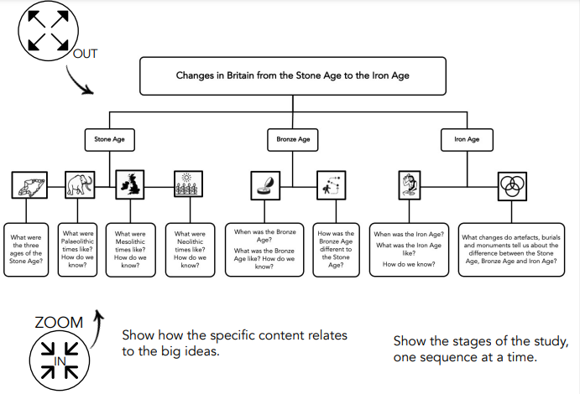
The Big Ideas
At Barnham, we put an emphasis on sharing the big ideas with the children at the beginning of every module.
Implementation

Slide 5
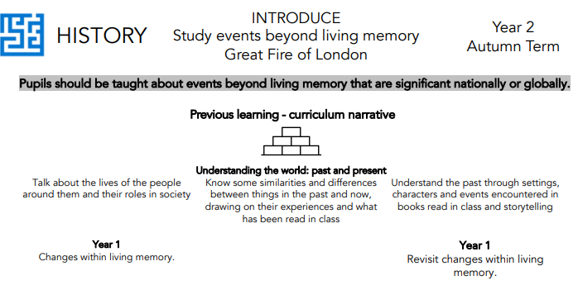

National Curriculum History objectives and how these links to prior learning are evident at the beginning of every module.
A Year 2 module showing how the module builds on prior learning in Year 1.
Implementation
A Year 6 module building on prior learning in Year 4 and 5.

Slide 6
Cumulative Quizzing Model (Supporting Cognitive Load)
Pupils are given opportunities to retrieve their knowledge at regular intervals throughout the unit through a 'teach – test – teach – test' model. The aim of this model is to reinforce and revisit previously taught knowledge and vocabulary. In Years 2 and 3, children are tested using written quizzes. 'Socrative' is used to facilitate this model of testing in Years 4 – 6 via pupil iPads.
Implementation

Slide 7
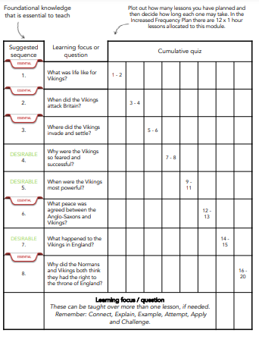
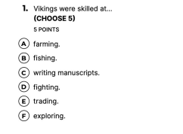
Cumulative Quizzing Model (Supporting Cognitive Load)
Sample of module sequence and cumulative quizzing overview
Example questions
Implementation

Slide 8
Minimum lesson expectations
All history lessons will incorporate the following elements:
Explicit teaching of vocabulary
Revisiting of prior learning
Use of specific vocabulary in learning
Reading
Evidence of learning in pupil's books
Implementation

Slide 9
Vocabulary
EYFS
At Barnham CEVCP, we want our children to have an expansive vocabulary and through teacher modelling and planning, children are given opportunity to use and apply appropriate vocabulary. Language is developed with vocabulary being a focus. This is also encouraged through outdoor learning, real-life learning opportunities and having visitors in school.
Implementation

Slide 10
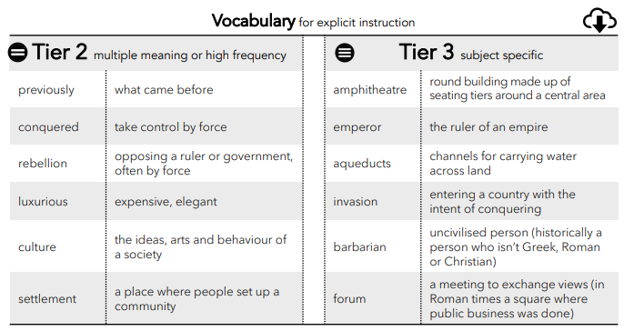
Vocabulary modules in Years 1 - 6
Vocabulary instruction is at the heart of the curriculum and subject specific words are incorporated in each module.
An example of ocabulary to be taught as part of a Year 3 module on the Roman Empire.
Implementation

Slide 11
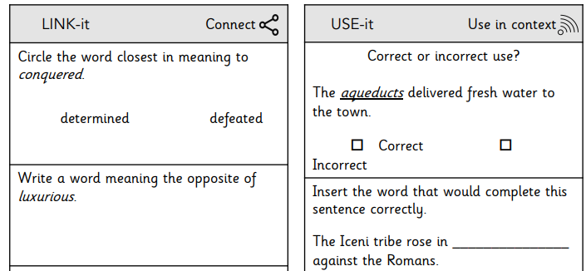
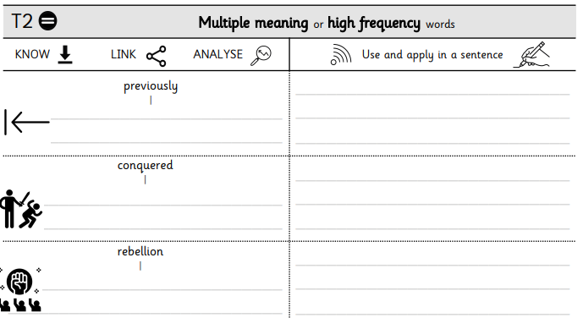
Explicit teaching of vocabulary
Children use and apply taught vocabulary
Implementation
Use of dual coding

Slide 12
Use of vocabulary within a Year x lesson
Paste book example here
Implementation

Slide 13
Knowledge organisers and Knowledge Notes
Accompanying each module is a Knowledge Organiser which contains key vocabulary, information and concepts which all pupils are expected to understand and retain. Knowledge notes are the elaboration and detail which help pupils acquire the content of each module. They support vocabulary and concept acquisition through a well-structured sequence that is cumulative. Each Knowledge Note begins with questions that link back to the cumulative quizzing, focussing on key content to be learnt and understood. Knowledge Organisers and Knowledge Notes are dual coded to provide pupils with visual calls to aid understanding and recall. Knowledge Organisers and Knowledge Notes are referenced throughout each module. In addition, pupils can access at home learning platforms that are used in school e.g. Curriculum Visions.
Implementation

Slide 14
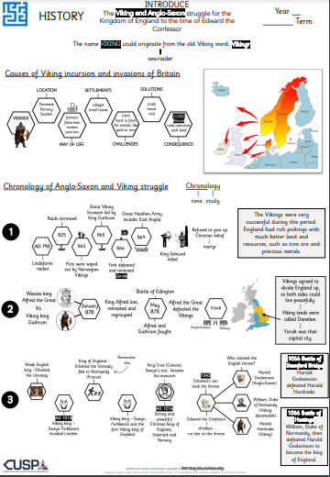
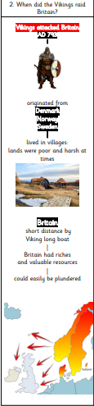
Knowledge organisers and Knowledge Notes
Year 4 Knowledge Organiser
Implementation
Accompanying Year 4 Knowledge Note

Slide 15
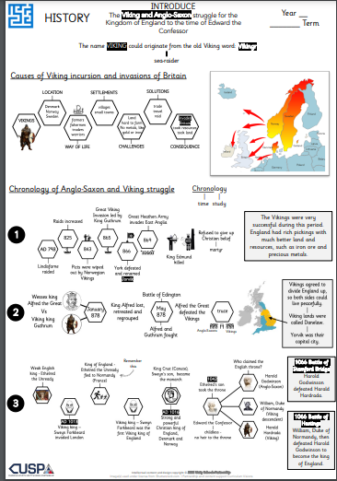
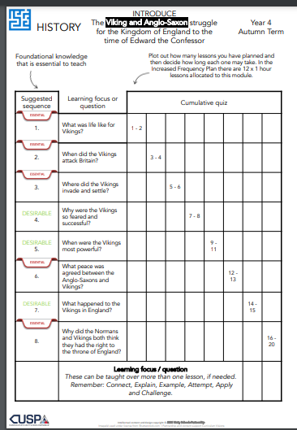

Planning using CUSP materials
Lesson planning is completed with the use our suggested lesson sequence, in conjunction with prior quizzing and content from the Knowledge Organisers.
Implementation

Slide 16
Tailoring for SEND
At Barnham CEVC we aim for all science lessons and learning questions to be accessible to all pupils. Pre-teaching of scientific vocabulary provides all children with the opportunity to demonstrate an understanding of subject specific language. The use of dual coded Knowledge Notes and Organisers provide visuals to aid understanding and recall. In addition, knowledge notes are utilised in all lessons to minimise cognitive overload, so children can use and apply their knowledge more easily. Sentence stems can be used where necessary to aid with written evidence.
Implementation

Slide 17

Reading
Our History curriculum is supported by a wealth of high quality texts which support pupil’s learning and develop their skills in accessing information from a range of sources. Unity Schools Partnership are working closely with, ‘Curriculum Visions,’ to ensure that our subject content has materials that can be accessed by pupils both in school and at home.
Implementation

Slide 18
Oracy
When discussing their findings or presenting information, pupils are encouraged to speak using full sentences and incorporating sunject specific vocabulary. This is modelled by teachers e.g. using my turn, your turn.
Writing
Pupils are expected to write across all areas of the curriculum with teachers modelling how to write purposefully in each subject.
Implementation

