Slide 1

Geography
Impact​
Impact

Slide 2
How do we measure the impact of geography teaching?
Subject Leaders use insight as an assessment tool for seeing their subject assessment overviews across the school, as seen in this example:
Impact

Slide 3
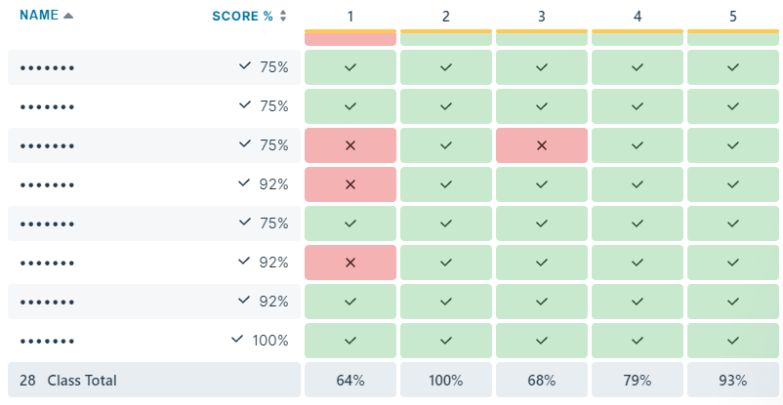
Cumulative quizzing
Pupil end of module results are compared to show how much pupils have gained and retained across the module.
Impact
End of module quizzing

Slide 4
Pupil book study
What we do and what it shows and how we use it for CPD
Impact

Slide 5
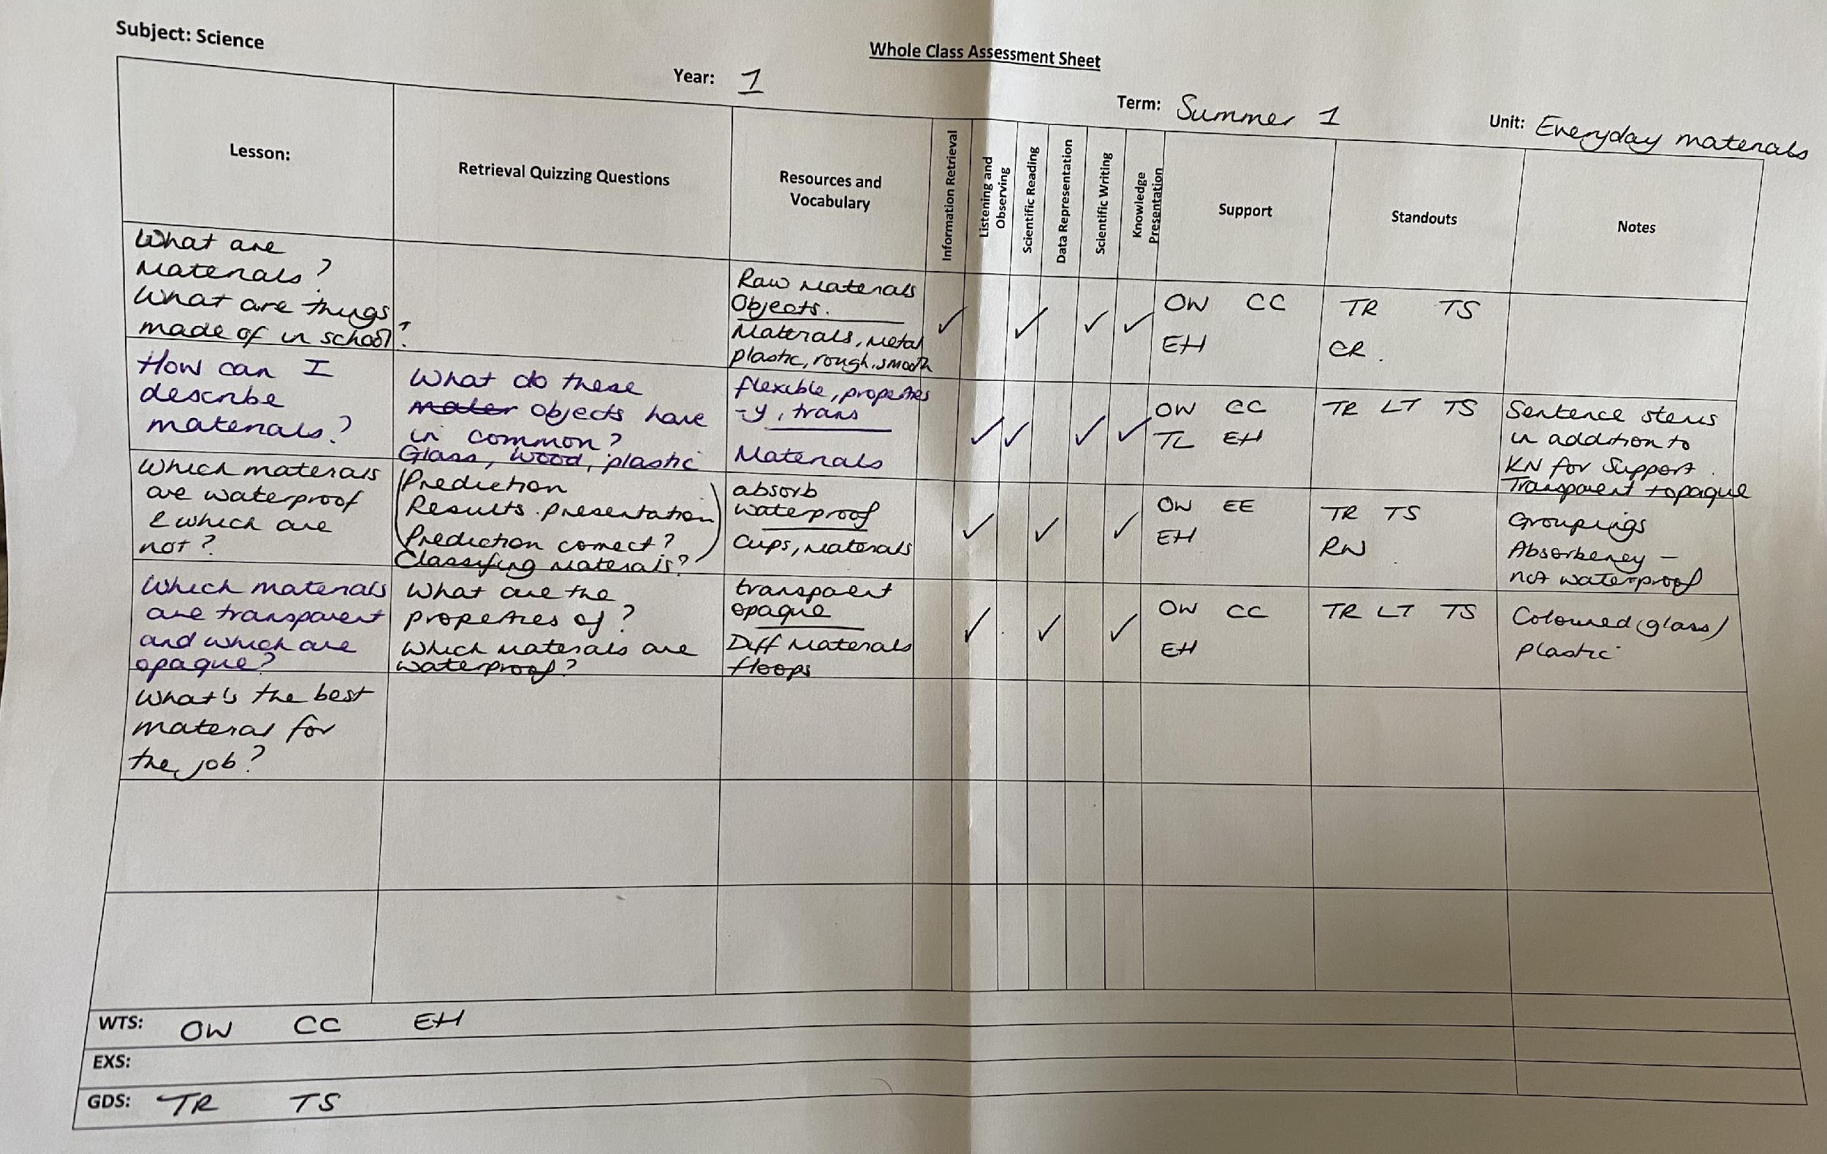
Teacher assessment
Work is regularly assessed through the use of 'Whole Class Feedback Sheets', and pupils are given regular feedback on their successes and development areas within and across modules.
Add our own feedback examples
Impact
Ongoing document used by teachers throughout the module. Subsequent lessons are adapted for further retrieval or address misconceptions.

Slide 6
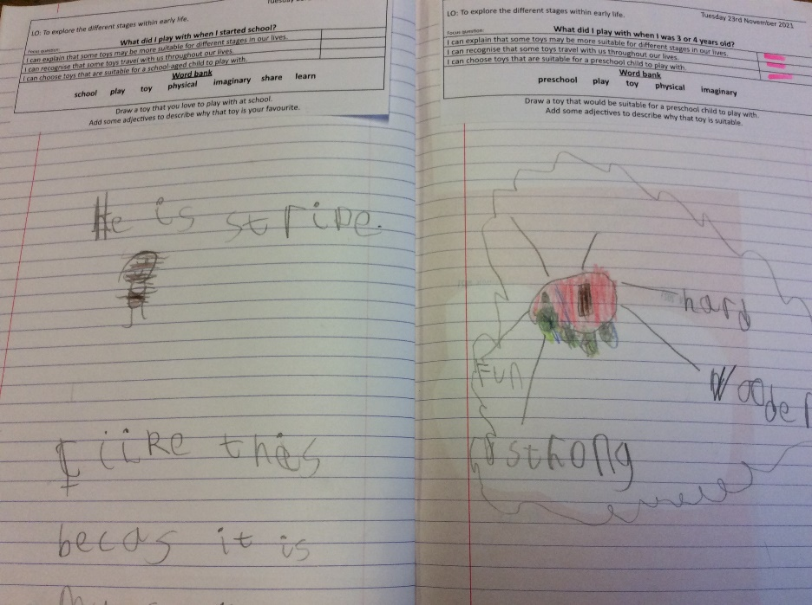
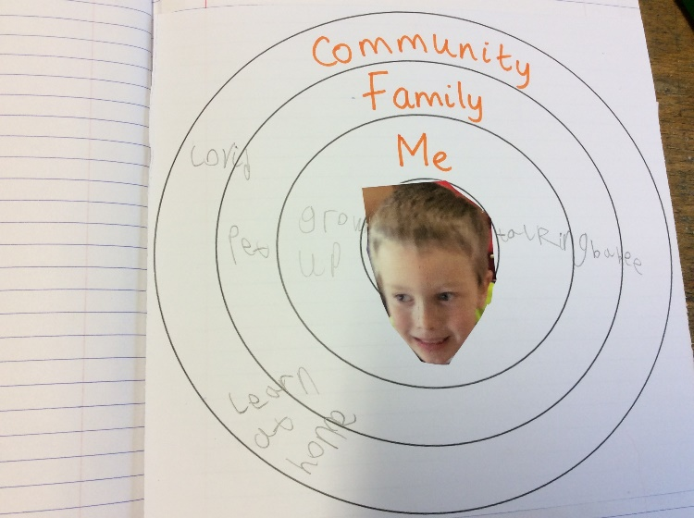
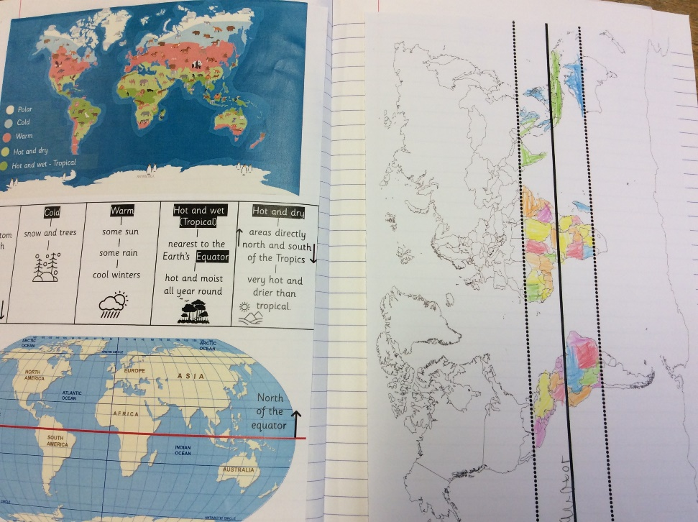
Sequence of learning Year 1 (SEN)
Impact

Slide 7
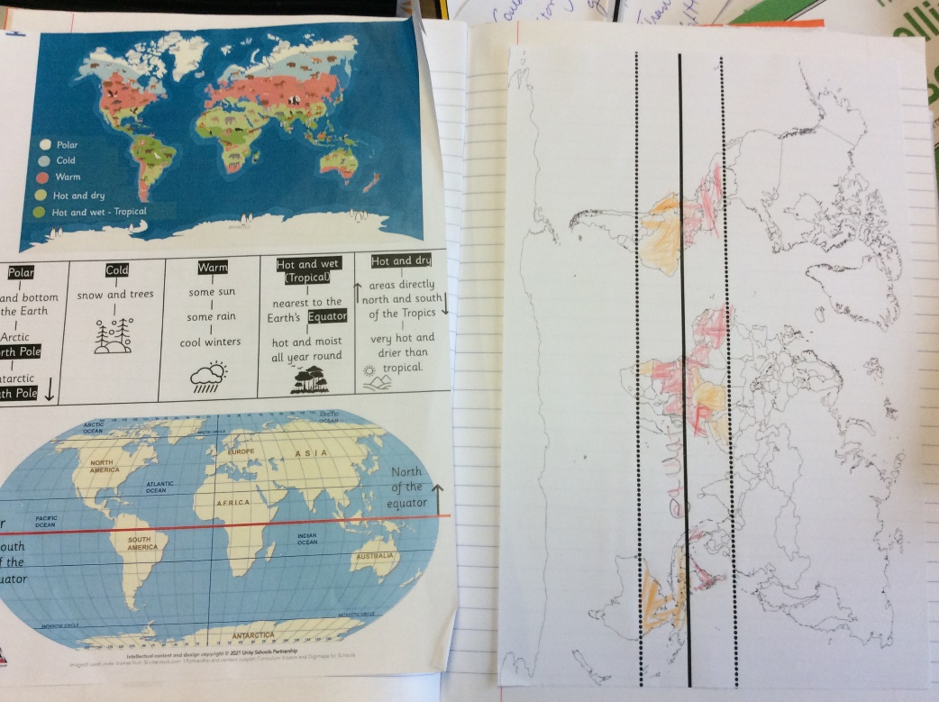
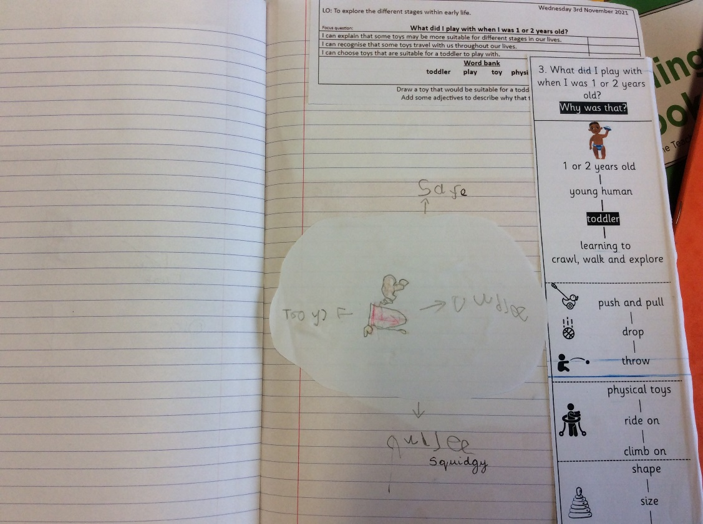
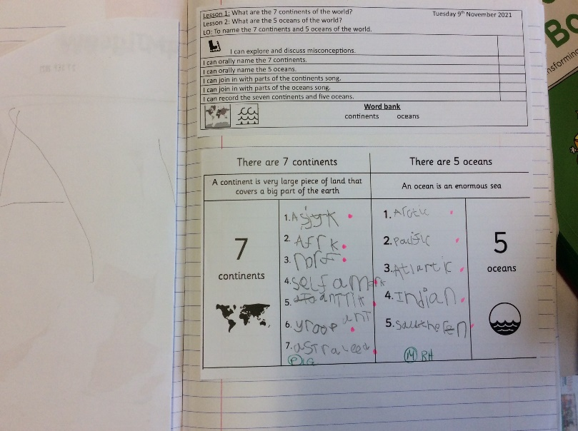
Sequence of learning Year 1 (Expected)
Impact

Slide 8
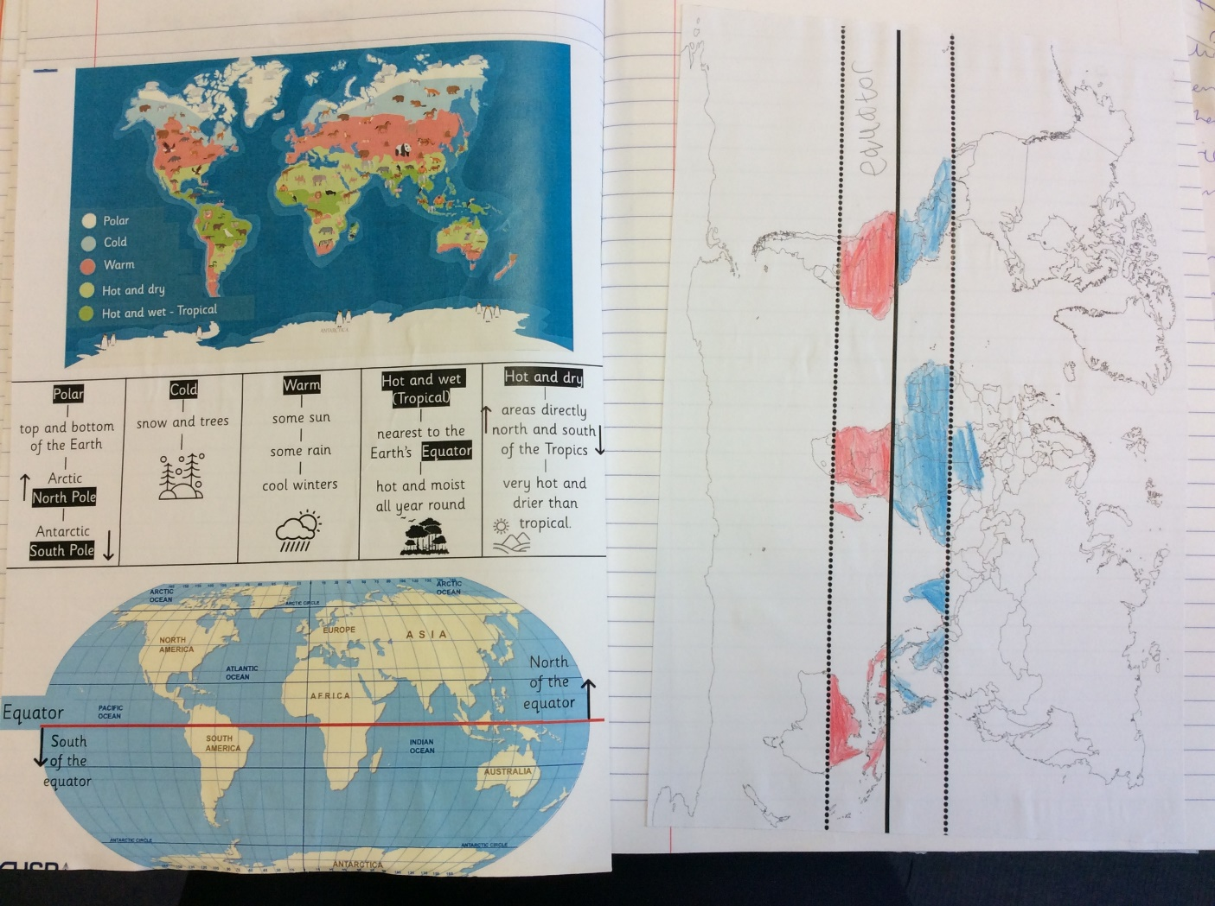
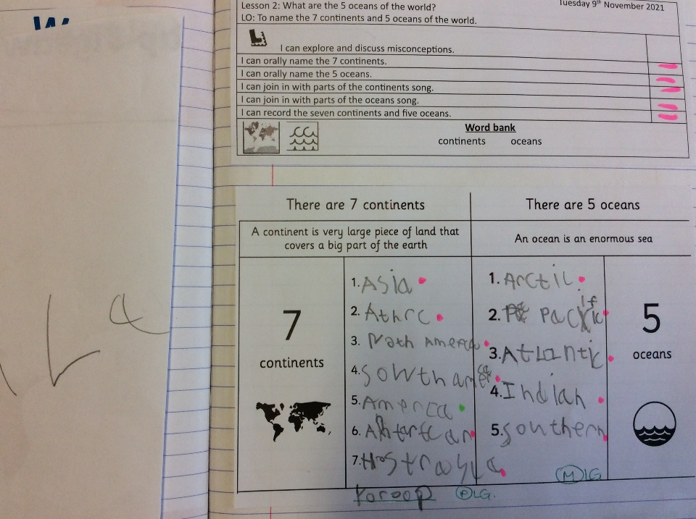
Sequence of learning Year 1 (Greater Depth)
Impact

Slide 9
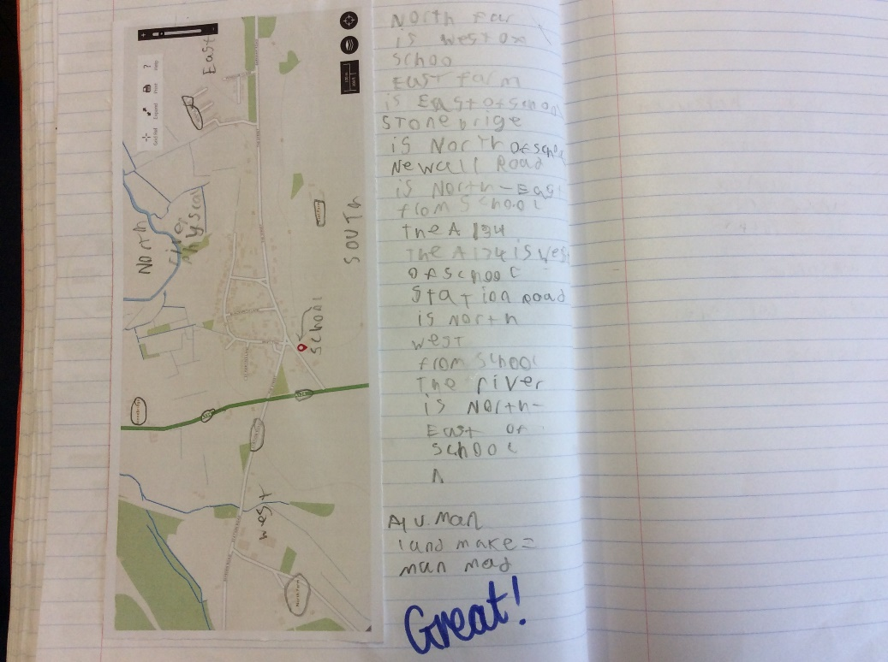
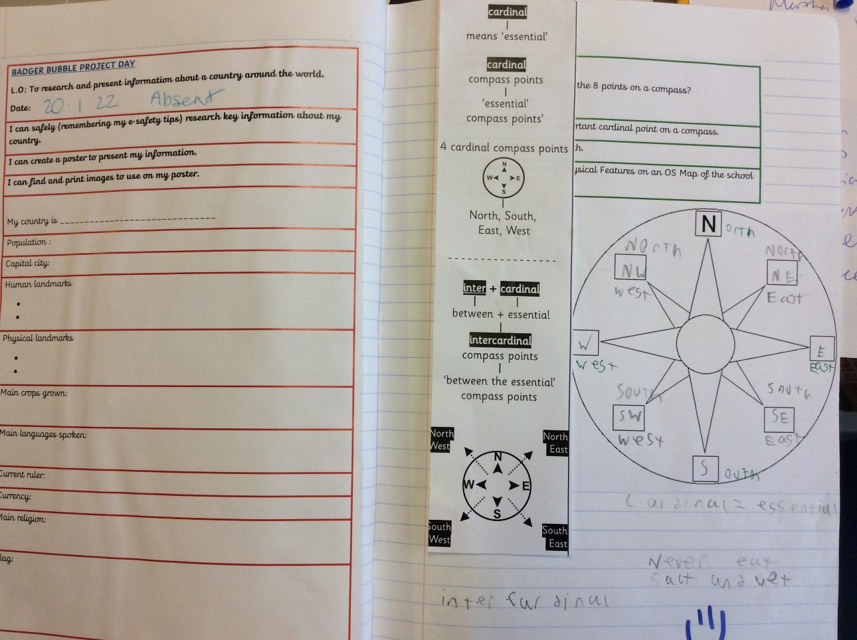
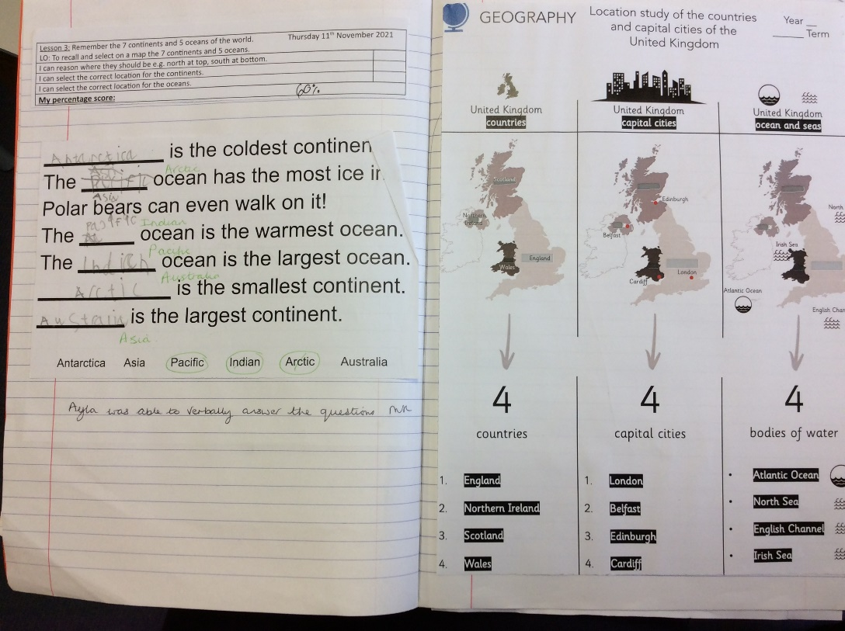
Sequence of learning Year 2 (SEN)
Impact

Slide 10

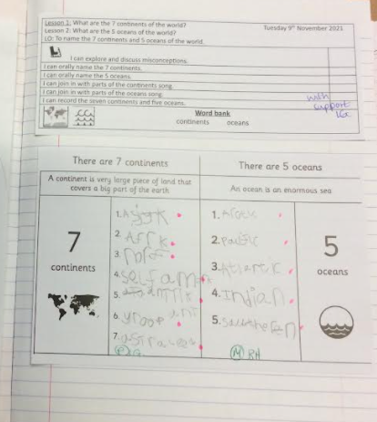
Sequence of learning Year 2 (Expected)
Impact

Slide 11
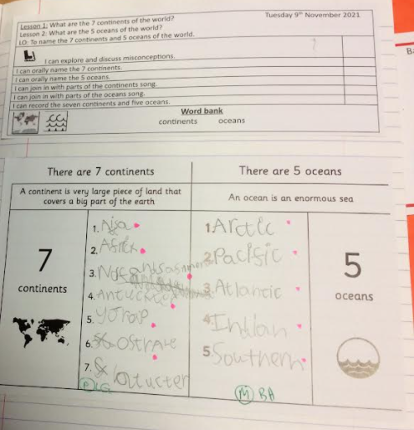
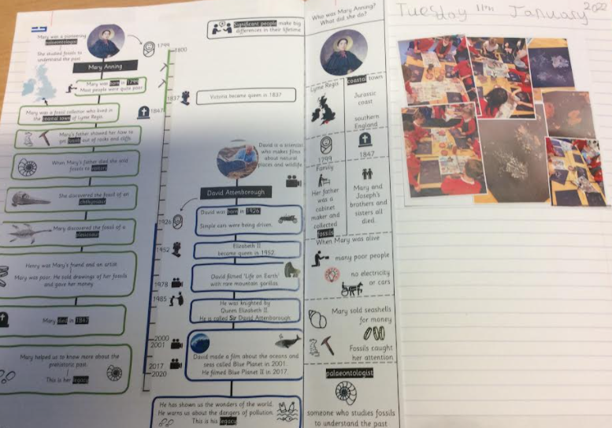
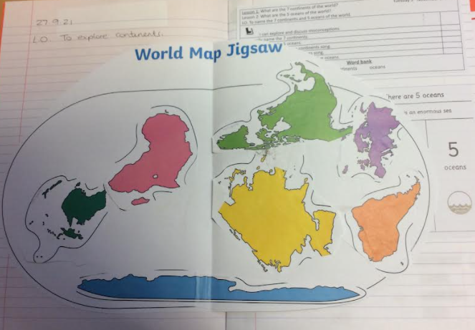
Sequence of learning Year 2 (Greater Depth)
Impact

Slide 12
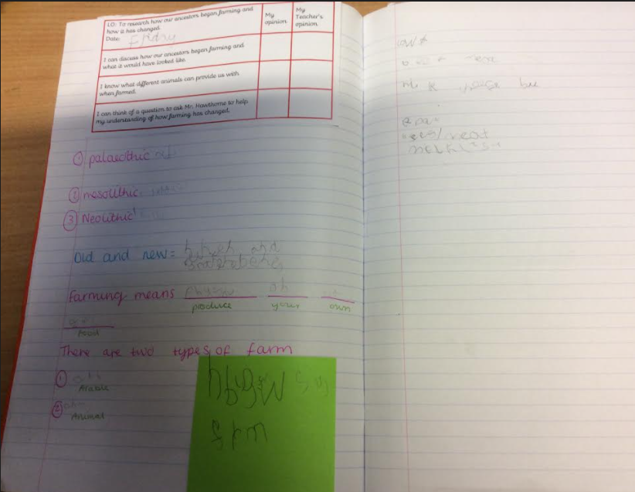
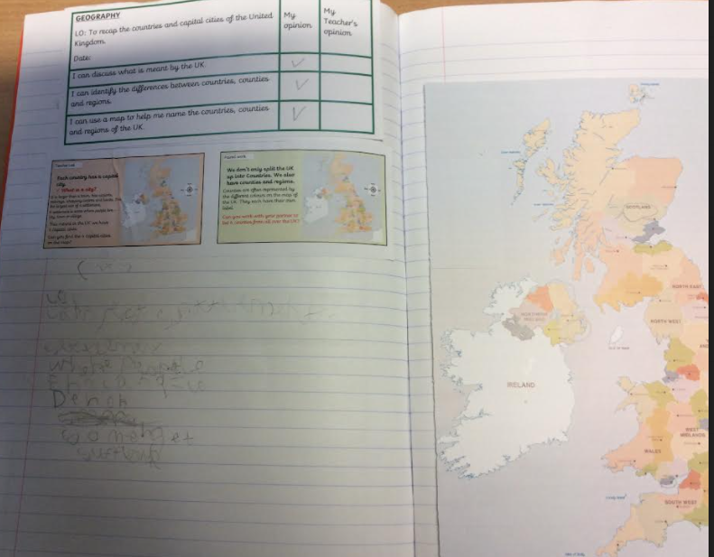
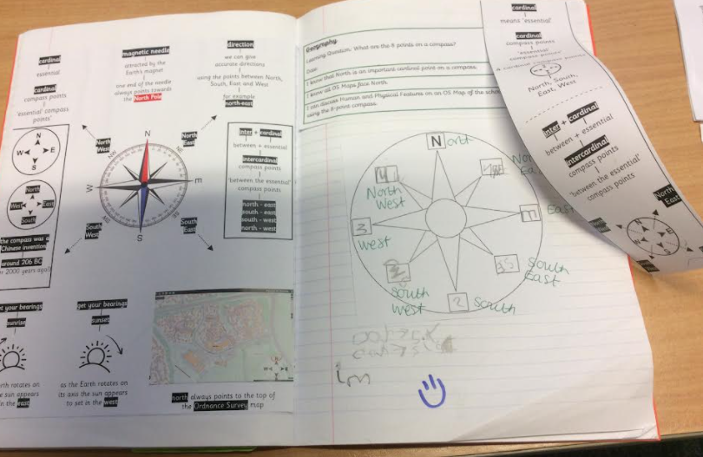
Sequence of learning Year 3 (SEN)
Impact

Slide 13
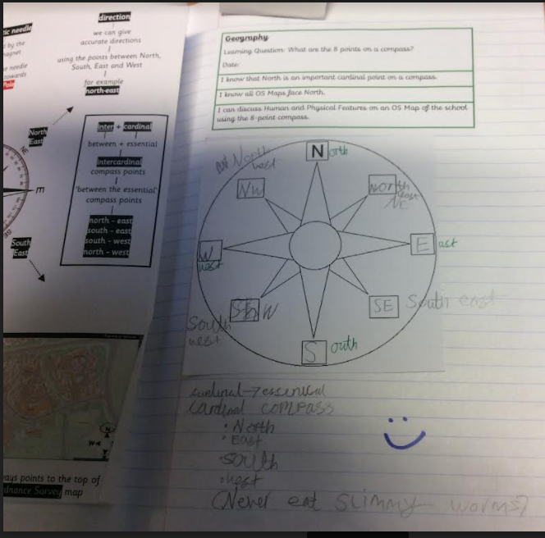
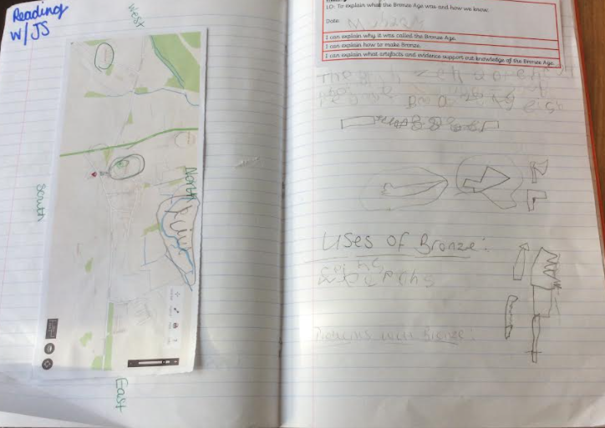
Sequence of learning Year 3 (Expected)
Impact

Slide 14
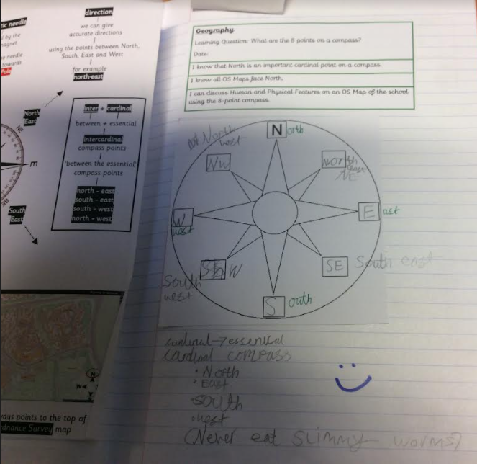
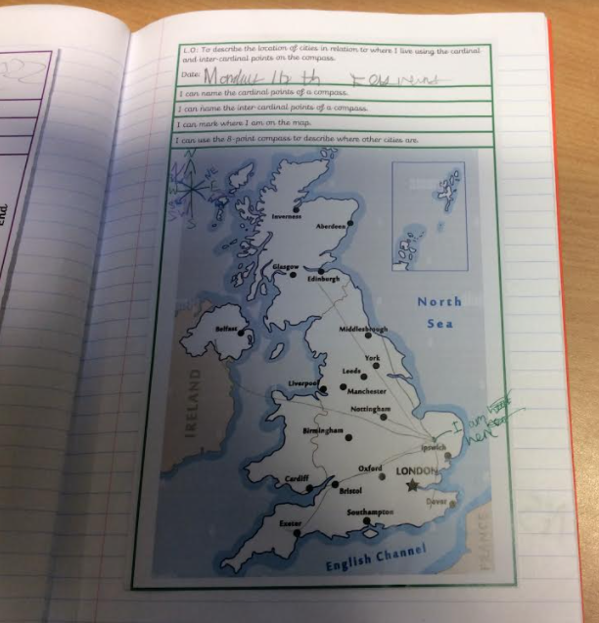
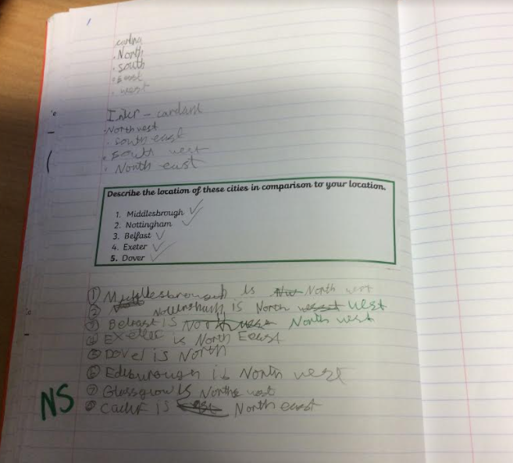
Sequence of learning Year 3 (Greater Depth)
Impact

Slide 15
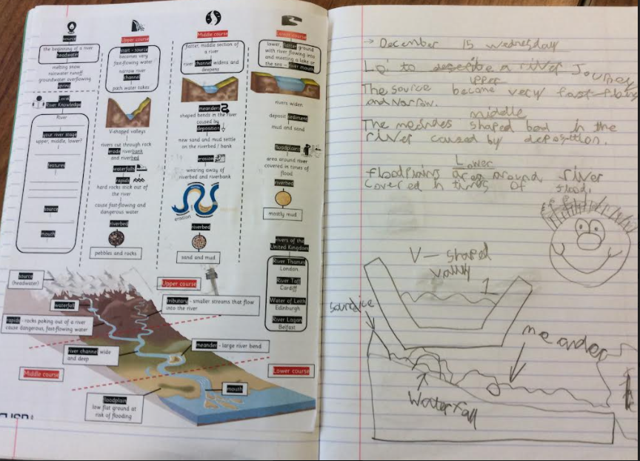
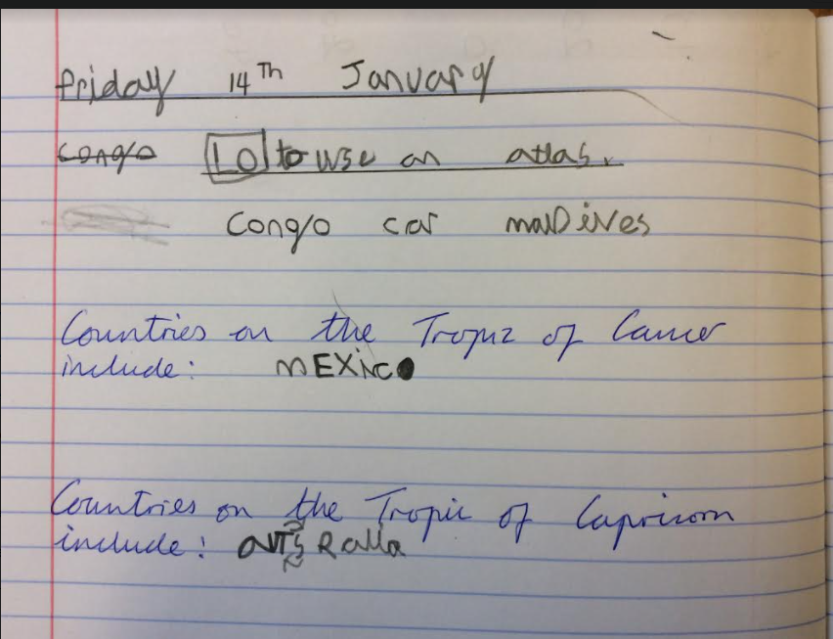
Sequence of learning Year 4 (SEN)
Impact

Slide 16
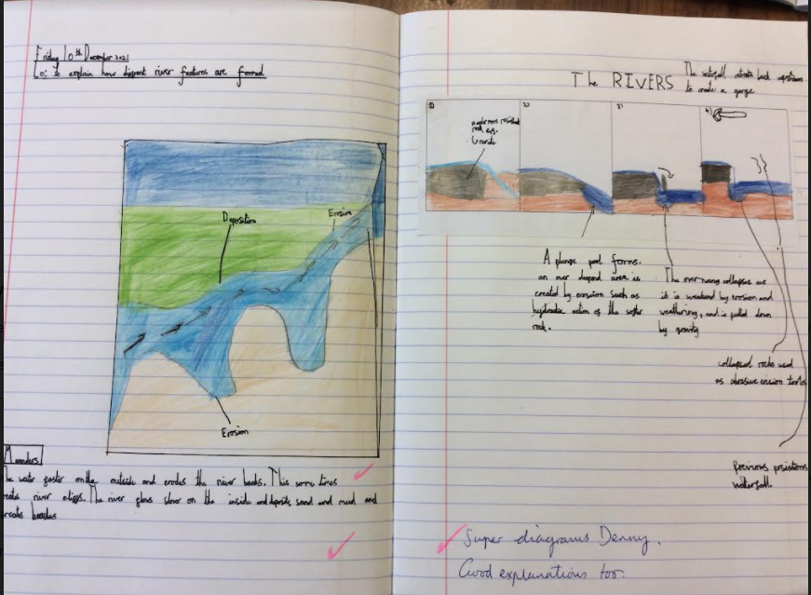
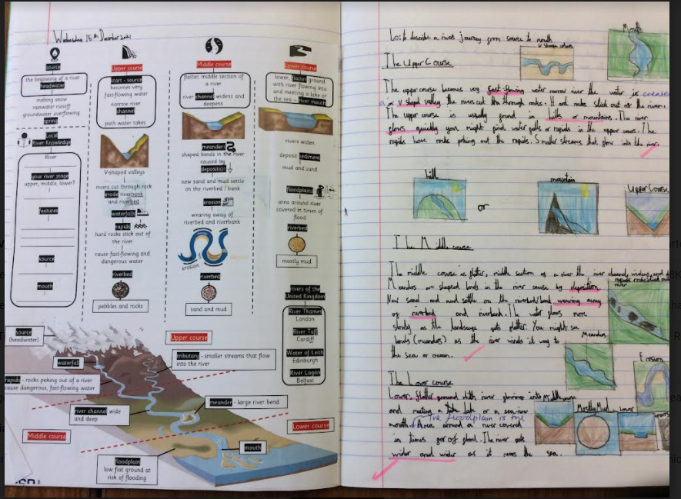
Sequence of learning Year 4 (Expected)
Impact

Slide 17
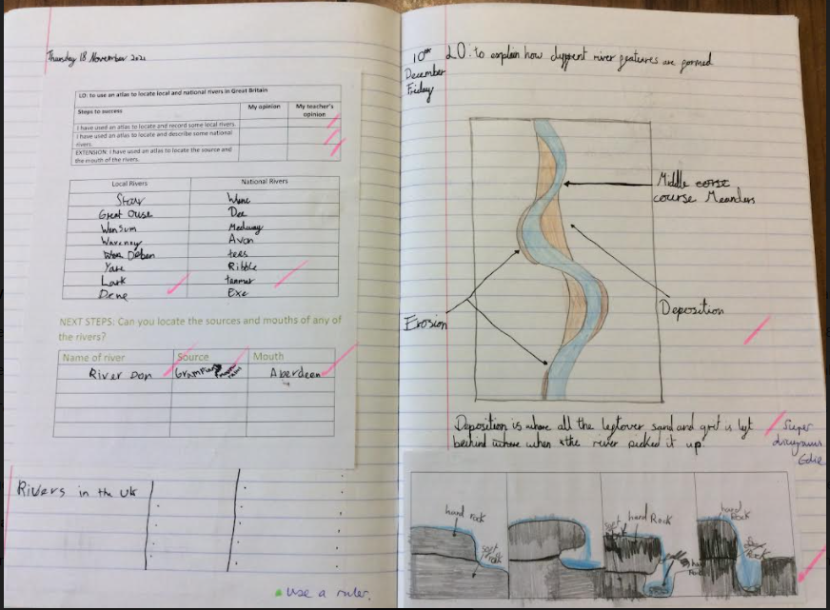
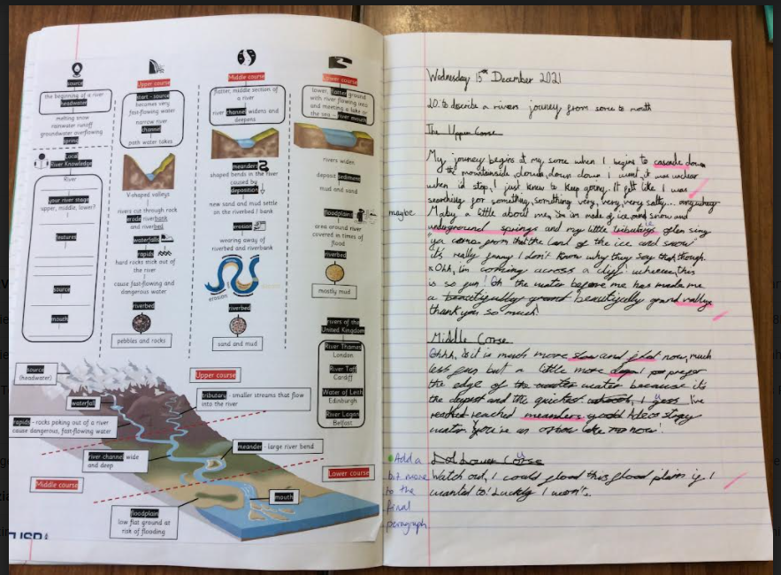
Sequence of learning Year 4 (Greater Depth)
Impact

Slide 18
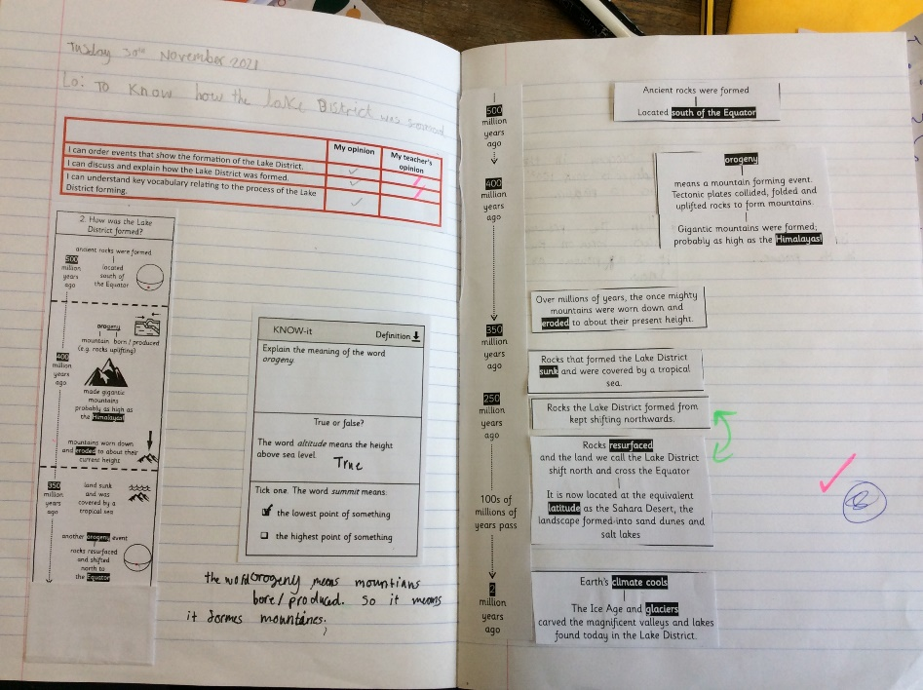
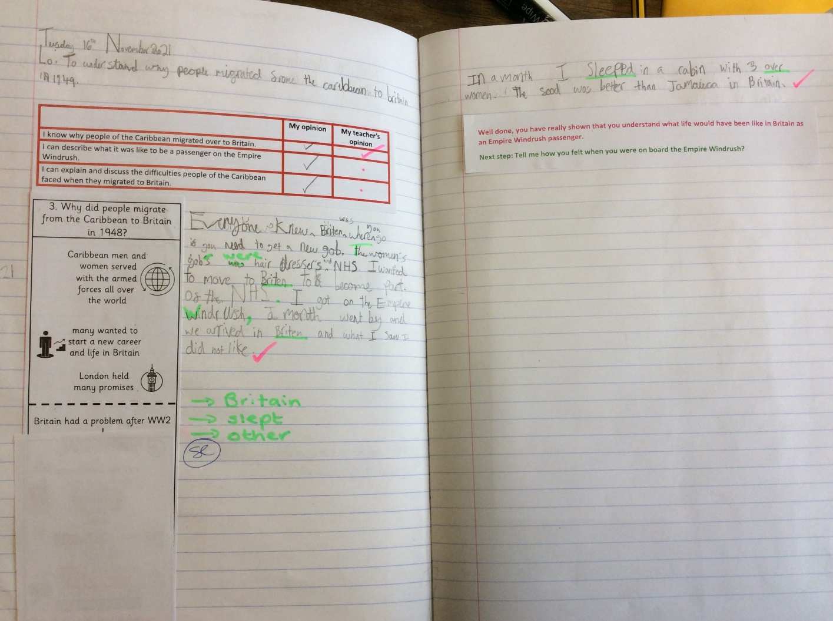
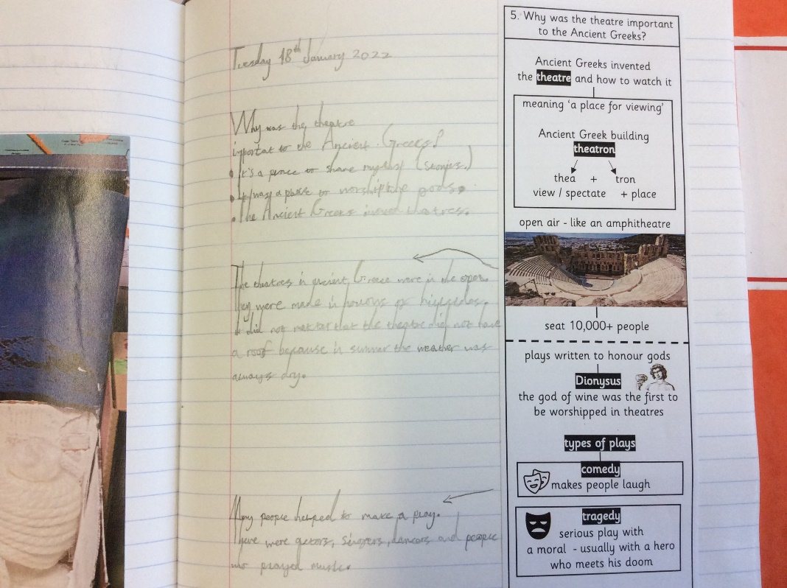
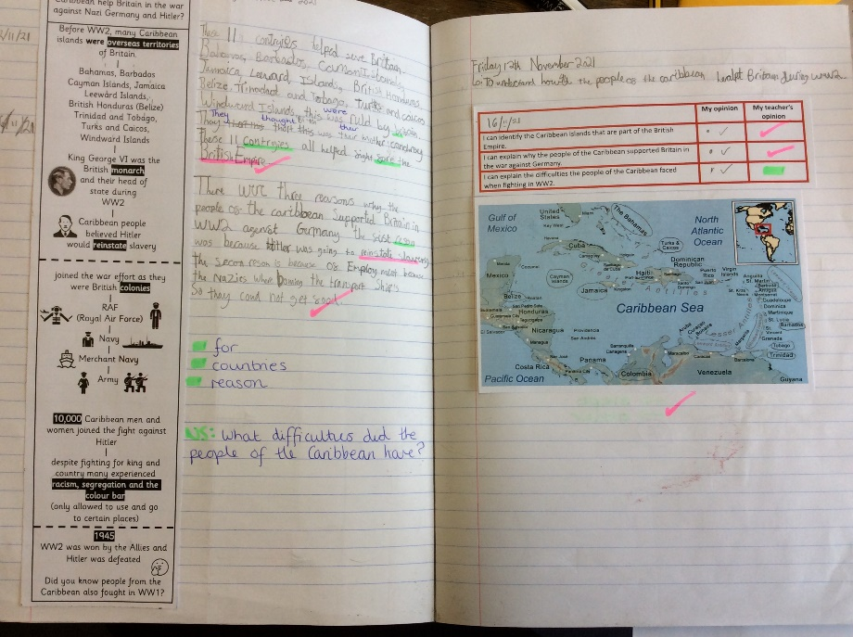
Sequence of learning Year 5 (SEN)
Impact

Slide 19
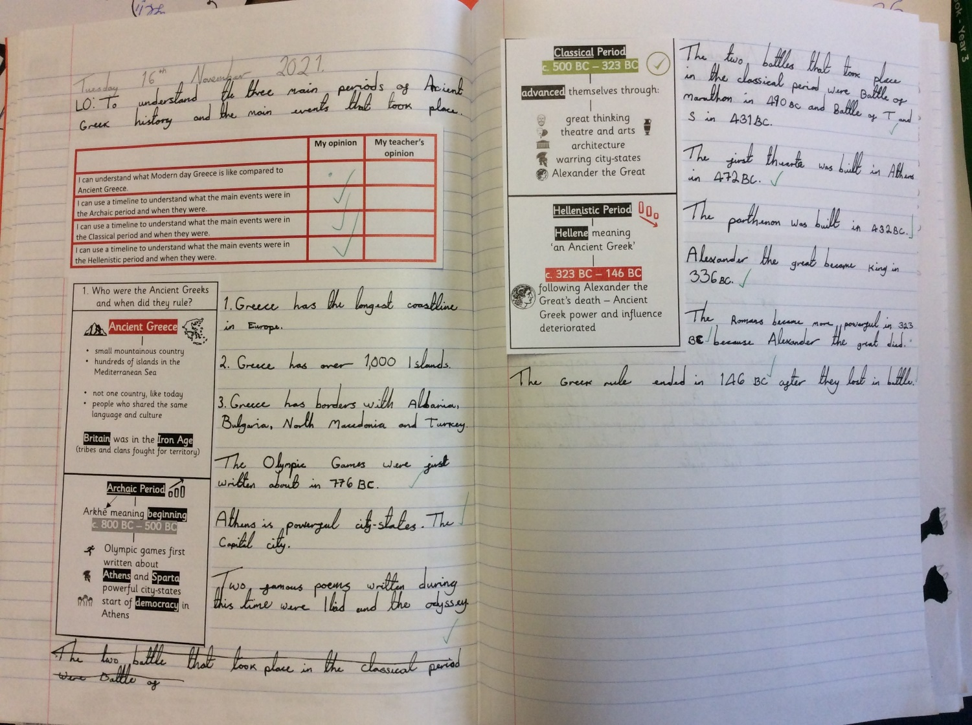
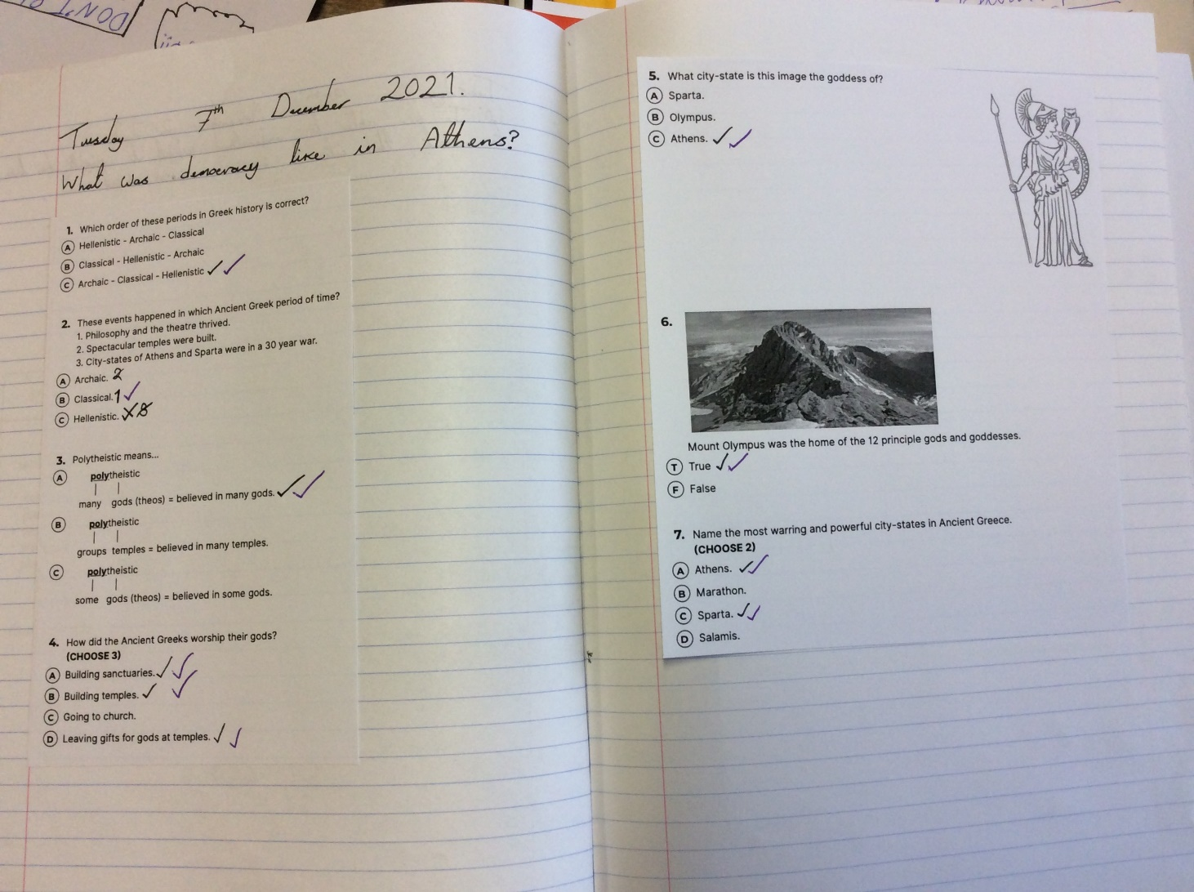
Sequence of learning Year 5 (Expected)
Impact

Slide 20
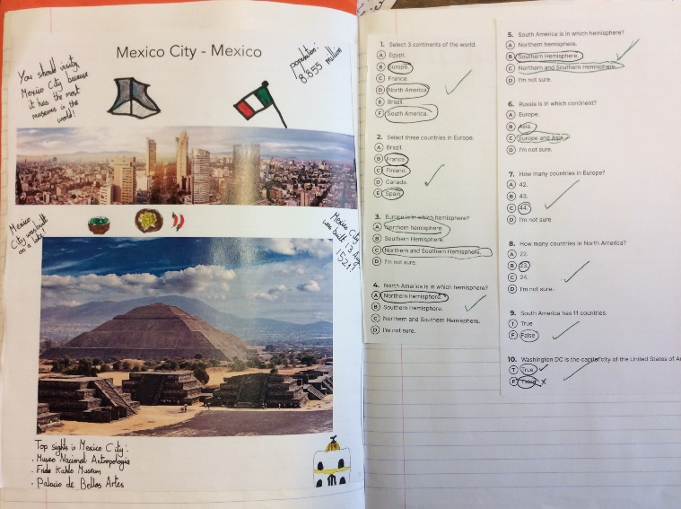
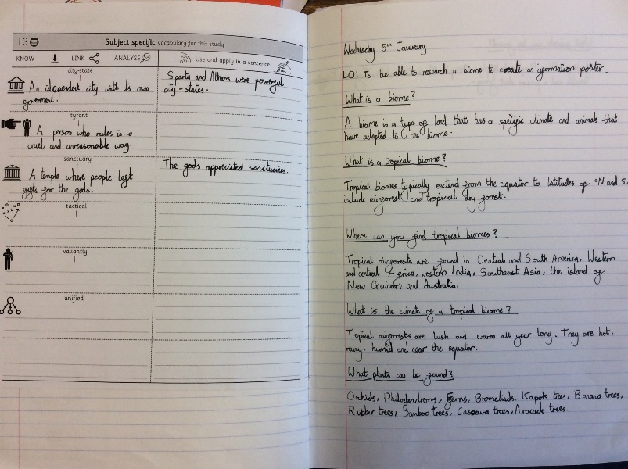
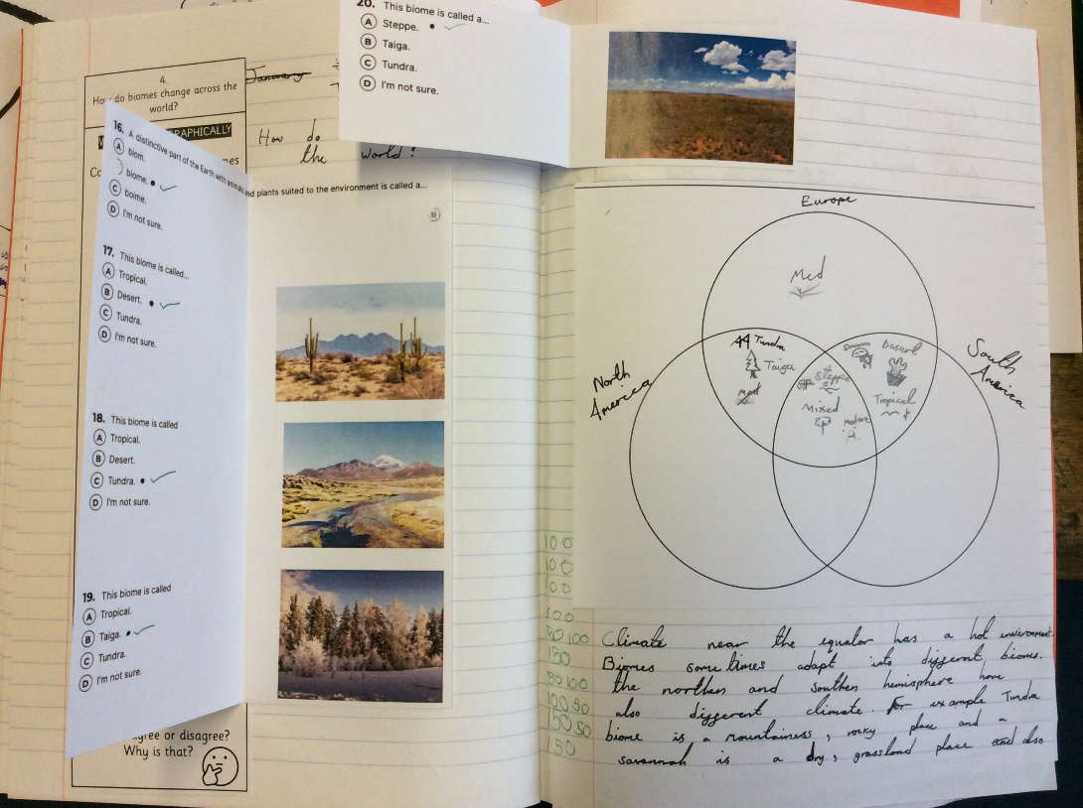
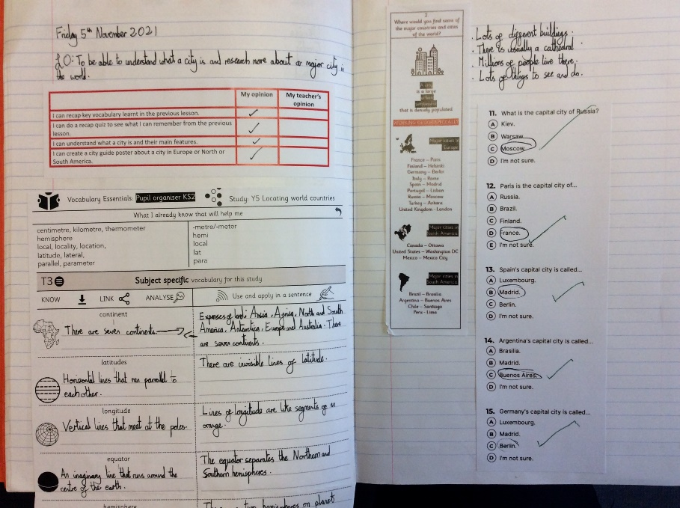
Sequence of learning Year 5 (Greater Depth)
Impact

Slide 21
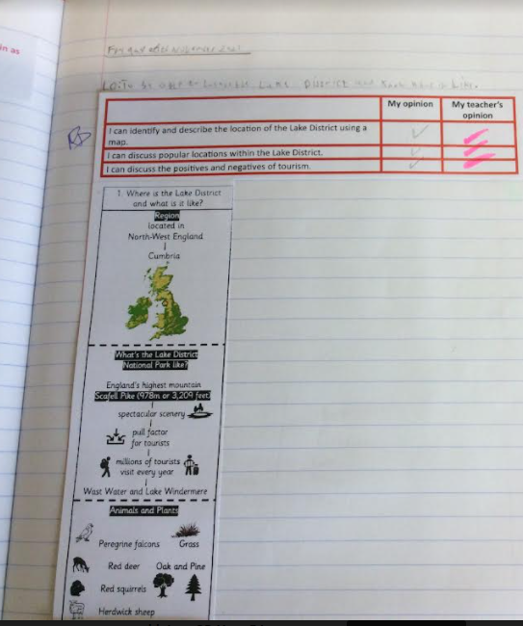
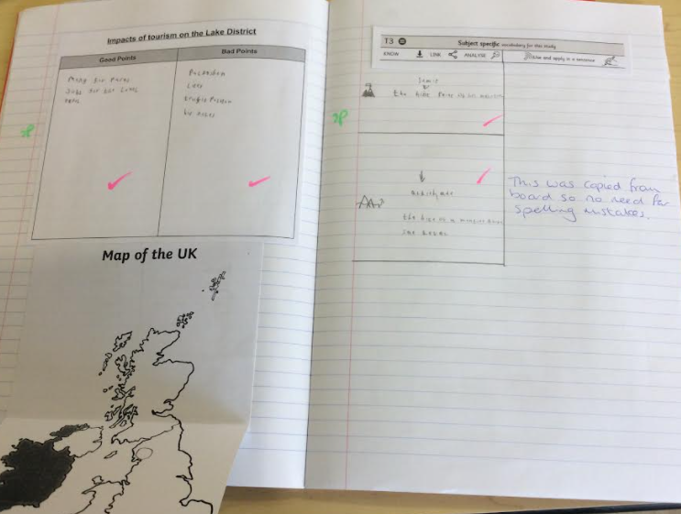
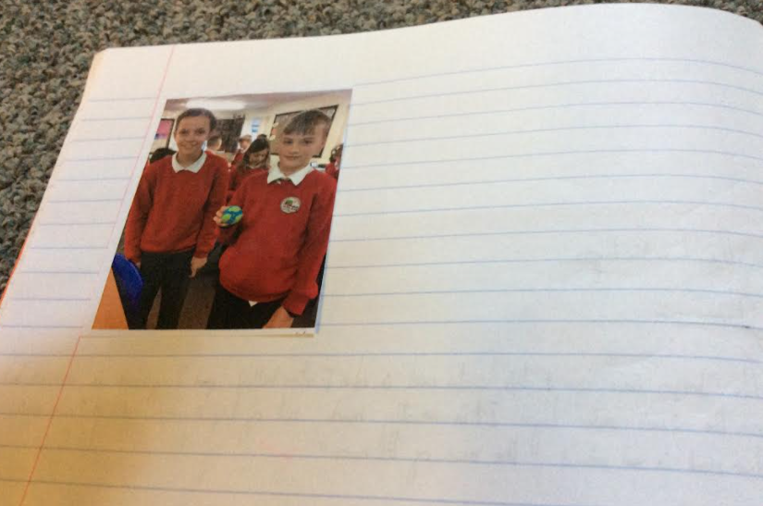
Sequence of learning Year 6 (SEN)
Impact

Slide 22
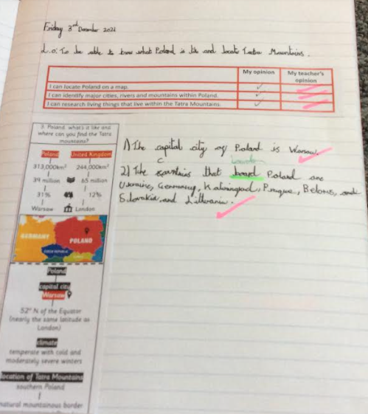
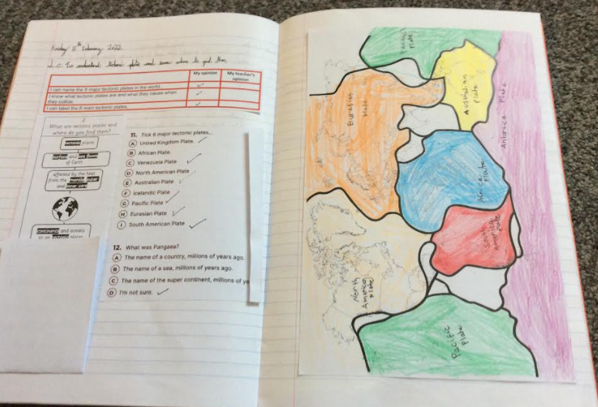
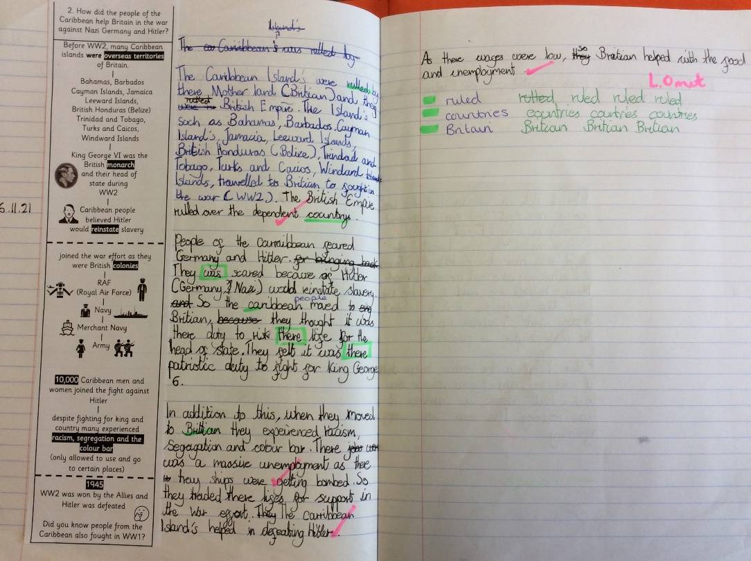
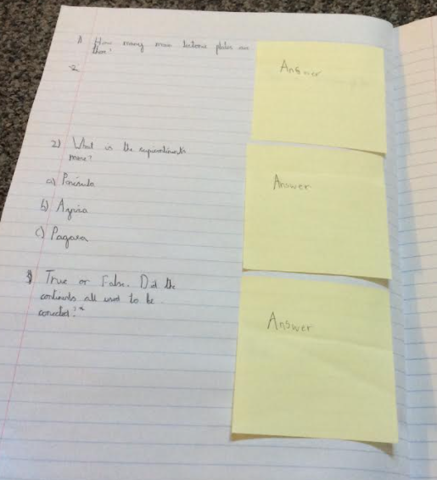
Sequence of learning Year 6 (Expected)
Impact

Slide 23
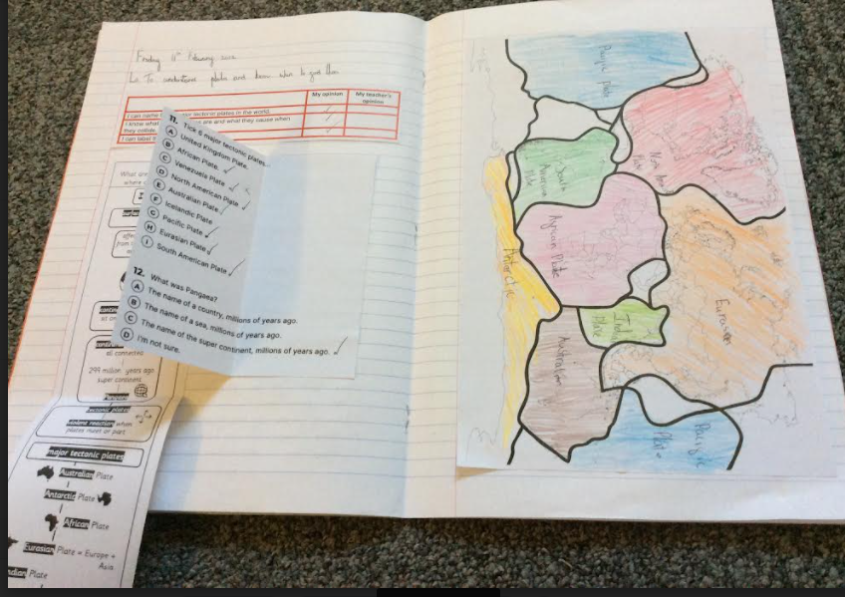
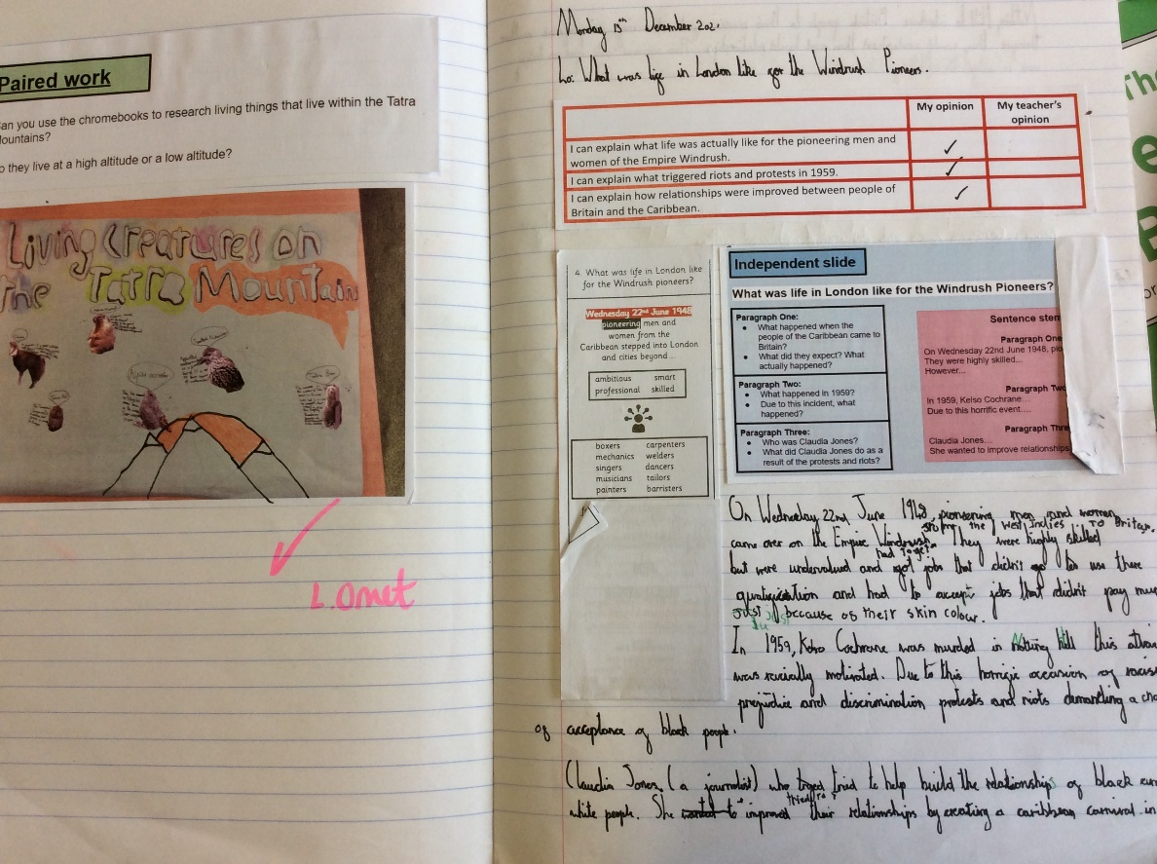

Sequence of learning Year 6 (Greater Depth)
Impact

