Slide 1

Geography
Intent
Intent

Slide 2
Geography
Why is geography important?
At Barnham, we recognise that high-quality geography education should inspire in pupils a curiosity and fascination about the world and its people that will remain with them for the rest of their lives. Teaching should equip pupils with knowledge about diverse places, people, resources and natural and human environments, together with a deep understanding of the Earth’s key physical and human processes. As pupils progress, their growing knowledge about the world should help them to deepen their understanding of the interaction between physical and human processes, and of the formation and use of landscapes and environments. Geographical knowledge, understanding and skills provide the frameworks and approaches that explain how the Earth’s features at different scales are shaped, interconnected and change over time.
Intent

Slide 3
Geography
Aims of the Geography Curriculum
Our curriculum aims to ensure that all pupils:
develop contextual knowledge of the location of globally significant places – both terrestrial and marine – including their defining physical and human characteristics and how these provide a geographical context for understanding the actions of processes
understand the processes that give rise to key physical and human geographical features of the world, how these are interdependent and how they bring about spatial variation and change over time ▪ are competent in the geographical skills needed to:
collect, analyse and communicate with a range of data gathered through experiences of fieldwork that deepen their understanding of geographical processes ▪ interpret a range of sources of geographical information, including maps, diagrams, globes, aerial photographs and Geographical Information Systems (GIS)
communicate geographical information in a variety of ways, including through maps, numerical and quantitative skills and writing at length.
Intent

Slide 4
Geography at Barnham: CUSP Principles
A guiding principle of CUSP Geography is that each study draws upon prior learning. For example, in the EYFS, pupils may learn about People, Culture and Communities or The Natural World through daily activities and exploring their locality and immediate environment. This is revisited and positioned so that new and potentially abstract content in Year 1 can be put into a known location and make it easier to cognitively process. Pupils in EYFS explore globes and world locations through their curiosity corners, making links to where animals live. This substantive knowledge is used to remember and position the locations of continents and oceans, with more sophisticated knowledge. High volume and deliberate practice is essential for pupils to remember and retrieve substantive knowledge and use their disciplinary knowledge to explain and articulate what they know. This means pupils make conscious connections and think hard, using what they know.
CUSP Geography is built around the principles of cumulative knowledge focusing on spaces, places, scale, human and physical processes with an emphasis on how content is connected and relational knowledge acquired. An example of this is the identification of continents, such as Europe, and its relationship to the location of the UK.
CUSP Geography equips pupils to become ‘more expert’ with each study and grow an ever broadening and coherent mental model of the subject. This guards against superficial, disconnected and fragmented geographical knowledge. Specific and associated geographical vocabulary is planned sequentially and cumulatively from Y1 to Y6. High frequency, multiple meaning words (tier 2) are taught and help make sense of subject specific words (tier 3). Each learning module in geography has a vocabulary module with teacher guidance, tasks and resources.
CUSP Geography is planned so that the retention of knowledge is much more than just ‘in the moment knowledge’. The cumulative nature of the curriculum is made memorable by the implementation of Bjork’s desirable difficulties, including retrieval and spaced retrieval practice, word building and deliberate practice tasks. This powerful interrelationship between structure and research-led practice is designed to increase substantive knowledge and accelerate learning within and between study modules. That means the foundational knowledge of the curriculum is positioned to ease the load on the working memory: new content is connected to prior learning. The effect of this cumulative model supports opportunities for children to associate and connect with places, spaces, scale, people, culture and processes
Intent

Slide 5
Spaced Retrieval Practice Approach
Our geography curriculum is delivered through a series of modules which are deliberately spaced throughout the academic year with opportunities to introduce and revisit key concepts. This approach enables staff to deepen pupil understanding and embed learning.
Our curriculum maps clearly show how our CUSP curriculum delivers (introduces and revisits) the National Curriculum expectations for geography within and across year groups. All modules are identified on year group specific yearly overviews using green boxes.
Intent

Slide 6
Early Years
In Early Years, Geography is taught through Knowledge and Understanding of the World. The children learn about the world around them in their play and adult led activities. Our curriculum is designed to enable children to make sense of their physical world and community. Children are encouraged to be geographers by:
Finding out about and showing curiosity and interest in features of objects, events and living things
Describing and talking about what they see, including noticing similarities and differences
Showing curiosity and asking questions about why things happen and how things work
Showing understanding of cause-effect relations
Noticing and commenting on patterns
Showing an awareness of change
Explaining their own knowledge and understanding, and asking appropriate questions of others
Investigating objects and materials by using all of their senses as appropriate
Intent

Slide 7
Key Stage 1KEY STAGE 1
The sequence in KS1 focuses young children to develop a sense of place, scale and an understanding of human and physical geographical features. Later in KS1, children learn about the purpose and use of sketch maps as well as the key features they need to include. CUSP map skills and fieldwork are essential to support children in developing an understanding of how to explain and describe a place, the people who live there, its space and scale.
Initially, children study the Orientation of the world through acquiring and making locational sense of the 7 continents and 5 oceans of the world. They extend their knowledge and study the Countries and capital cities of the United Kingdom, along with the oceans and seas that surround us. Further studies support retrieval; children revisit these locations with more complex and sophisticated tasks later in the school year. Enhanced provision in the classroom and use of maps, globes and atlases is essential to form coherent schemata around the big ideas that explain how we know where a place is, and how to locate it. For young children, routes and maps can be made concrete in day-to-day experiences in the safety of their school grounds and classrooms.
Throughout KS1, pupils enhance their locational knowledge by studying and identifying Human and physical features of places. To deepen this understanding and transfer concepts, pupils study Contrasting locations throughout the world. The location of these areas in the world are deliberately chosen to offer culturally diverse and contrasting places. Pupils study the human and physical features of a non-European location in Africa, such as Nairobi. This is also complemented by a study of an Indigenous tribe in the rainforests of Brazil and Venezuela. These two studies also offer rich opportunities to know, compare and contrast different cultures in two continents using the consistent thread of human and physical features.
Fieldwork and map skills are further developed with a study of the local area, using cardinal points of a compass. Pupils retrieve and apply knowledge about human and physical features in their local context. OS maps are introduced to pupils in KS1 using Digimap for Schools. Simple keys and features are identified and mapped locally to help begin to understand place, distance and scale. CUSP Geography gives pupils the knowledge they need to develop an increasingly sophisticated understanding of place. Pupils study a variety of places – this helps them to connect different geographical concepts and gives them perspectives and opportunities to compare and contrast locations
Intent

Slide 8
LOWER KEY STAGE 2
As pupils begin KS2, Fieldwork and map skills are revisited with the intercardinal points of a compass points being introduced to elaborate on the knowledge pupils already have around cardinal points. This substantive and disciplinary knowledge is utilised to support a study of the UK, focusing on regions, counties, landmarks and topography. This study demands analysis and pattern seeking to identify the Features of the UK. Further retrieval studies are designed to support conceptual fluency around physical and human features. Cause and effect are also developed through geographical reasoning. An example of this is the interrelationship between physical terrain of the northern regions of the UK and the lower lands of East Anglia, that are covered in glacial deposits.
Pupils elaborate and expand their understanding of human and physical features and apply it to the study of Rivers.
To enable accurate location of places around the globe, pupils study absolute positioning or reference systems through Latitude and longitude. Substantive knowledge is acquired and used to apply their new understanding to mapping and locational skills. An in-depth understanding of latitude and longitude is used by pupils throughout KS2.
Complementing studies on location and position is the focus on the Water cycle. It offers explanation and reason about physical processes as well as why certain biomes have specific features in specific global locations. Pupils study geographical patterns across the world using latitude of locations to explain why places are like they are. Further river studies revisit substantive knowledge and these are applied to the River Nile and the Amazon River as a precursor for future learning in other subjects. Further fieldwork and map skills are introduced to enrich pupils’ disciplinary knowledge of locations and places. Cultural awareness and diversity are taught specifically within learning modules. Examples include European studies, as well as studies of countries and people in Africa, and North and South America.
Intent

Slide 9
Upper Key Stage 2
The study of Biomes and Environmental regions builds upon world locations, latitude and longitude studies. World countries and major cities are located, identified and remembered through deliberate and retrieval practice, such as low stakes quizzing and Two things.
In upper KS2, the study of 4 and 6 figure grid references supports prior learning of reference systems and brings an increased accuracy to mapping and fieldwork skills. Again, this knowledge is designed to be interrelated and connected to the retrieval study of biomes and environmental regions. More advanced mapping skills using OS maps are studied and applied, with pupils using the accumulation of knowledge skilfully to analyse distribution and relationships. Route finding and decoding information through maps offers challenge through increasingly complex orienteering and mapping tasks.
Pupils take part in geographical analysis using patterns and comparison of both human and physical processes as well as the features present in chosen locations. This abstract concept is made concrete through studying and comparing the Lake District, Tatra mountains of Poland and the Blue mountains of Jamaica. Physical processes such as orogeny and glaciation are acquired to explain significant change over long periods of time. The concept of physical process is revisited through a study of Earthquakes, mountains and volcanoes. This depth study allows pupils the opportunity to have a more sophisticated knowledge of physical processes and make connections about how the environment has been shaped, as a result.
Settlement, trade and economic activities are the focus of a study that draws upon the Windrush generation module in CUSP History. This develops an increasing knowledge about migration and the factors that push people away or draw people towards settlements. Within these studies, pupils make relational connections between settlements and physical or human features. Settlements such as ports or major world cities are studied to explain the reasons why certain places are populated and why. Disciplinary knowledge supports pupils to reason and explain the effect of change on a place, drawing on prior substantive knowledge they can retrieve and reuse.
Intent

Slide 10

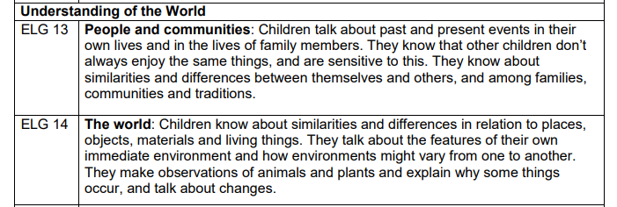
Content and sequence - EYFS to Key Stage 1
Intent

Slide 11
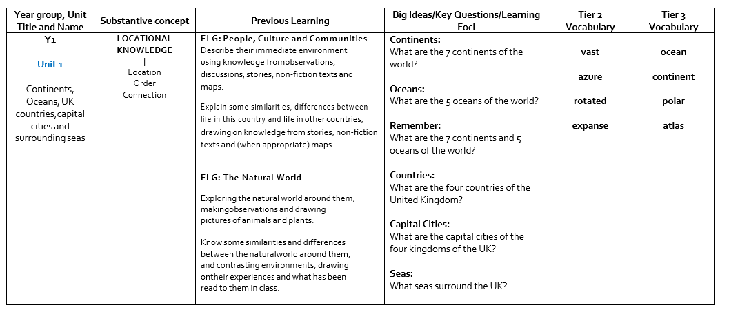
Content and Sequence: Year 1
CUSP geography Progression Tables
Intent

Slide 12
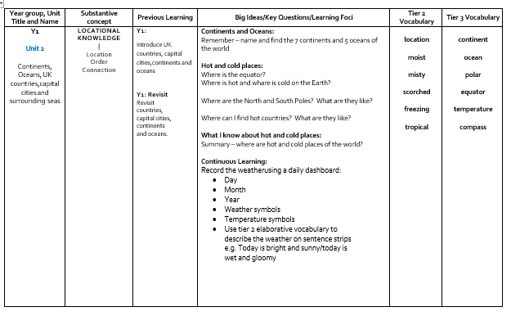
Content and Sequence: Year 1 cont.
CUSP geography Progression Tables
Intent

Slide 13
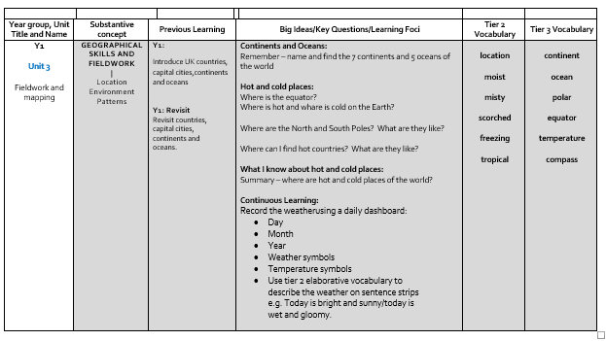
Content and Sequence: Year 1 cont.
Intent

Slide 14
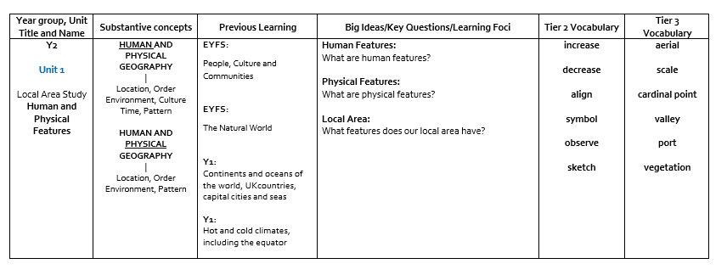
Content and Sequence: Year 2
Intent

Slide 15
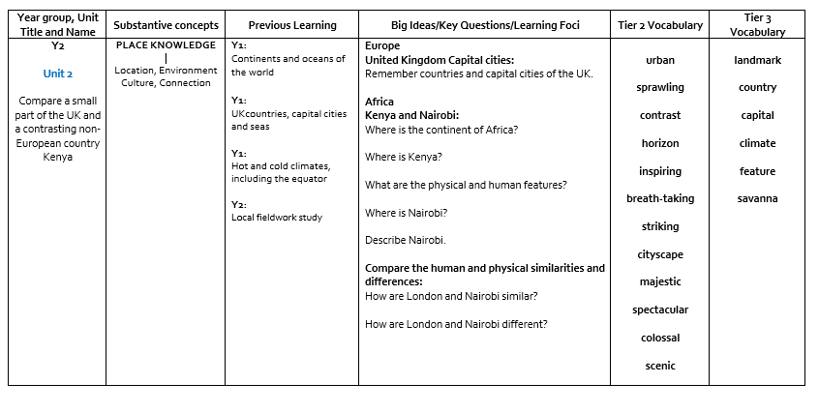
Content and Sequence: Year 2 cont.
Intent

Slide 16
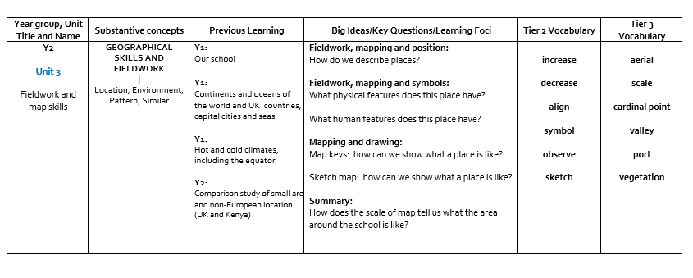
Content and Sequence: Year 2 cont.
Intent

Slide 17
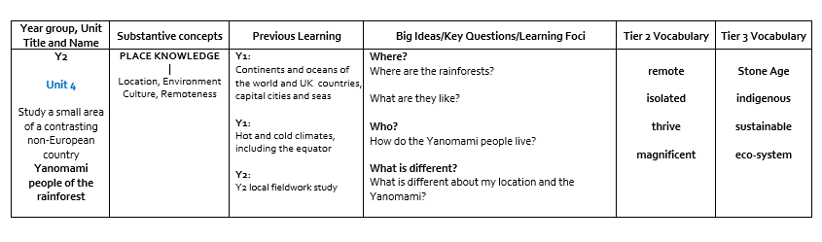
Content and Sequence: Year 2 cont.
Intent

Slide 18
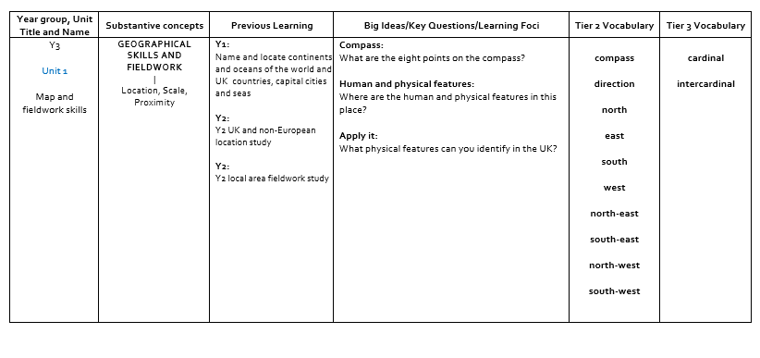
Content and Sequence: Year 3
Intent

Slide 19
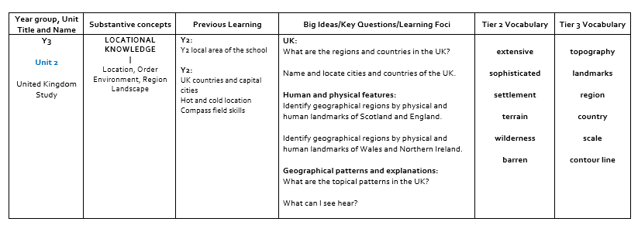
Content and Sequence: Year 3 cont.
Intent

Slide 20
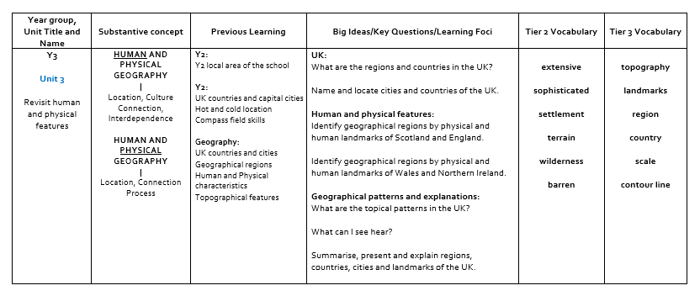
Content and Sequence: Year 3 cont.
Intent

Slide 21
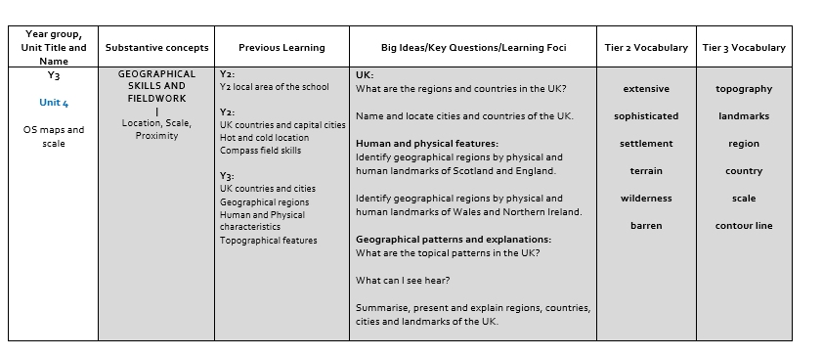
Content and Sequence: Year 3 cont.
Intent

Slide 22
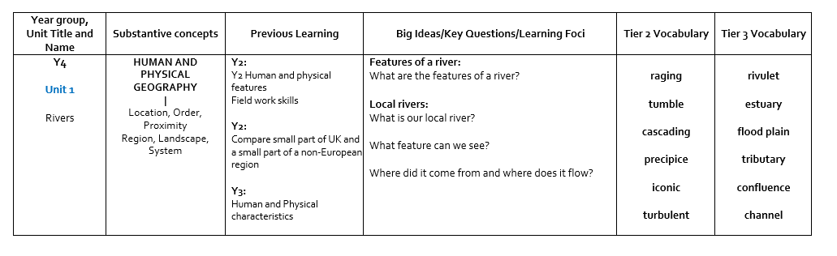
Content and Sequence: Year 4
Intent

Slide 23
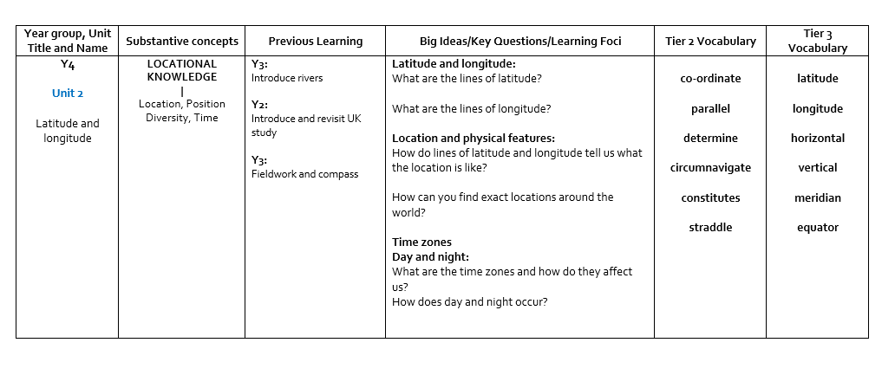
Content and Sequence: Year 4
Intent

Slide 24
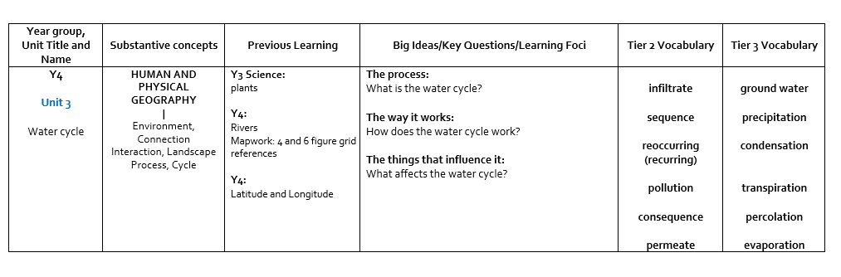
Content and Sequence: Year 4
Intent

Slide 25
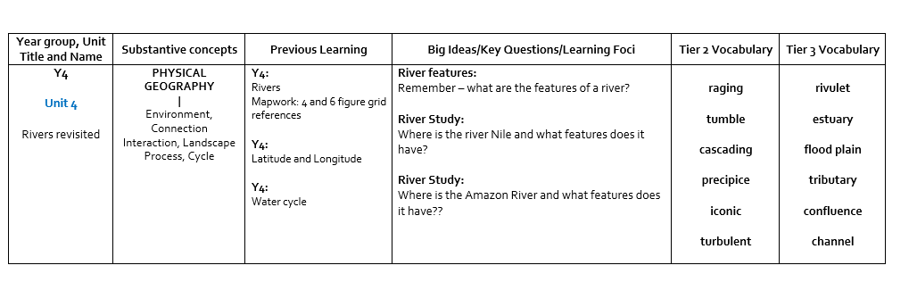
Content and Sequence: Year 4
Intent

Slide 26
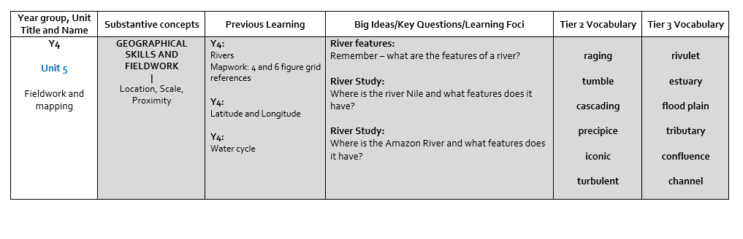
Content and Sequence: Year 4 cont.
Intent

Slide 27
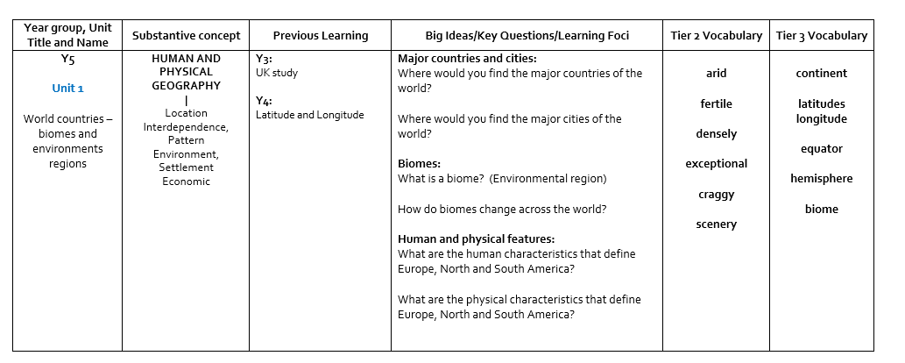
Content and Sequence: Year 5
Intent

Slide 28
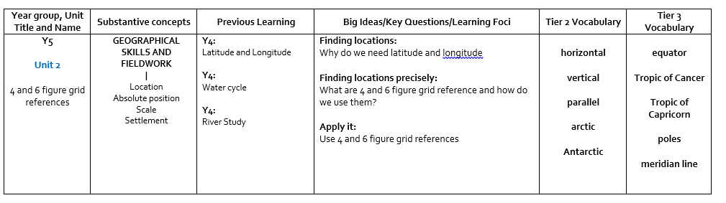
Content and Sequence: Year 5 cont.
Intent

Slide 29
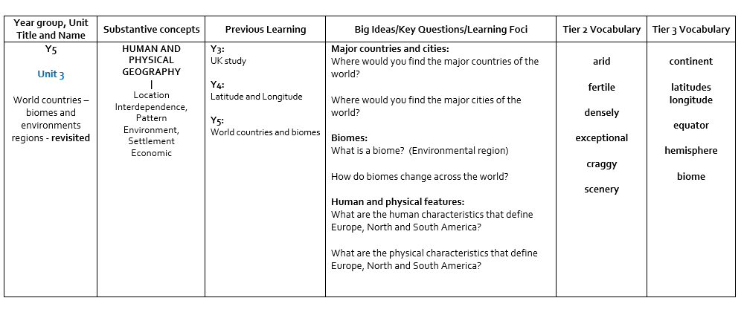
Content and Sequence: Year 5 cont.
Intent

Slide 30
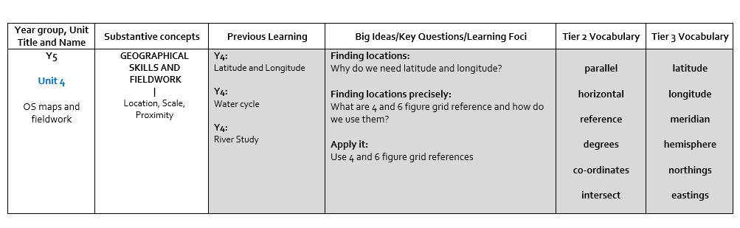
Content and Sequence: Year 5 cont.
Intent

Slide 31
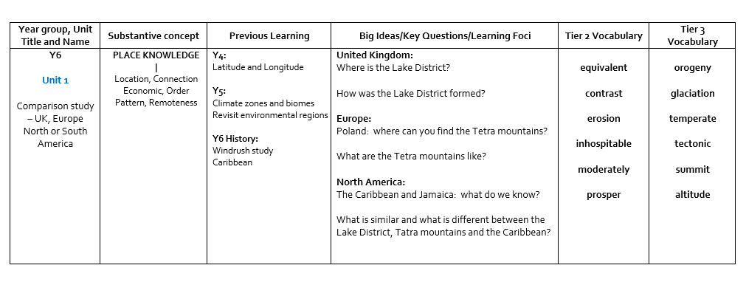
Content and Sequence: Year 6
Intent

Slide 32
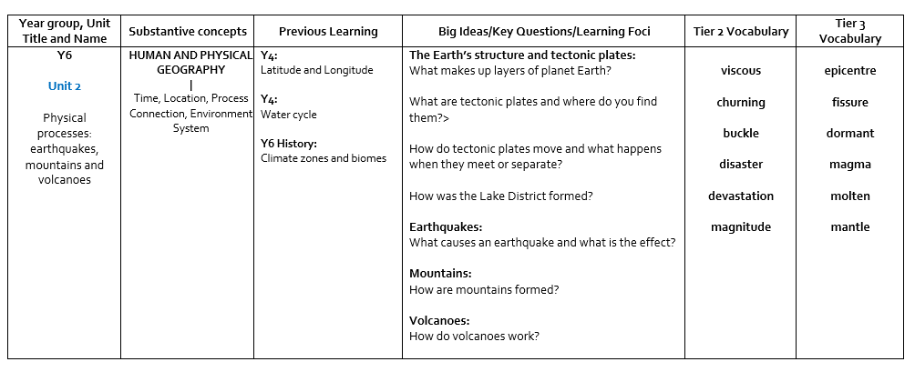
Content and Sequence: Year 6 cont.
Intent

Slide 33
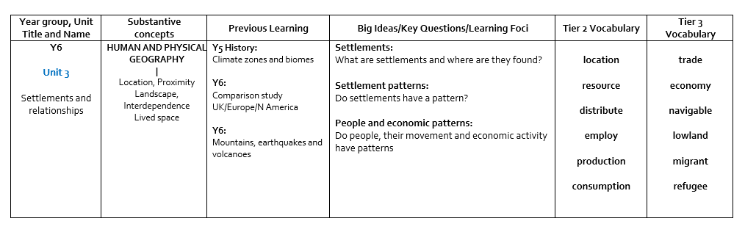
Content and Sequence: Year 6
Intent

